Slide 1
Staff CPD - History – May 2023 (KLG) Focus: substantive concepts and disciplinary skills
What are they ?
What is the difference ?
Being confident about where they are in our history curriculum
Sharing this with our children
Resources to aid this

Slide 2
Substantive knowledge / concepts
Substantive concepts are those concerned with the subject matter of history –the WHAT- the substance about which students are learning.
It’s the content of your curriculum.
Over time, children will deepen their understanding of substantive concepts as they learn about new periods/ events in history
Egs of substantive concepts in our history curriculum include: empire, civilization, monarchy, conquest, settlement, power, society.
Children will begin to make links between past and current topics as their understanding of these substantive concepts develops.
We need to be using this key vocabulary repeatedly so the children have a clear understanding of its meaning and can define it.

Slide 3
Substantive concepts across KS1 and KS2
History | Autumn | Spring | Summer
Year 1/2 Year A | How did people travel through History? SOCIETY | What was it like when the Queen came to the throne in 1953? SOCIETY MONARCHY | What does it take to be a great explorer ? ( focus on Matthew Henson and Felicity Aston) VOYAGE CONQUEST
Year 1/2 Year B | What has changed since my grandparents were young? (60’s/70’s) SOCIETY | How have people helped to make the world a better place? (Rosa parks, Nelson Mandela, Greta Thunberg, etc) FREEDOM RIGHTS SOCIETY | How did the Victorian period help shape the Warrington we know today ? ( local history) SOCIETY MONARCHY EMPIRE
Year 3/4 Year A | Who first lived in Britain ? ( Stone Age to Iron Age) SETTLEMENT CIVILIZATION | Would I like to have been an Ancient Egyptian ? ( Ancient civilization) RELIGION SOCIETY CIVILIZATION | Why did the Normans build so many castles ? ( British History beyond 1066) CONQUEST POWER MONARCHY CONFLICT
Year 3/4 Year B | Why are we still talking about Ancient Greece ? ( Ancient civilizations) CIVILIZATION DEMOCRACY EMPIRE POWER | What did the Romans ever do for us ? ( Britain- significant themes in local history- local viewpoint: Trip to Chester and links to geography topic of mapping in sp 2) CIVILISATION EMPIRE SOCIETY CONQUEST TRIBES POWER CONFLICT | Did the punishment fit the crime ?(1066 to present. British values- prevent lesson) SOCIETY POWER RULES AND LAWS
Year 5/6 Year A | Who were the Mayans and what have we learnt form them ? ( Early civilization and non- European society) CIVILIZATION | Were the Anglo- Saxons really smashing ? ( settlements and Kingdoms) SOCIETY RELIGION RULES AND LAWS MONARCHY | Were the Vikings always victorious and vicious ? SETTLEMENT SOCIETY CONFLICT
Year 5/6 Year B | How and why did WWII start? (British history beyond 1066-since 1930) CONFLICT NATIONALITY POWER EMPIRE RIGHTS | Why should the world be ashamed of slavery? ( history beyond 1066) SLAVE TRADE MIGRATION | Why was the Islamic civilization known as the ‘Golden Age’ ? ( Non- European society) RELIGION CIVILIZATION
How is the body of knowledge in term 1 of Class 2 preparing the children for the body of knowledge they will encounter in term 3 in class 3?
How is the body of knowledge in term 2 of Class 3 preparing the children for the body of knowledge they will encounter in term 1 in class 4 ?
To be used as a quick class discussion focus at start / end of lesson during course of the topic. Making links between prior learning, seeing events and periods in history as part of a bigger picture rather than just isolated events standing alone.
Allows children to develop their disciplinary skills too – eg cause and consequence, similarity and difference, sources and evidence etc

Slide 4
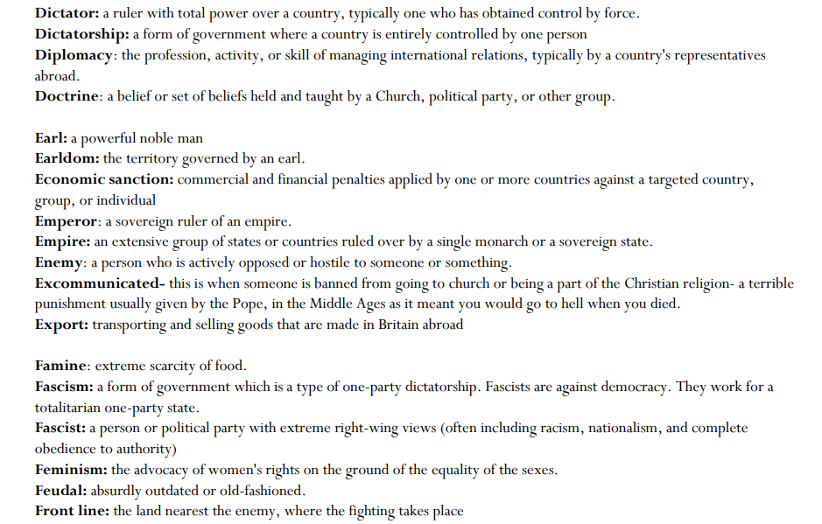
Substantive concepts - definitions

Slide 5
Disciplinary knowledge/skills
These are skills which are specific to the academic study of history.
They are the HOW- how historians find out about the past
HISSCC
H = Historical significance
I = Interpretation ( of artefacts, sources, evidence )
S= Similarity and difference
S = Sources and evidence
C = Continuity and change
C = Cause and consequence

Slide 6
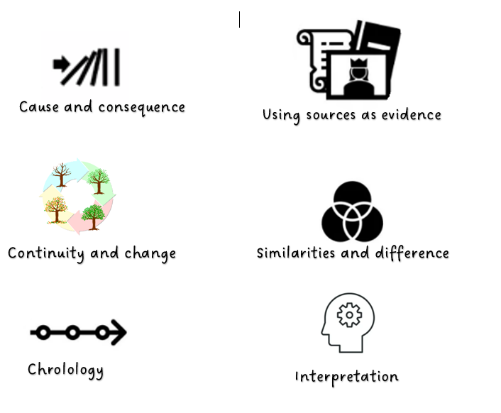
Share these with our children and talk about what they mean.
These skills are used by historians to learn about events from the past and understand them.
Put on history wall .
At start of each lesson, make clear which we are focusing on/using today.
Add it to LO in books ?

Slide 8
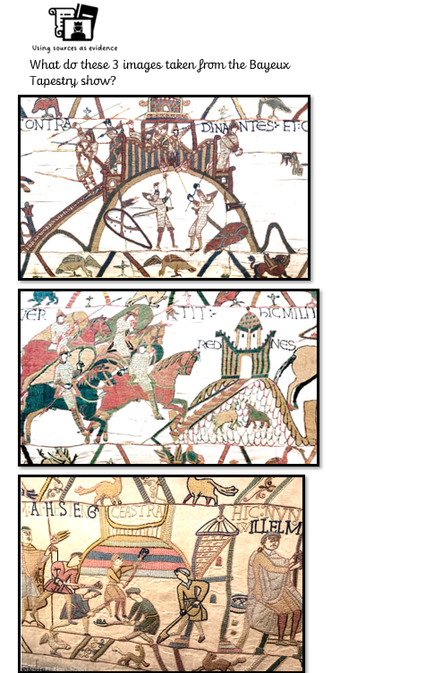
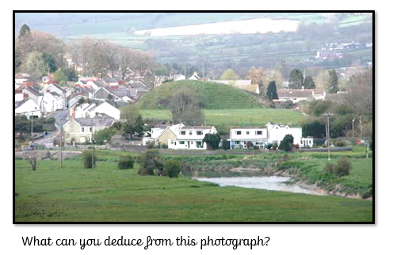

Slide 9
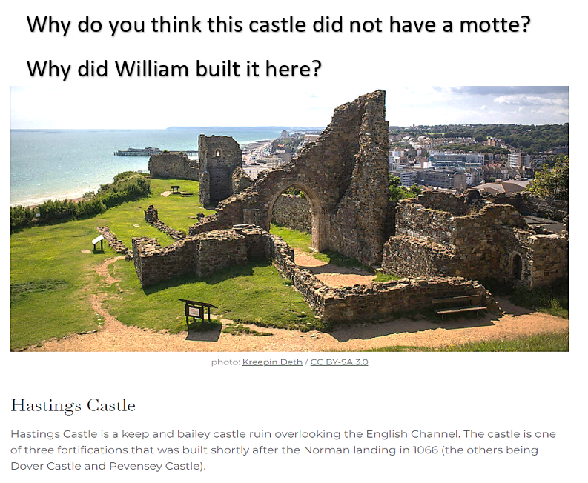
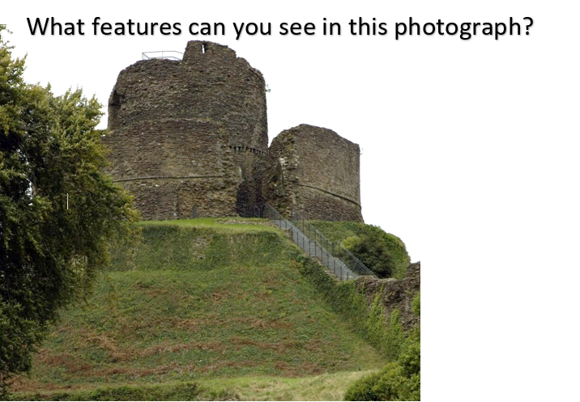

Slide 10
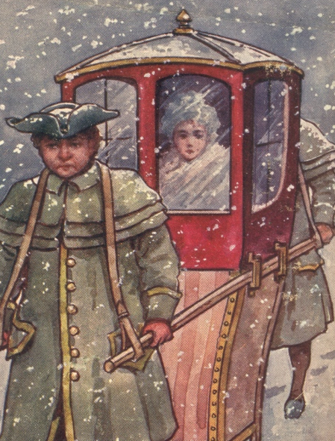
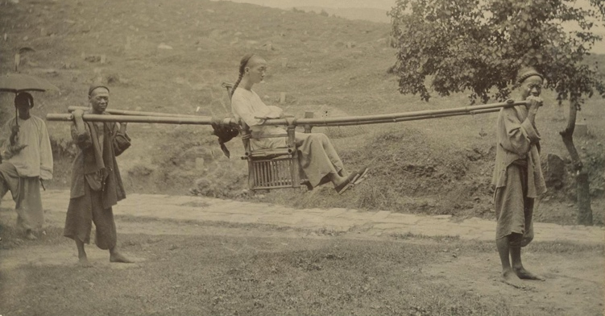
Old and New Transport How do these modes of transport work?
This is called a sedan chair. People carry the person sitting in the chair. They were first used in China over 4000 years ago!
Can you spot the differences between how they are carrying the chairs in the pictures?

Slide 11
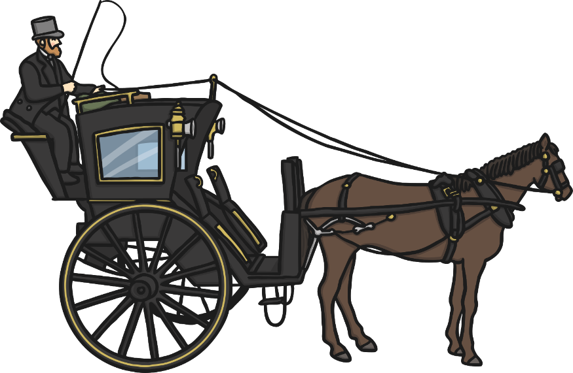
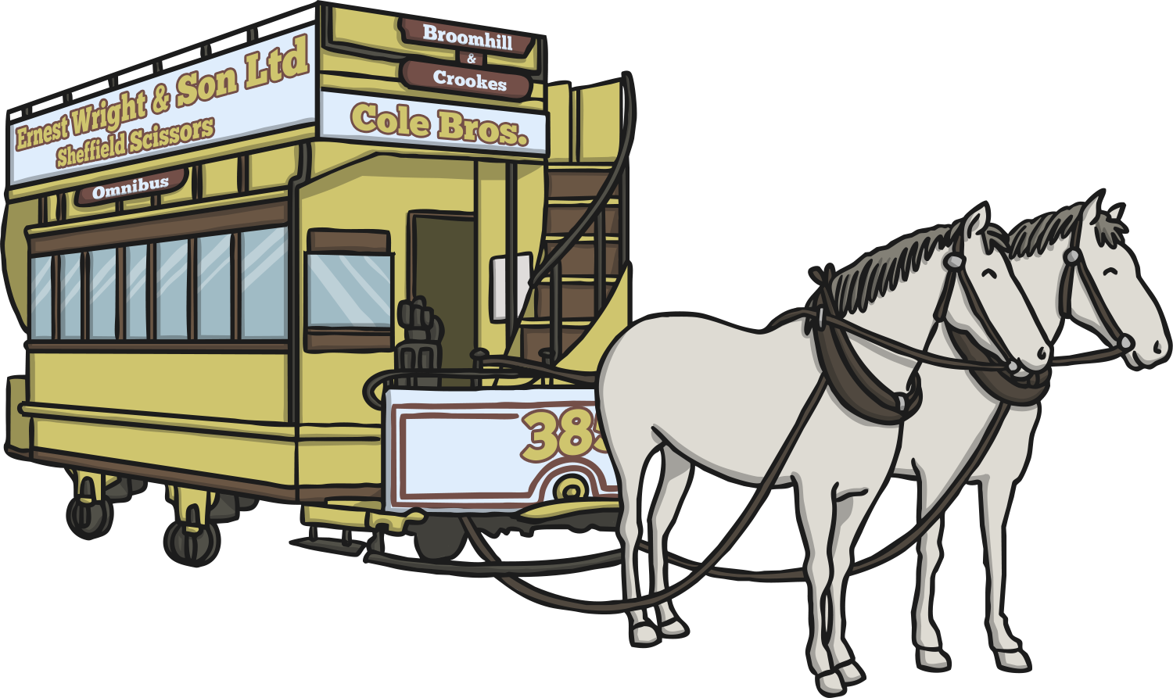
Old and New Transport How do these modes of transport work?
Horse and carriage was the most common way to travel until the invention of the motor car.
Do we still use them now?
What is the same ?
What is different ?
This is an early type of bus that was called an omnibus. It was pulled by horses. People had to pay to get on.

Slide 12
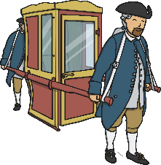
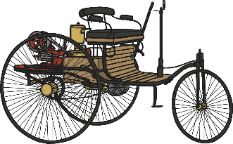
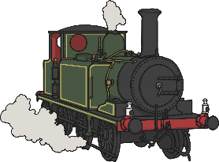
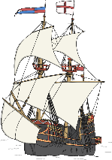
Old and New Transport How has travel and transport changed?
Can you order the pictures of different types of transport onto your timeline?
OLDEST
NEWEST

Slide 13
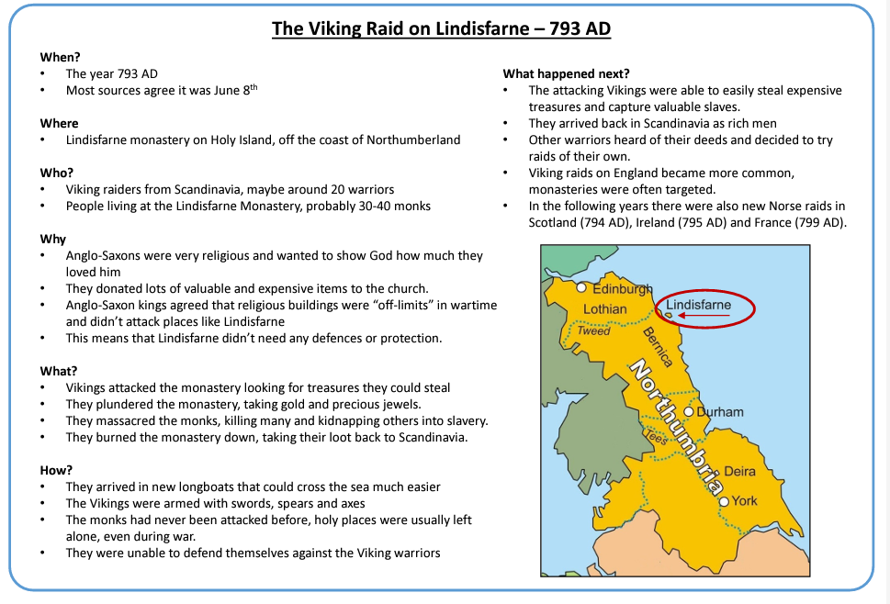

Slide 16
Pick one of the history topics from your class:
Can you identify at least 1 substantive concept within this topic ?
Can you identify where, in your scheme of work for this topic, any of the disciplinary skills can be used ?
Can you see where prior/ future learning has links with this topic ?
History | Autumn | Spring | Summer
Year 1/2 Year A | How did people travel through History? | What was it like when the Queen came to the throne in 1953? | What does it take to be a great explorer ? ( focus on Matthew Henson and Felicity Aston)
Year 1/2 Year B | What has changed since my grandparents were young? (60’s/70’s) | How have people helped to make the world a better place? (Rosa parks, Nelson Mandela, Greta Thunberg, etc) | How did the Victorian period help shape the Warrington we know today ? ( local history)
Year 3/4 Year A | Who first lived in Britain ? ( Stone Age to Iron Age) | Would I like to have been an Ancient Egyptian ? ( Ancient civilization) | Why did the Normans build so many castles ? ( British History beyond 1066)
Year 3/4 Year B | Why are we still talking about Ancient Greece ? ( Ancient civilizations) | What did the Romans ever do for us ? ( Britain- significant themes in local history- local viewpoint: Trip to Chester and links to geography topic of mapping in sp 2) | Did the punishment fit the crime ?(1066 to present. British values- prevent lesson)
Year 5/6 Year A | Who were the Mayans and what have we learnt form them ? ( Early civilization and non- European society) | Were the Anglo- Saxons really smashing ? ( settlements and Kingdoms) | Were the Vikings always victorious and vicious ?
Year 5/6 Year B | How and why did WWII start? (British history beyond 1066-since 1930) | Why should the world be ashamed of slavery? ( history beyond 1066) | Why was the Islamic civilization known as the ‘Golden Age’ ? ( Non- European society)

