Slide 1
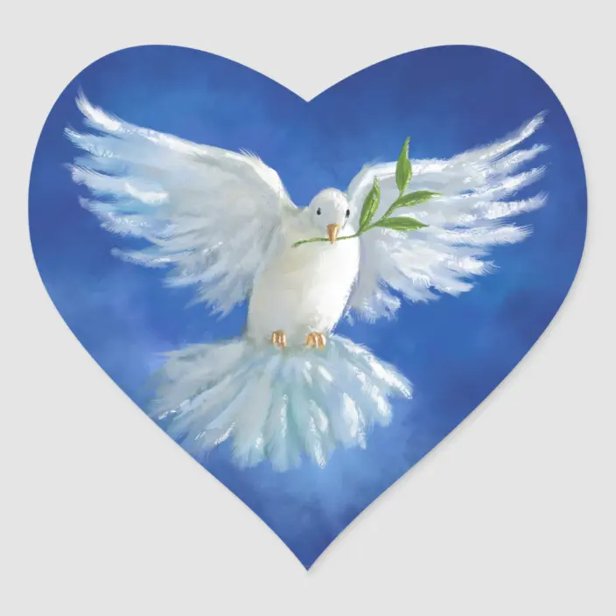
Collective worship
The value of Peace
“A heart at peace gives life to the body” Proverbs 14:30
Worship 4-being a peacemaker

Slide 2



We think of God’s son, Jesus who loves us.
We think of God the Father who teaches us through his word.
We think of God, the Holy spirit, who guides us.

Slide 3
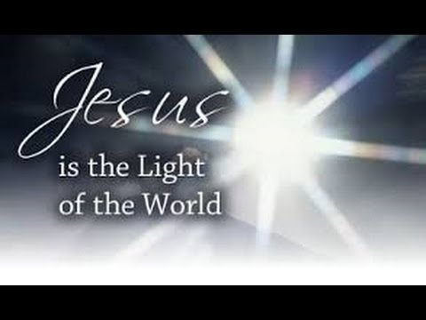
What did Jesus say?
Jesus said “Blessed are the peacemakers, for they shall be called the children of God” (Matthew :5:9)
Why do you think he said this?
When we help and are peace makers we are following God’s wishes.

Slide 4
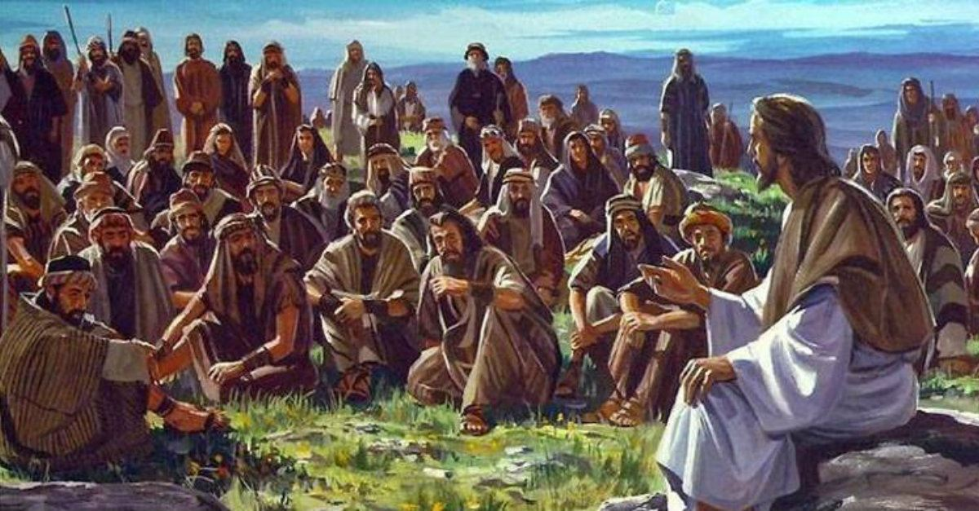
The Sermon on the Mount
The words spoken were from when Jesus was talking to his followers. They remind Christians about the importance of being peacemakers.
Today we recognise Peacemakers through awarding a prize…The Nobel Peace prize.

Slide 5
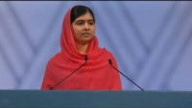
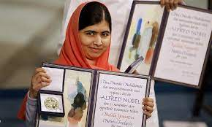
Malala Yousafzai
She gained global attention when she survived an assassination attempt at age 15. In 2014 Yousafzai and Kailash Satyarthi were jointly awarded the Nobel Prize for Peace in recognition of their efforts on behalf of children's rights.

Slide 6
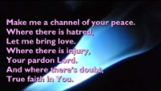
Reflection
What do you feel when you hear this: make me a channel of your peace?

Slide 7

Dear God,
Help us to find ways to be peacemakers to our friends and our families. Help us to be a channel of YOUR peace.
Guide us in your light forever and always.
Amen.

Slide 8
Collective worship
The value of Peace
“A heart at peace gives life to the body” Proverbs 14:30
Class Worship 4

Slide 9
We think of God’s son, Jesus who loves us.
We think of God the Father who teaches us through his word.
We think of God, the Holy spirit, who guides us.

Slide 10
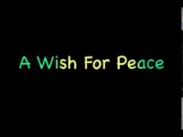
Reflection
What do you feel when you hear this :
Use postits to record what YOU think.

Slide 11


Slide 12
Collective worship
The value of Peace
“A heart at peace gives life to the body” Proverbs 14:30
Praise Worship 4

Slide 13
Reflection
What do you feel when you hear this: make me a channel of your peace?

Slide 14
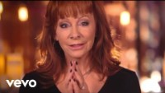
Reflection:
Can you pray for peace?
.

Slide 15
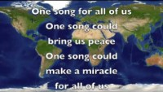
Especially for key stage 1

Slide 16

Children’s choice

Slide 18
Collective worship
The value of Peace
“A heart at peace gives life to the body” Proverbs 14:30
Class Worship 3
Thursday

Slide 19
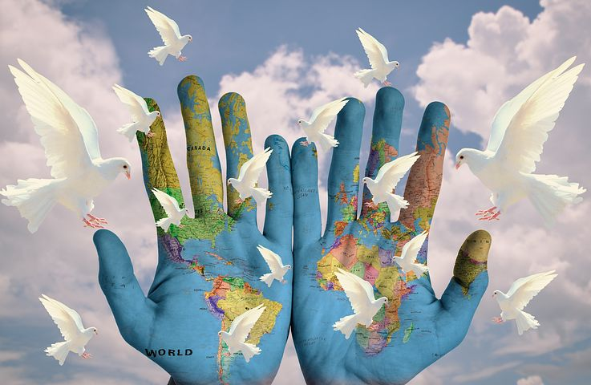
Reflection
How can YOU be the voice of Peace?
Value Passport:
Look at the image how do you think it is saying PEACE.
Write on a postit to let us know your thoughts.

Slide 21
Collective worship
The value of Peace
“A heart at peace gives life to the body” Proverbs 14:30
Celebration Worship 3

Slide 22
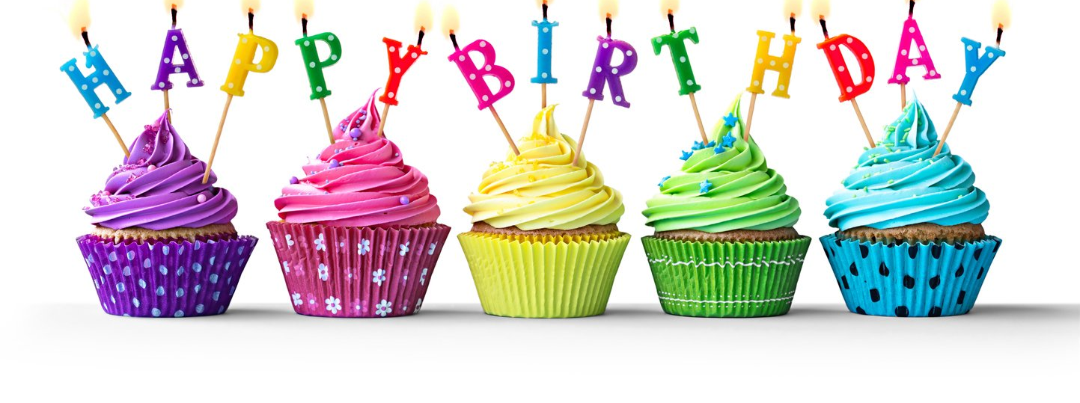
Birthdays….Happy Birthday to YOU.

Slide 23

Personal Development Awards
For the Lord gives wisdom: out of his mouth comes knowledge and understanding. Proverbs 2:6

Slide 24

Head Teacher Awards
Love never fails – 1 Corinthians 13.:8
Achievement for all

Slide 25

Ethos group
Prayer to share

Slide 26

Reminders:

Slide 27


Reverend Jan
Blessing to all

