Slide 1
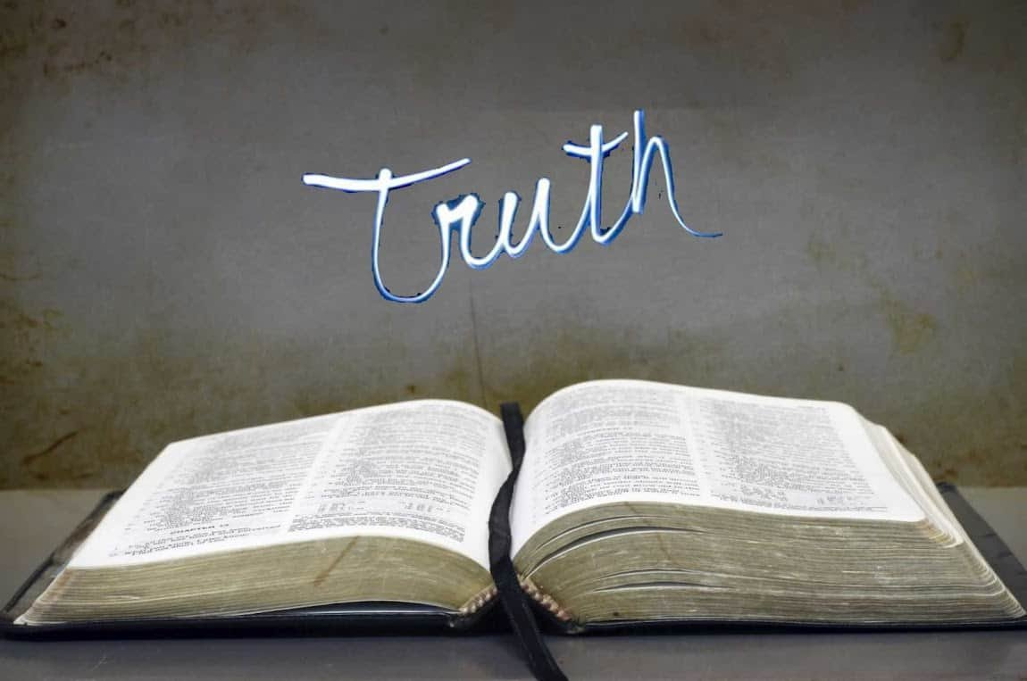
Collective worship
The value of Truthfulness
“The truth will set you free” John 8:32
Worship 4

Slide 2
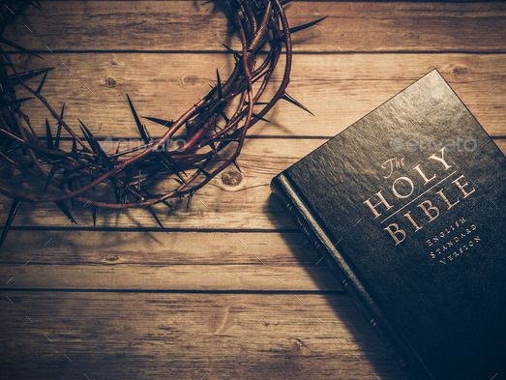
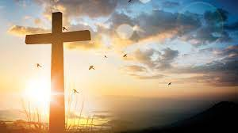
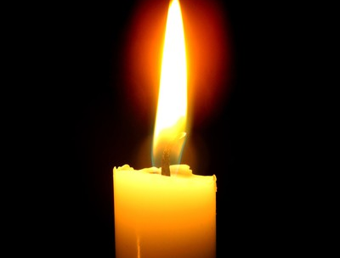
We think of God’s son, Jesus who loves us.
We think of God the Father who teaches us through his word.
We think of God, the Holy spirit, who guides us.

Slide 3
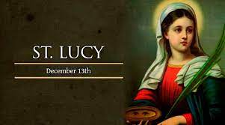
Standing up for the truth
In this act of worship we will learn how a young Christian girl called Lucy, who lived nearly 2000 years ago. She was prepared to risk everything to be true to her beliefs.
Lucy lived in the Roman empire 300 years after the birth of Jesus. The Emperor of the time was Diocletian, he was powerful and ruthless and degreed that everyone should worship the Roman Gods or be put to death!
The Christian community were very afraid as they believed in only one God,

Slide 4
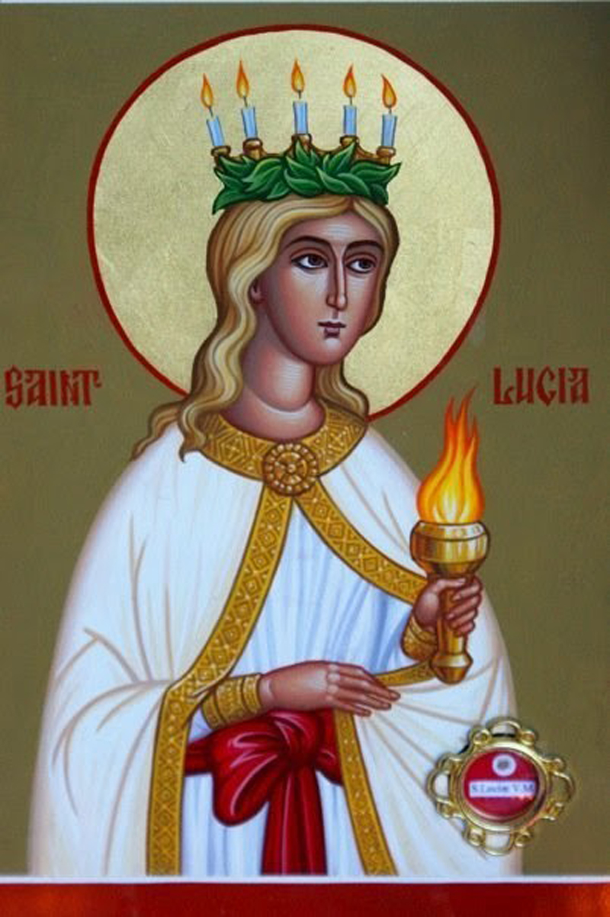
In Italy, there were secret underground tunnels known only to Christians called the catacombs and so many fled to them to escape punishment.
Lucy’s family were NOT Christians but Lucy believed in Jesus and decided to help those who had fled to the dark catacombs by taking food and blankets for warmth.
The tunnels were dark and she needed to carry all she could so she created a crown for her head and fixed a circle of candles which when lit would show her the way.
Imagine the astonishment of the Christians hiding away, when they saw a young girl in white robes with a halo of light emerging in the darkness.
The joy and gratitude made Lucy realise that the darkness, danger and difficulties were worth it to help others.
A young man fell in love with Lucy but when she wouldn’t give up being a Christian he reported her to the Roman authorities and they came to take her away…she refused to say she was not a Christian and was put to death.

Slide 5
Lucy was not forgotten and the memory of her deeds lived on her name meant “light”
That is what Saint Lucy brought – Light of her candles, light of her love, compassion and bravery.

Slide 6
Reflection:
Would YOU stand up for something that is right?

Slide 7
This is me – The Greatest showman

Slide 8
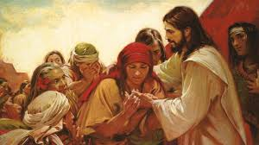
Please bow your heads and put your hands together, or sit quietly to reflect.
Prayer:
Father God,
Please help us to have courage, courage to be ourselves, courage to stand up for things we know to be right.
Guide us in your light, now and forever.
Amen.

Slide 9
Collective worship
The value of Truthfulness
“The truth will set you free” John 8:32
Worship 4-Class worship HEART SMART

Slide 10
We think of God’s son, Jesus who loves us.
We think of God the Father who teaches us through his word.
We think of God, the Holy spirit, who guides us.

Slide 12
Collective worship
The value of Truthfulness
“The truth will set you free” John 8:32
Worship 4-
Praise worship

Slide 13
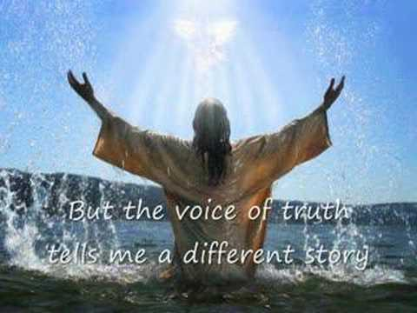
Song to reflect: This is me!

Slide 14
Song to reflect:
https://www.youtube.com/watch?v=tcuiuIwtpa4

Slide 15
Especially for key stage 1 –This little light of mine

Slide 16
Children’s choice

Slide 18
Collective worship
The value of Truthfulness
“The truth will set you free” John 8:32
Worship 4-
Class worship Thursday

Slide 19
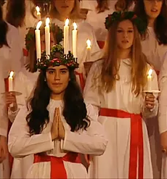
In Sweden Saint Lucy is commemorated on December 13 in a festival of light.
The white robe is for innocence.
The red sash stands for how she died.
The candles show she was a bearer of light.
What would you stand up for? Answer on a postit?

Slide 21
Celebration Collective worship
The value of Truthfulness
“The truth will set you free” John 8:32
Worship 2-
Celebration worship

Slide 22
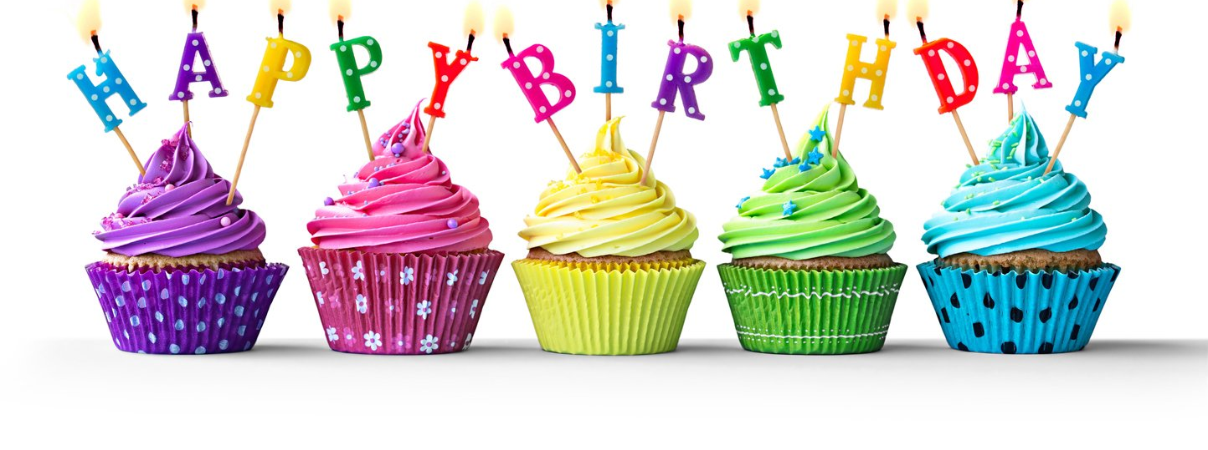
Birthdays….Happy Birthday to YOU.

Slide 23
Personal Development Awards

Slide 24
Head Teacher Awards
Achievement for all

Slide 25
Shining Stars

Slide 26
This is me – The Greatest showman

Slide 27
Reminders:

Slide 28
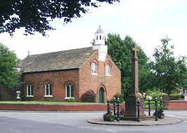
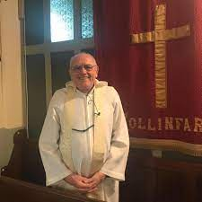
Blessing to all

