Slide 1
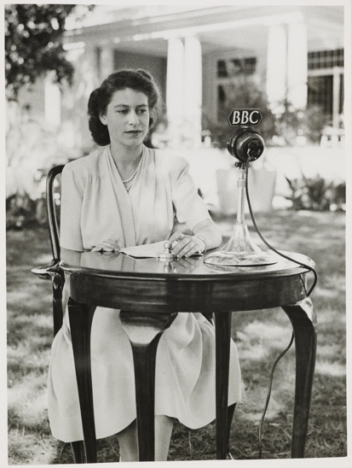
HM Queen Elizabeth II What can we learn from her Christian faith and example of Servant Leadership?

Slide 2
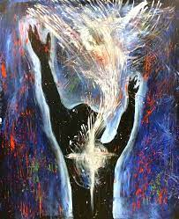
Living for God
Above all, love each other deeply, because love covers over a multitude of sins.
Offer hospitality to one another without grumbling. Each of you should use whatever gift you have received to serve others, as faithful stewards of God’s grace in its various forms.
If anyone speaks, they should do so as one who speaks the very words of God. If anyone serves, they should do so with the strength God provides, so that in all things God may be praised through Jesus Christ.
To him be the glory and the power for ever and ever.
Amen.

Slide 3
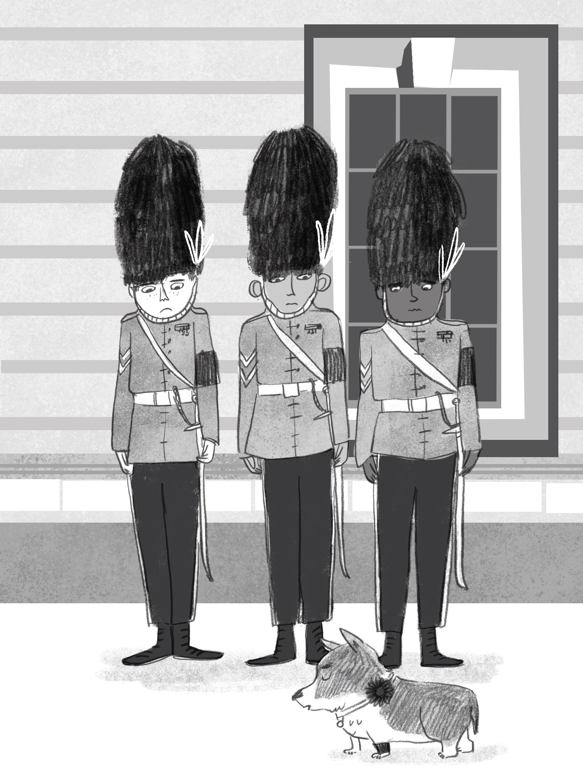
Dear God
We gather here today to remember Her Majesty the Queen.
We give thanks for her long life, and for all the ways she loved and served those in her care.
We bring you our sadness for what we have lost;
Our gratitude for what we remember and cherish;
And our wondering about what is to yet to come.
Thank you for the comfort, peace and hope you bring us.
Amen

Slide 4
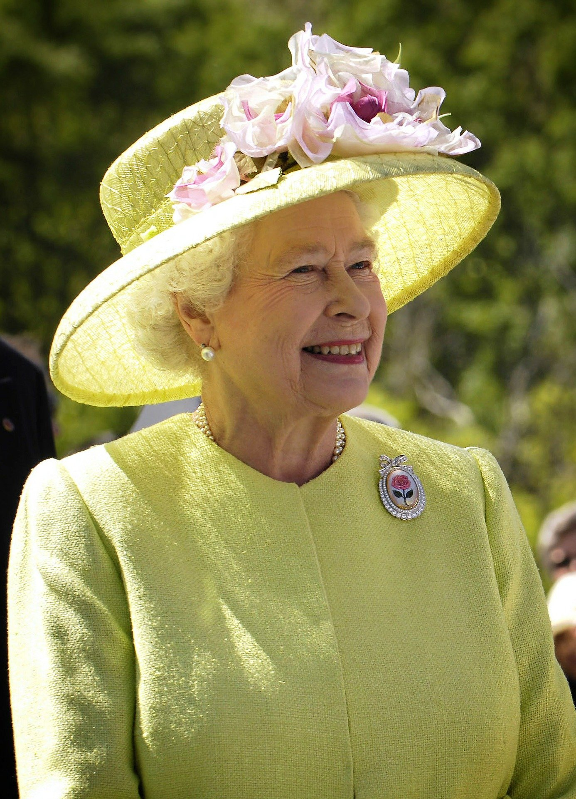
Who was the Queen to you?

Slide 5
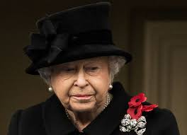
I wonder… is it always easy to serve and think of others?
I wonder… what can we learn from the Queen’s example in asking for God’s help?
I declare before you all that my whole life, whether it be long or short, shall be devoted to your service ... God help me to make good my vow, and God bless all of you who are willing to share in it.

Slide 6
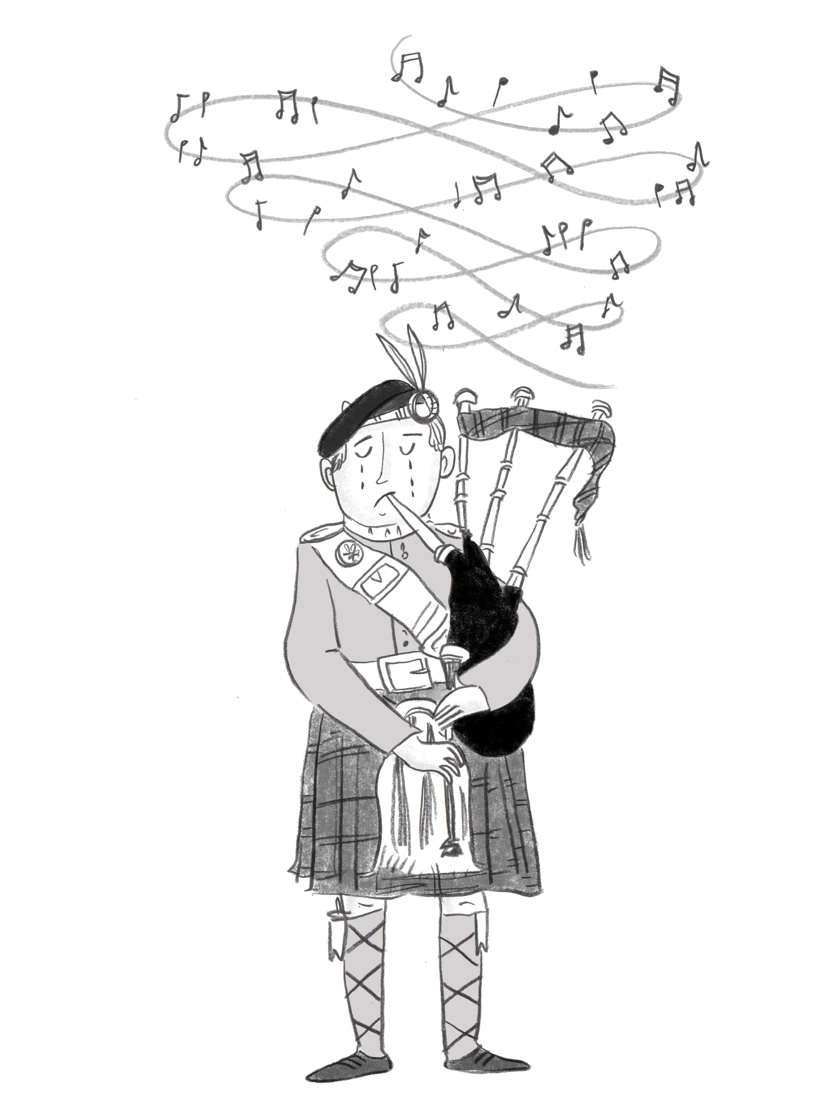
HM Queen Elizabeth II
Today I am feeling………………………… about the Queen
I remember the Queen ………………………………………
The Queen showed us how to be……………………………
I hope we never forget………………………………………

Slide 7
“The love will have been enough; all those impulses of love return to the love that made them. Even memory is not necessary for love.”
Above all, love each other deeply.
1 Peter 4:8

Slide 9
Now let your servant depart in peace.
Luke 2:29

