Slide 1

Collective worship
The value of Peace
“A heart at peace gives life to the body” Proverbs 14:30
Worship 3-living at Peace with the world

Slide 2



We think of God’s son, Jesus who loves us.
We think of God the Father who teaches us through his word.
We think of God, the Holy spirit, who guides us.

Slide 3
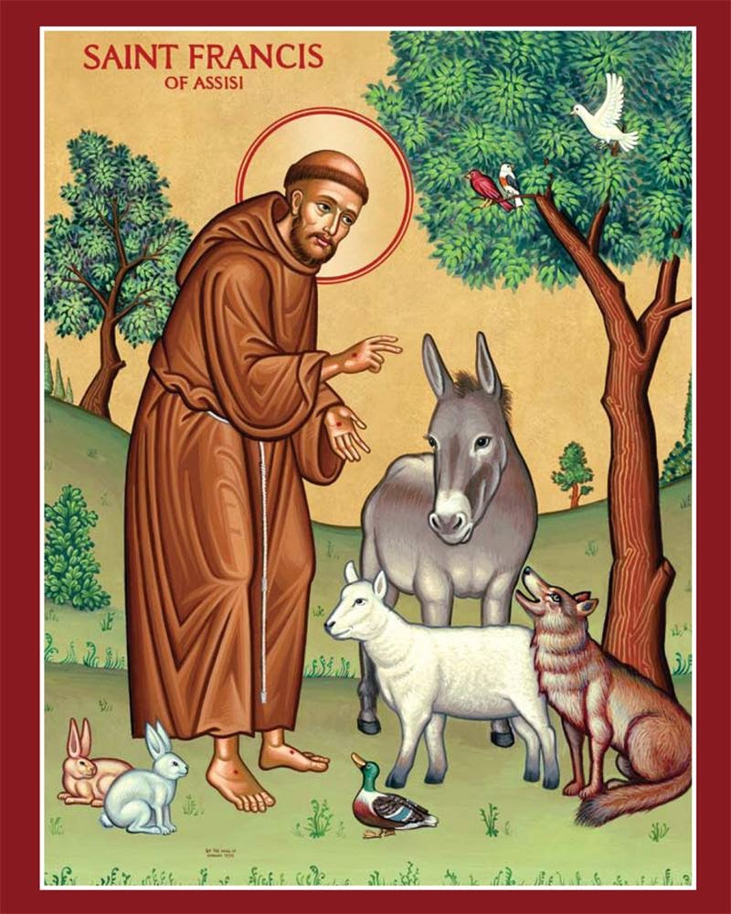
Do you know who is in this picture ?
Are there any clues in the picture that tell us anything about the person?

Slide 4
St Francis of Assisi
He lived nearly 900 years ago and is still remembered today through his actions. This is his story…
St Francis was born in 1181, his father was a wealthy cloth merchant. As a young man he went to war and was captured.
When he was finally released he cam to believe that God wanted him to become poor and live a live of simplicity.

Slide 5
Francis tried to show others how much God cares for all people. One day he exchanged his clothes with a beggar to show people that God loves all people and wants us to be loving and generous.
Francis believed that the natural world deserved to be cared for and respected. He treated everything in the world as his “brother” or “sister” showing great care and respect.
Francis sold all his belongings so that he could restore a ruined church, where he often went to pray.
St Francis tried to teach people about God’s love and about how they should live their lives. He encouraged all to live in peace with one another and the world. As his followers grew a monastic order called the Franciscans developed.

Slide 6
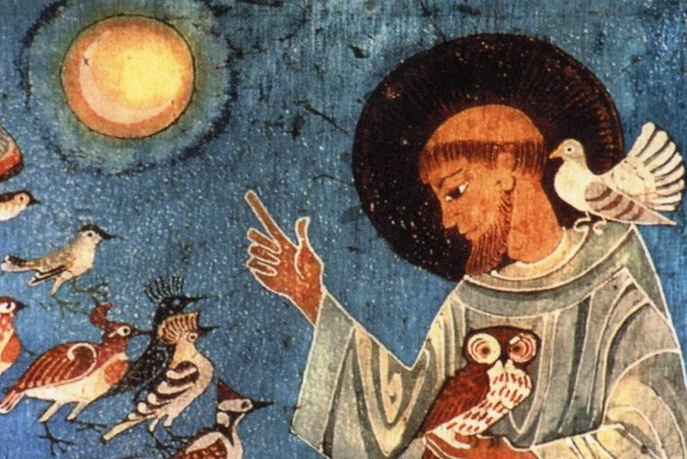
Reflection:
How can YOU be a channel of God’s Peace?

Slide 7
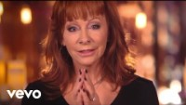
Reflection:
Can you pray for peace?
.

Slide 8

Dear God,
Help us to find ways to follow the example of St Francis. Help us to be peacemakers to our friends and our families.
Guide us in your light forever and always.
Amen.

Slide 9
Collective worship
The value of Peace
“A heart at peace gives life to the body” Proverbs 14:30
Class Worship 3

Slide 10
We think of God’s son, Jesus who loves us.
We think of God the Father who teaches us through his word.
We think of God, the Holy spirit, who guides us.

Slide 11
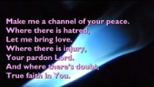
Reflection
What do you feel when you hear this:make me a channel of your peace?
Use postits to record what YOU think.

Slide 12
Collective worship
The value of Peace
“A heart at peace gives life to the body” Proverbs 14:30
Praise Worship 3

Slide 13
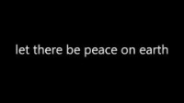

Slide 14
Reflection:
Can you pray for peace?
.

Slide 15

Especially for key stage 1

Slide 16

Children’s choice

Slide 17


Slide 18
Collective worship
The value of Peace
“A heart at peace gives life to the body” Proverbs 14:30
Class Worship 3
Thursday

Slide 19
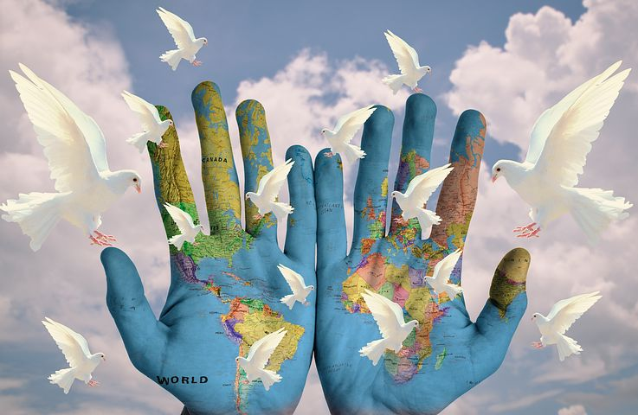
Reflection
How can YOU be the voice of Peace?
Value Passport:
Class 1:Draw a picture of someone you love
Class 2:Draw a picture of Peace for your family
Class 3: Draw a poster to represent Peace.
Class 4: Write a Prayer to share about Peace

Slide 21
Collective worship
The value of Peace
“A heart at peace gives life to the body” Proverbs 14:30
Celebration Worship 3

Slide 22

Birthdays….Happy Birthday to YOU.

Slide 23

Personal Development Awards
For the Lord gives wisdom: out of his mouth comes knowledge and understanding. Proverbs 2:6

Slide 24

Head Teacher Awards
Love never fails – 1 Corinthians 13.:8
Achievement for all

Slide 26

Ethos group
Prayer to share

Slide 27

Reminders:

Slide 28


Reverend Jan
Blessing to all

