Slide 1
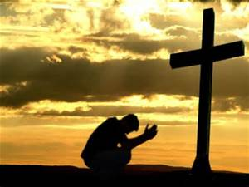
Collective worship
The value of Forgiveness
Forgive and you will be forgiven... Luke 6:37
Worship 1

Slide 2
What does forgiveness mean?
The meaning of Forgiveness is :
when you are truly sorry, it will be ok

Slide 3
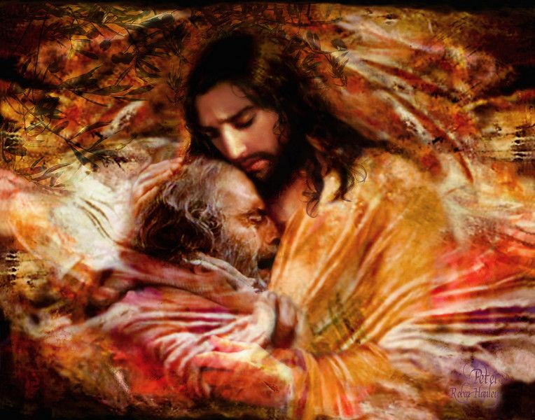
What do Christians believe?
That when they say sorry to God for the wrong things they have done HE forgives them completely and gives them a new start.

Slide 4
How can you describe forgiveness?
Forgiveness is…
Forgetting the hurts,
Offering a new beginning,
Restoring a friendship,
Given and received,
Identifying responsibility,
Valuing the truth
Ending an argument,
Not holding a grudge,
Encouraging Honesty,
Saying sorry,
Starting again.
Which line do YOU think describes real forgiveness and why?

Slide 5
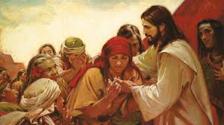
This is a teaspoon prayer: it includes a Thank you , Sorry and Please (tsp)
Please bow your heads and put your hands together, or sit quietly to reflect
Prayer:
Dear God,
Thank you for offering forgiveness to all, through Jesus. Sorry for the times we have been slow to say sorry, or to forgive. Please help us when we do something wrong to say sorry and to accept an apology with kindness.
Guide us in your light forever and always.
Amen.

