Slide 1
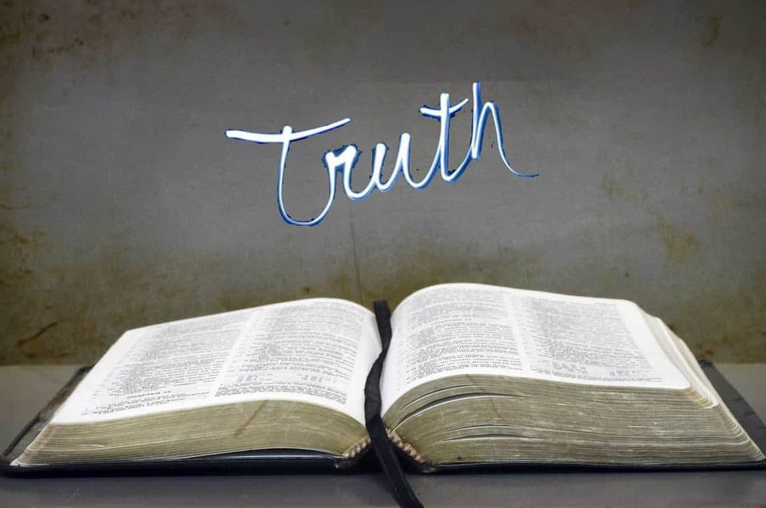
Collective worship
The value of Truthfulness
“The truth will set you free” John 8:32
Worship 3

Slide 2



We think of God’s son, Jesus who loves us.
We think of God the Father who teaches us through his word.
We think of God, the Holy spirit, who guides us.

Slide 3
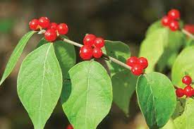
Is it easy to make the right choice?
Here are the berries of the honeysuckle.
They are bright red and look so juicy BUT they are POISONOUS!
The wild birds love them in winter but if we ate them it would make us seriously ill.
We all need to be careful to know which fruits are safe and those that can make us seriously ill.

Slide 4

The Bible also tells us of two people who had a choice to make…

Slide 5
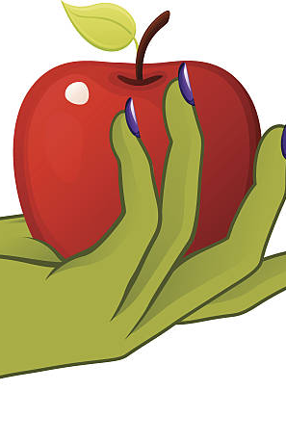
Reflection:
Sometimes like Adam and Eve , we may be tempted to make the wrong choices.
In the story God warns Adam and Eve that the fruit from that tree would make them unhappy. It’s like they took the “bad” fruit!
Making the choice to do the right thing can be difficult.
Telling the truth and choosing to make the right choice needs like everything PRACTICE.
Can you remember a time when you did something you knew to be wrong. How did you feel?

Slide 6
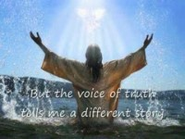
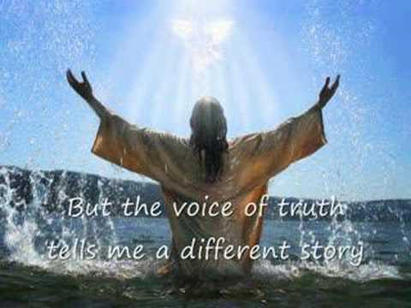
Song to reflect:
https://www.youtube.com/watch?v=tcuiuIwtpa4

Slide 7

Please bow your heads and put your hands together, or sit quietly to reflect.
Prayer:
Father God,
From time to time we all behave badly.
Give us the wisdom to admit when we are wrong and the courage to make the right choice. Help us to be truthful.
Guide us in your light.
Amen.

Slide 8
Collective worship
The value of Truthfulness
“The truth will set you free” John 8:32
Worship 3-Class worship

Slide 9
We think of God’s son, Jesus who loves us.
We think of God the Father who teaches us through his word.
We think of God, the Holy spirit, who guides us.

Slide 10
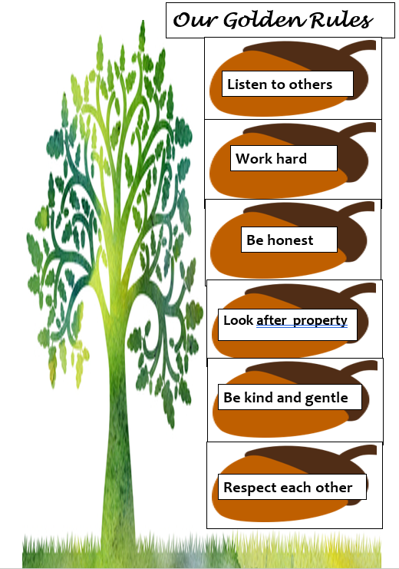
Why do we have Golden rules in our school?
What would happen if we didn’t have any rules?
Which rule do YOU think is most important and why?
Choose a question and answer on a postit?

Slide 11


Slide 12
Collective worship
The value of Truthfulness
“The truth will set you free” John 8:32
Worship 3-
Praise worship

Slide 13
Song to reflect:
https://www.youtube.com/watch?v=tcuiuIwtpa4

Slide 14
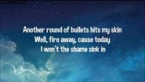
This is me – The Greatest showman

Slide 15
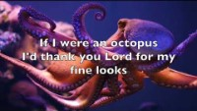
Especially for key stage 1
–The butterfly song

Slide 16

Children’s choice

Slide 18
Collective worship
The value of Truthfulness
“The truth will set you free” John 8:32
Worship 3-
Class worship Thursday

Slide 19
Reflection
Class 1:
Draw a picture to show how you follow the Golden rules. Choose one to share on Friday
Class 2:
Draw a picture of the most important Golden rule.
Class 3:
Draw a picture of a Golden rule and the consequence of not following
Class 4:
Draw a picture of a Golden rule and explain the consequence of not following it.

Slide 21
Celebration Collective worship
The value of Truthfulness
“The truth will set you free” John 8:32
Worship 2-
Celebration worship

Slide 22
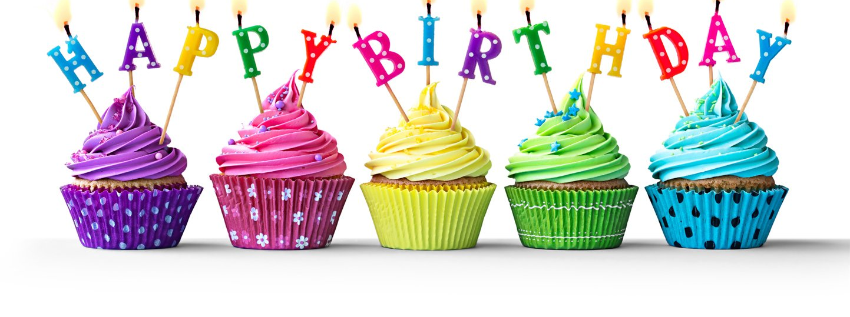
Birthdays….Happy Birthday to YOU.

Slide 23

Personal Development Awards

Slide 24
Song to reflect:
https://www.youtube.com/watch?v=tcuiuIwtpa4

Slide 25

Head Teacher Awards
Achievement for all

Slide 26

Sharing from EYFS – drawing a Golden rule.

Slide 27

Reminders:

Slide 28


Reverend Jan
Blessing to all

