Slide 1
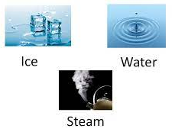
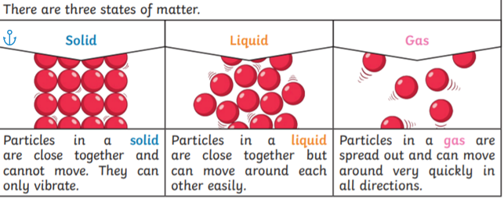
Science – big ideas
How do some solids , liquids and gases change state ?
Key knowledge
Know that some solids, liquids and gases can change state
Know that certain materials can change state
Know what the temperature of water is when it boils or freezes
Know which materials, other than water, change state
Explain the differences between solids, liquids and gases
Know what is meant by the terms: condensation, and evaporation
Vocabulary
evaporation | when a liquid changes to a gas
condensation | when a gas changes into a liquid
melting | when a solid becomes a liquid
solidifying | when a liquid becomes a solid
precipitation | rain, snow, sleet and hail
degrees - Celsius | the most common unit of temperature
matter | Matter is anything that has weight and takes up space. Everything you can see and touch is made up of matter. Matter exists in three main forms: solids, liquids, and gases.
When it is very cold, water turns into ice. When water is hot in a kettle and boils, steam is made. When temperatures are warmer, ice melts and becomes water. Chocolate and ice-cream also melt. You can’t see a gas but may be able to smell or hear it.
Prior knowledge

