Slide 1
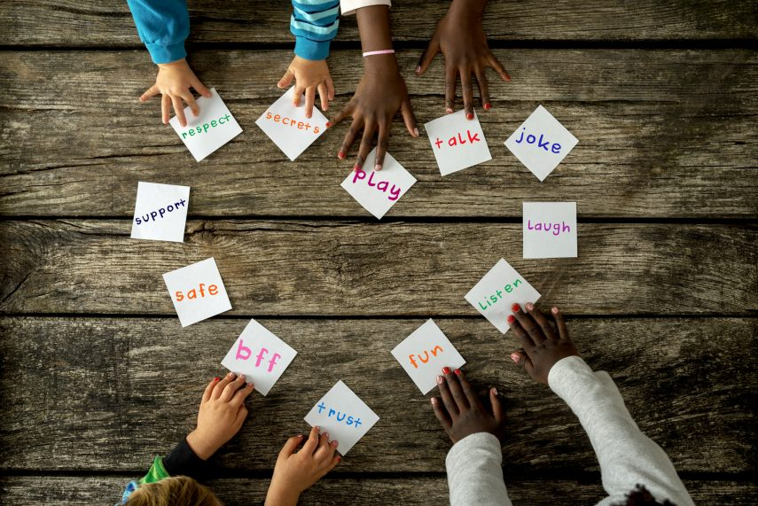
Collective worship
The value of Friendship
“A friend loves at all times” Proverbs 17:17
Worship 3

Slide 2



We think of God’s son, Jesus who loves us.
We think of God the Father who teaches us through his word.
We think of God, the Holy spirit, who guides us.

Slide 3

What did Jesus want?
Jesus wants us to understand that when we chose to believe and to help- that your life can be transformed.
When we love and forgive we are following God’s wishes.

Slide 4
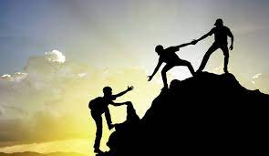

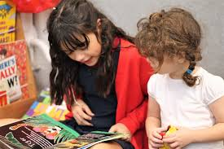
Have YOU ever helped a friend?
Can you see how the pictures show ways we can help each other …our friends.

Slide 5
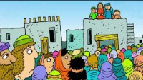
Down through the roof…

Slide 6
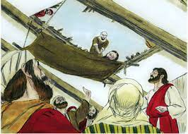
Down through the roof…
We always want the very best for our friends. Sometimes we know when our friends are feeling down or need help.
As Christians we can also pray for our friends when they are in trouble, worried or unhappy.
Jesus can help give people a new beginning.

Slide 7

Original track – Beatles

Slide 8
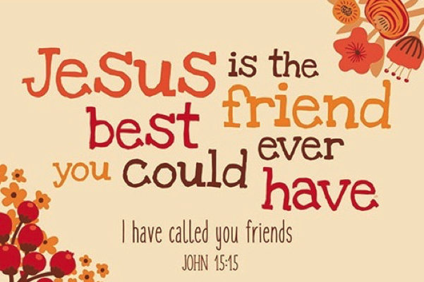
Reflection
If you can’t help a friend on your own who would you seek help from?

Slide 9

Prayer:
Dear God,
Thank you for our friends. Sometimes we know we will let people down but when that happens, help us to know how to make it right again. Guide us in your light forever and always.
Amen.

Slide 10
Collective worship
The value of Friendship
“A friend loves at all times” Proverbs 17:17
Worship 3
class worship

Slide 11
We think of God’s son, Jesus who loves us.
We think of God the Father who teaches us through his word.
We think of God, the Holy spirit, who guides us.

Slide 12

Reflection
Is there an emotion that we should include on our emotions chart to help friends…can you design one?

Slide 13
This is a teaspoon prayer: it includes a Thank you , Sorry and Please (tsp)
Please bow your heads and put your hands together, or sit quietly to reflect
Prayer:
Dear God,
Thank you for being the light of the world, Sorry for the times we have not been as good a friend as we should have. Please help us to shine as lights and be supportive to our friends in good times and bad. Guide us in your light forever and always.
Amen.

Slide 14
Collective worship
The value of Friendship
“A friend loves at all times” Proverbs 17:17
Worship 3 Praise worship

Slide 15

The Lord is my shepherd

Slide 16
Original track – Beatles

Slide 17

Especially for key stage 1

Slide 18

Children’s choice

Slide 19


Slide 20
Collective worship
The value of Friendship
“A friend loves at all times” Proverbs 17:17
Worship 2
Worship passports

Slide 21

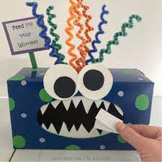
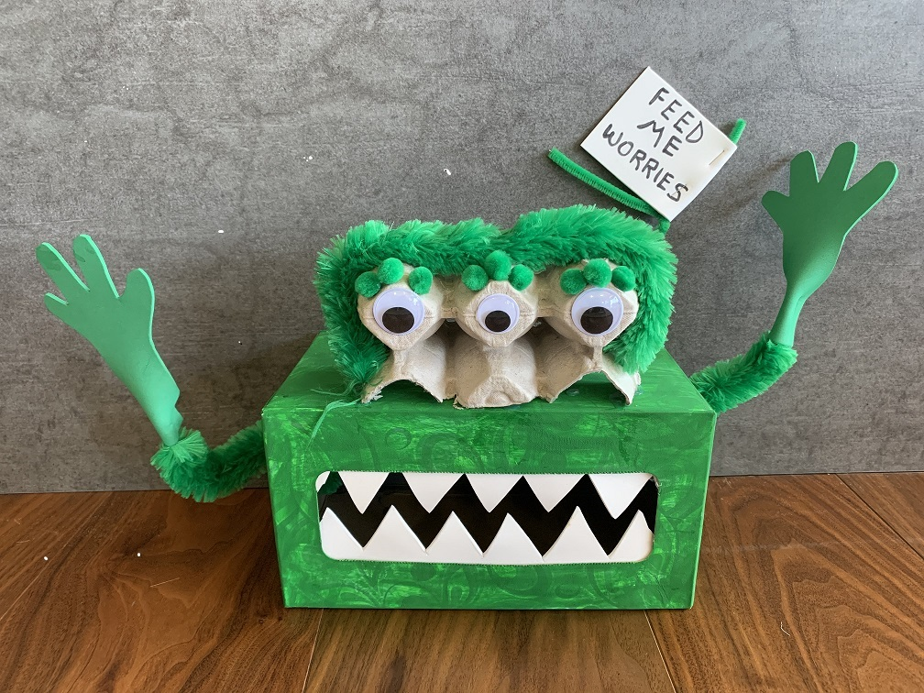
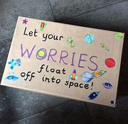
Reflection
How can YOU help your friend?
Value passport activity
To show love for your friends.
For all to create a design for a worry box for the class.

Slide 23
Celebration Collective worship
The value of Friendship
“A friend loves at all times” Proverbs 17:17
Worship 3
Celebration Worship

Slide 24

Birthdays….Happy Birthday to YOU.

Slide 25

Personal Development Awards

Slide 26

Head Teacher Awards
Achievement for all

Slide 27

Prayer to share

Slide 28

Reminders:

Slide 29


Reverend Jan
Blessing to all

