Slide 1
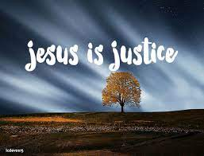
Collective worship
The value of Justice
“Hold fast to love and justice Hosea 12:6
Worship 1:

Slide 2



We think of God’s son, Jesus who loves us.
We think of God the Father who teaches us through his word.
We think of God, the Holy spirit, who guides us.

Slide 3
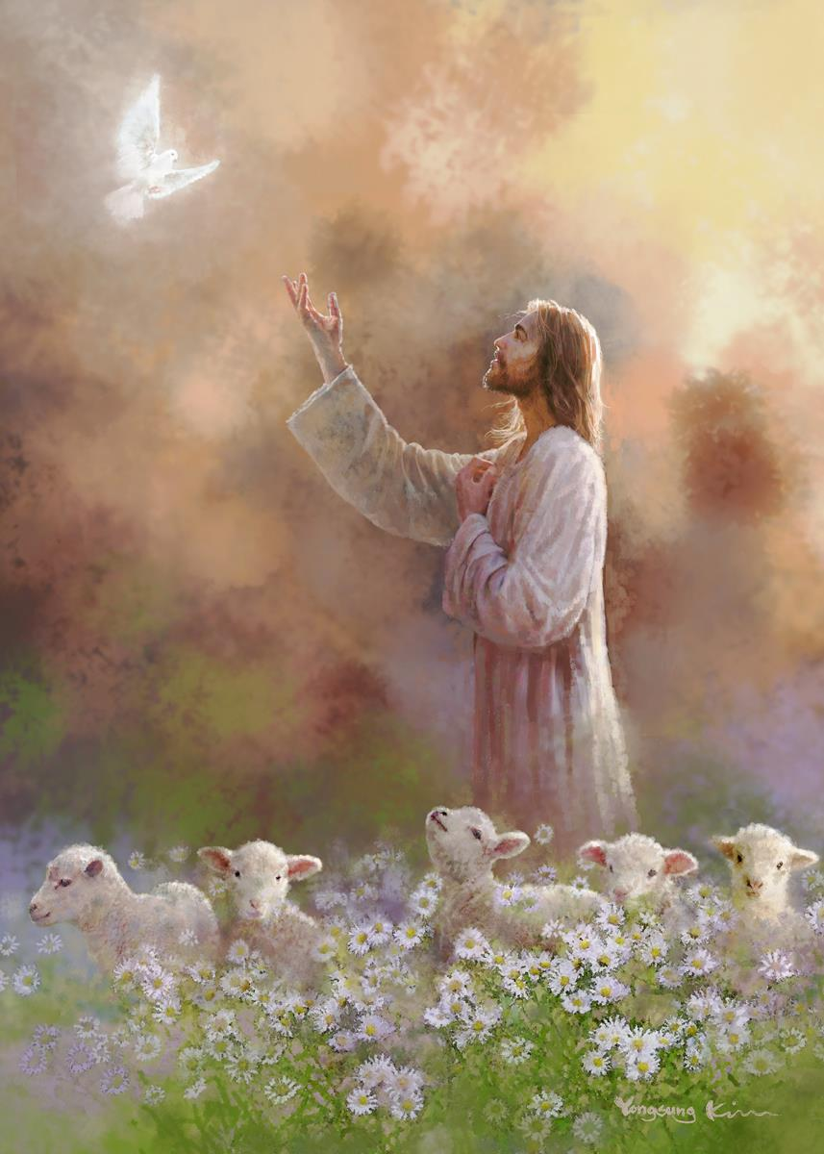
What do Christians believe?
Christians believe that justice is revealed in the bible seen in the context of love. It is about responsibility for each other, the poor and oppressed.
Justice

Slide 4
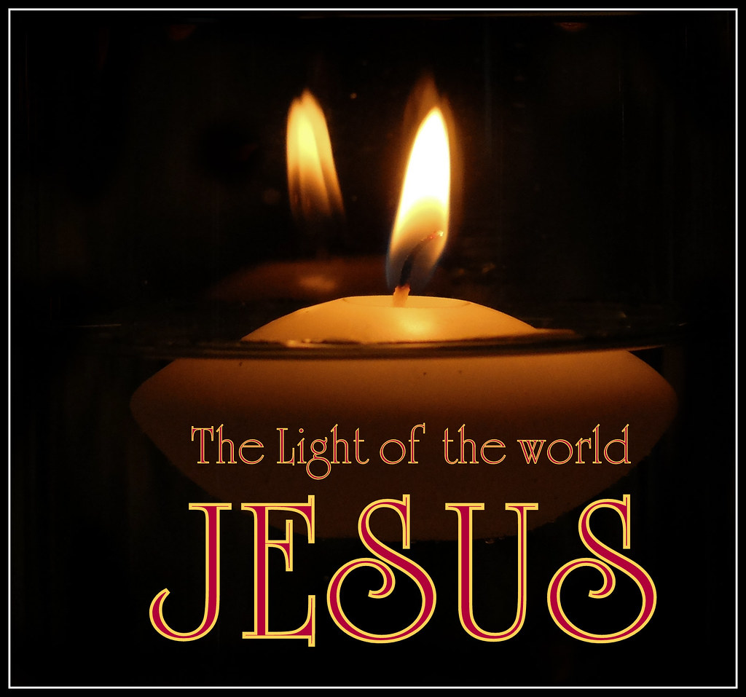
What did Jesus say?
Jesus gave the message that we should
“love others as we do ourselves”
and
“Learn to do good; seek justice, correct oppression; bring justice to the fatherless, and plead the widow's cause,” (Isaiah 1:17).
When we love and seek justice we are following God’s wishes.

Slide 5
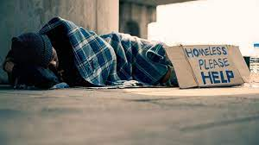





How do we learn to do good?
How can YOU support others?

Slide 6
Collective worship
The value of Justice
“Hold fast to love and justice Hosea 12:6
Worship 1: Tuesday
Class worship

Slide 7

Prayer:
Dear God,
Help us to see when things are unfair. Thank you for all the people who work for charities to help others. Help us to learn from their kindness.
Guide us in your light forever and always.
Amen.

Slide 8
We think of God’s son, Jesus who loves us.
We think of God the Father who teaches us through his word.
We think of God, the Holy spirit, who guides us.

Slide 9

How can we have justice for all?
Discuss with a partner and jot down what you think.
How can we make sure Love never fails?

Slide 10
Prayer:
Dear God,
Help us to see when things are unfair. Thank you for all the people who work for charities to help others. Help us to learn from their kindness.
Guide us in your light forever and always.
Amen.

Slide 11
Collective worship
The value of Justice
“Hold fast to love and justice Hosea 12:6
Worship 1: Wednesday
Praise worship

Slide 12
We think of God’s son, Jesus who loves us.
We think of God the Father who teaches us through his word.
We think of God, the Holy spirit, who guides us.

Slide 13
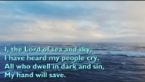
Here I am Lord

Slide 14

I’ll stand by You

Slide 15
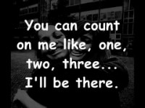
Count on me

Slide 16

Children’s choice

Slide 17


Slide 18
Collective worship
The value of Justice
“Hold fast to love and justice Hosea 12:6
Worship 1: Thursday
Class worship

Slide 19
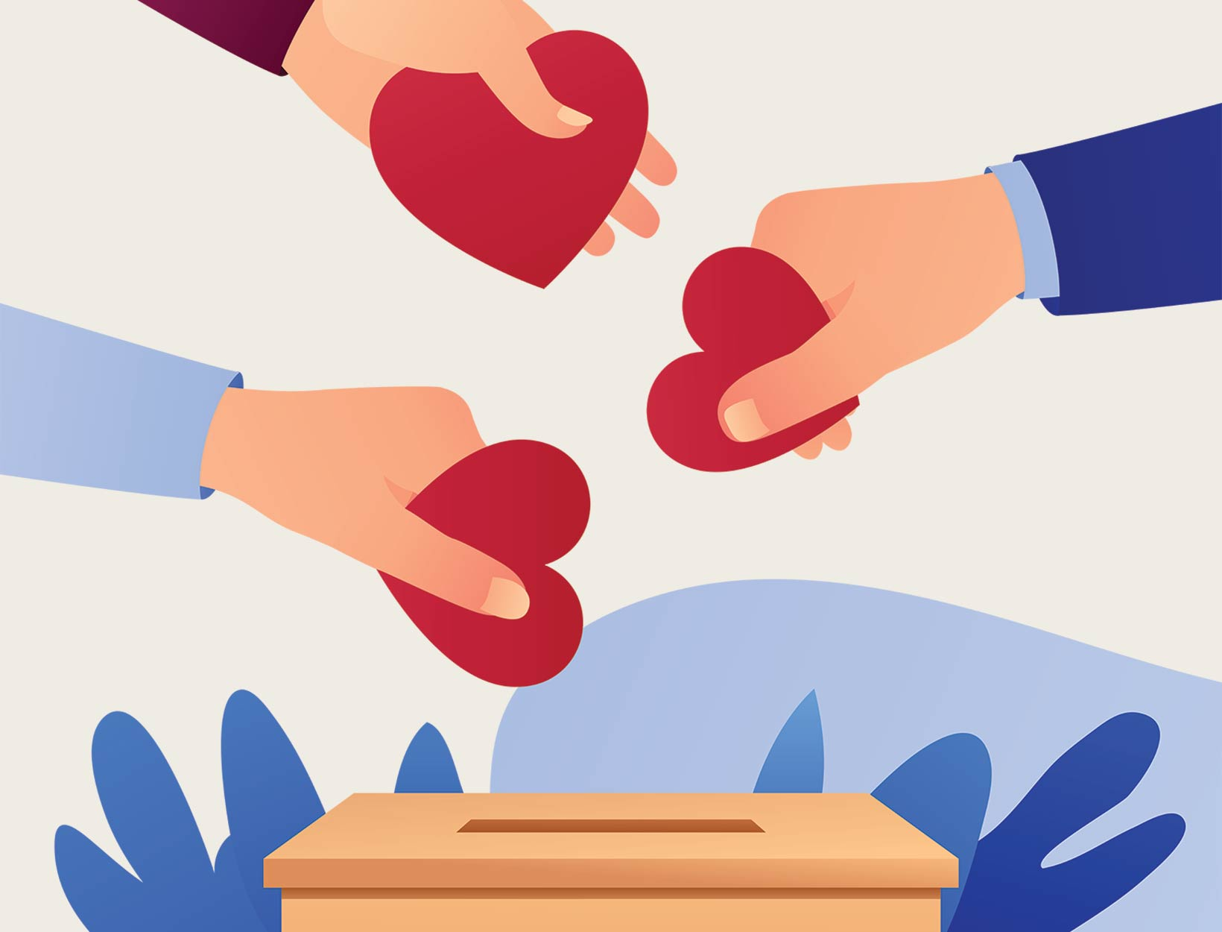
Reflection
How can YOU show how you can help others?
Value Passport:
Class 1:
Draw a heart and give it to someone you love.
Class 2:
Use a heart and write how you can help someone.
Class 3:
Write a class list of charities that you would love to help
Class 4:
Write and share a prayer in class collective worship about how we can help others.

Slide 21
Collective worship
The value of Justice
“Hold fast to love and justice Hosea 12:6
Worship 1: Friday
Celebration worship

Slide 22

Head Teacher Awards
Achievement for all

Slide 23

Personal Development Awards
Helping children prepare for life, growing with God.

Slide 24

Birthdays….Happy Birthday to YOU.

Slide 25
I’ll be there…

Slide 26
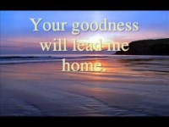
The Lord is my shepherd

Slide 27

Reminders:

Slide 28

Class 4
Prayer to share on Love and helping others.

Slide 29


Reverend Jan
Blessing to all

