Slide 1
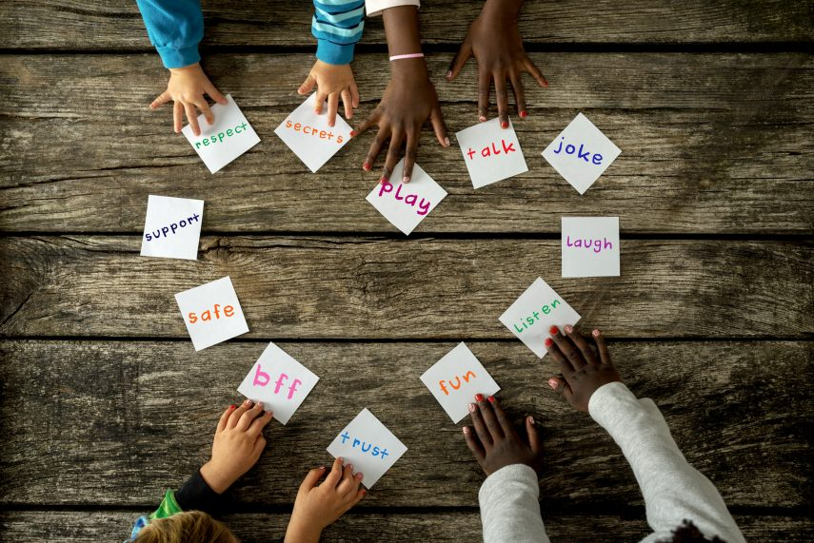
Collective worship
The value of Friendship
“A friend loves at all times” Proverbs 17:17
Worship 6
British Values
Mutual Respect

Slide 2



We think of God’s son, Jesus who loves us.
We think of God the Father who teaches us through his word.
We think of God, the Holy spirit, who guides us.

Slide 3

Love them like Jesus

Slide 4



Slide 5
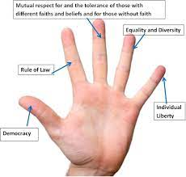
We are going to be learning about British values
democracy
the rule of law
individual liberty
mutual respect
tolerance of those of different faiths and beliefs

Slide 6
Mutual Respect…
Mutual respect is when two people may not agree on everything but they don't get upset. over little things and are willing to work things. out because they care for the other. This is literally "the golden rule" of the Bible.
Do unto others as you would have them do unto you.
In other words, if you want to be treated with kindness, be kind to others. ... "But love your enemies, and do good, and lend, expecting nothing in return, and your reward will be great.“ Matthew 7:17

Slide 7
Reflection…
How can you show mutual respect?

Slide 8

Please bow your heads and put your hands together, or sit quietly to reflect.
Prayer:
Dear God,
Please help us to know how we are loved and cared for, in school, our home and in your world.
Help us to show mutual respect to all.
Thank you for letting us know that love never fails.
Guide us in your light, now and forever.
Amen.

Slide 9
Collective worship
The value of Friendship
“A friend loves at all times” Proverbs 17:17
Worship 6

Slide 10
We think of God’s son, Jesus who loves us.
We think of God the Father who teaches us through his word.
We think of God, the Holy spirit, who guides us.

Slide 11

Reflection – Why do you think we say HEART?
Which can you remember…test your teacher.
H
E
A
R
T

Slide 12
Which letter means a lot to you?
The HEART of our school:
H – Helping children prepare for life, growing with God.
E – Embracing Christian Values.
A - Achievement for all.
R - Reading at the heart of our school
T – Teaching a knowledge rich curriculum.

Slide 13


Slide 14
Collective worship
The value of Friendship
“A friend loves at all times” Proverbs 17:17
Worship 6

Slide 15
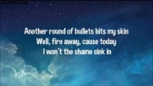
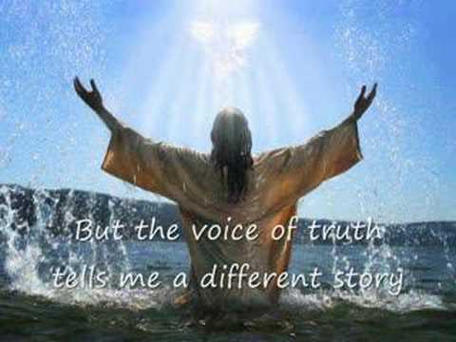
Song to reflect: This is me!

Slide 16
Love them like Jesus

Slide 17
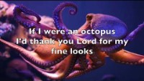
Especially for key stage 1
–The butterfly song

Slide 18

Children’s choice

Slide 20
Collective worship
The value of Friendship
“A friend loves at all times” Proverbs 17:17
Worship 6
Black History

Slide 21
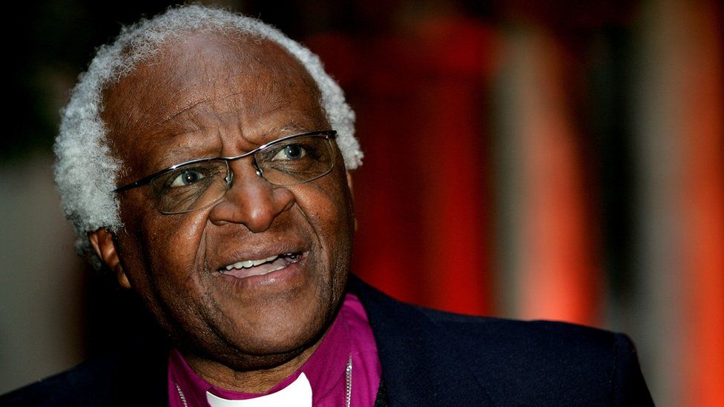
Reflection –
Black History Month
Black history month was first launched in London in the 1980s, where the aim was for the local community to challenge racism and educate themselves and others about the British history that was not taught in schools We are going to learn about that history every half term….
Desmond Tutu was a church of England Archbishop serving in South Africa. He was opposed to Apartheid – the discrimination of those based on the colour of their skin. He was appointed by Nelson Mandela to head South Africa's Truth and Reconciliation Commission set up to investigate crimes committed by both sides during the apartheid era. He was also credited with coining the term Rainbow Nation to describe the ethnic mix of post-apartheid South Africa.
Desmond Mpilo Tutu was born in 1931, and followed in his father's footsteps as a teacher. He was awarded the Nobel Peace Prize in 1984. he died on boxing day this year 26.12.2021. we will remember him and we are proud of him.
Can you think of how love never fails or how the Lord gives wisdom?

Slide 23
Collective worship
The value of Friendship
“A friend loves at all times” Proverbs 17:17
Worship 6
Black History

Slide 24

Birthdays….Happy Birthday to YOU.

Slide 25

Personal Development Awards

Slide 26

Song to reflect:

Slide 27

Head Teacher Awards
Achievement for all

Slide 28

Class 3
Prayer to share on mutual respect and love.

Slide 29

Reminders:

Slide 30


Reverend Jan
Blessing to all

