Slide 1
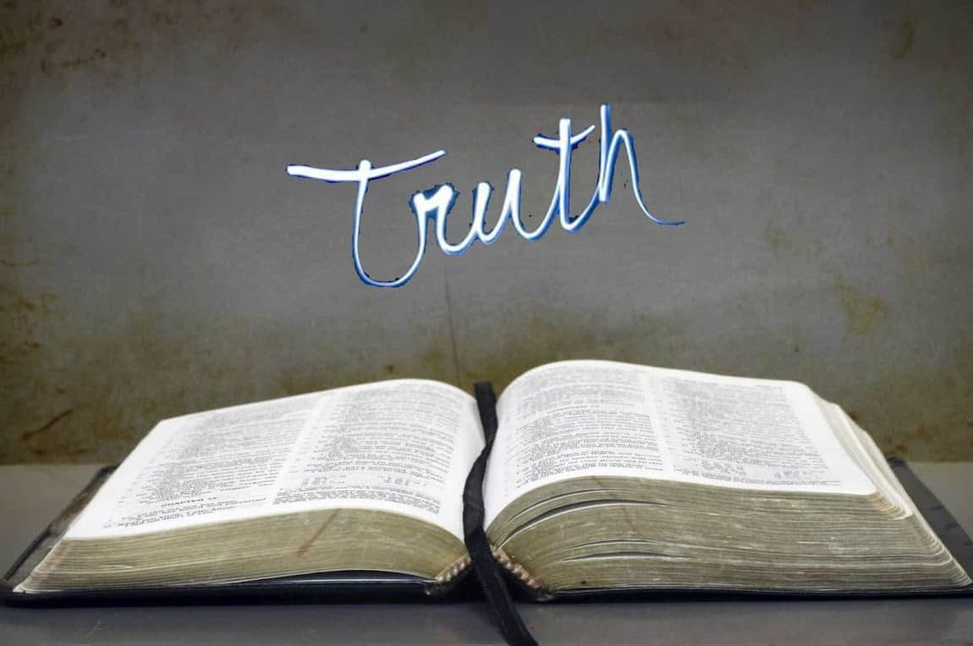
Collective worship
The value of Truthfulness
“The truth will set you free” John 8:32
Worship 5

Slide 2



We think of God’s son, Jesus who loves us.
We think of God the Father who teaches us through his word.
We think of God, the Holy spirit, who guides us.

Slide 3

Love them like Jesus

Slide 4



Slide 5
Put your thumb up if........
All these things help make up your identity
You have brown hair
Wear glasses
Have a brother or sister
Like football
Can speak another language
You like swimming in the sea!
Born in this country
Know what you want to be when you’re older

Slide 6
So what else makes up your personal identity?
Groups or clubs that you belong to - scouts, rugby, choir....
What your interests or talents are - film, dance, speed stacking....
What things and people that are important to you
What your hopes are for the future.
Which people are important to you.
Your religion
The languages that you speak.
Which country you are from.

Slide 7
We have talked about personal values, but can a country have values?
We all live in Britain, what do you think British values are?

Slide 8
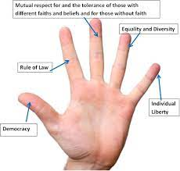
We are going to be learning about British values
democracy
the rule of law
individual liberty
mutual respect
tolerance of those of different faiths and beliefs

Slide 9
Reflection:
Why do you think we need British values?

Slide 10

Please bow your heads and put your hands together, or sit quietly to reflect.
Prayer:
Dear God,
Please help us to know how we are loved and cared for, in school, our home and in your world.
Thank you for letting us know that love never fails.
Guide us in your light, now and forever.
Amen.

Slide 11
Collective worship
The value of Truthfulness
“The truth will set you free” John 8:32
Worship 5-Class worship

Slide 12
We think of God’s son, Jesus who loves us.
We think of God the Father who teaches us through his word.
We think of God, the Holy spirit, who guides us.

Slide 13

Reflection – Why do you think we say HEART?
Which can you remember…test your teacher.
H
E
A
R
T

Slide 14
Which letter means a lot to you?
The HEART of our school:
H – Helping children prepare for life, growing with God.
E – Embracing Christian Values.
A - Achievement for all.
R - Reading at the heart of our school
T – Teaching a knowledge rich curriculum.

Slide 15


Slide 16
Collective worship
The value of Truthfulness
“The truth will set you free” John 8:32
Worship 5-
Praise worship

Slide 17
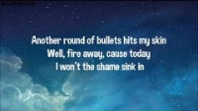
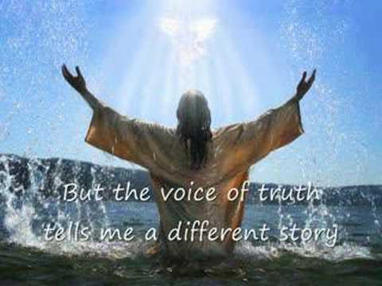
Song to reflect: This is me!

Slide 18
Love them like Jesus

Slide 19
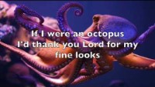
Especially for key stage 1
–The butterfly song

Slide 20
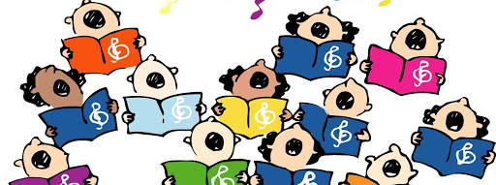
Children’s choice

Slide 22
Collective worship
The value of Truthfulness
“The truth will set you free” John 8:32
Worship 5-
Class worship Thursday

Slide 23
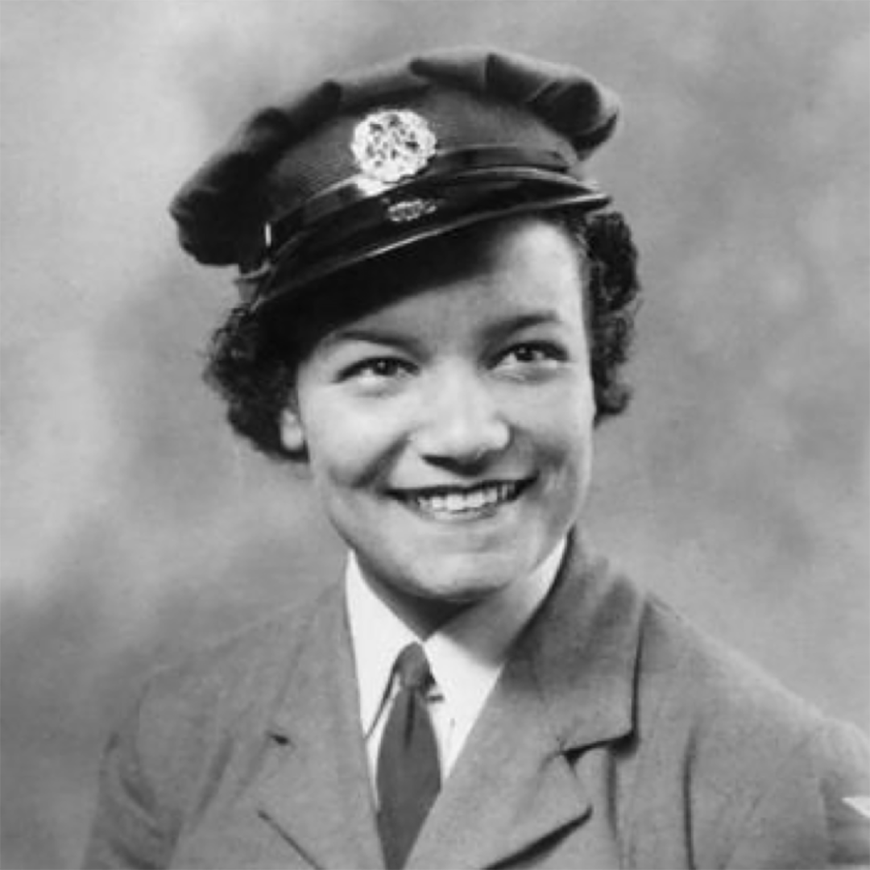
Reflection –
Black History Month
Black history month was first launched in London in the 1980s, where the aim was for the local community to challenge racism and educate themselves and others about the British history that was not taught in schools We are going to learn about that history every half term….
Lilian Bader was born in 1918 in Liverpool and went on to become one of the very first black women to join the British Armed Forces.
Starting out as a canteen assistant at an army base in Yorkshire, she eventually trained as an instrument repairer, before becoming a leading aircraftwoman and soon afterwards earning herself the rank of Corporal.
Three generations of her family served in the armed forces.
When she left the army to have children of her own, she retrained and got a degree from the University of London to become a teacher. We are proud of her.
Can you think of how love never fails or how the Lord gives wisdom?

Slide 25
Celebration Collective worship
The value of Truthfulness
“The truth will set you free” John 8:32
Worship -5
Celebration worship

Slide 26

Birthdays….Happy Birthday to YOU.

Slide 27

Personal Development Awards

Slide 28

Song to reflect:

Slide 29

Head Teacher Awards
Achievement for all

Slide 30

Reminders:

Slide 31


Reverend Jan
Blessing to all

