Slide 1
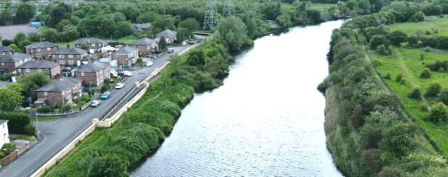
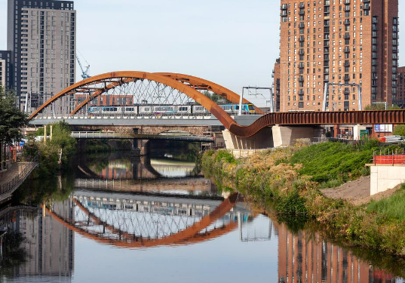
Big ideas
Where do rivers begin and end ?
Key knowledge
Know how a river is formed
Know that most rivers’ sources are in highland areas
Know that rivers flow into the sea and where this happens is called the estuary
Know that a river has an upper, middle and lower course and each has different features.
Know the names of and can locate some of the UK and world’s longest rivers
Know that most of the world’s main cities are situated close to a river
Vocabulary
estuary | An estuary is an area where a freshwater river or stream meets the sea
Source | The source of a river is where it begins, usually on high ground
meander | A meander is a winding curve or bend in a river
tributary | When one stream or river meets another and merge together, the smaller stream or river is known as a tributary
river erosion | Erosion occurs when the fastest currents in the river carve into the banks
deposition | Rocks and sediments eroded from one part of the river are deposited in another part or into the sea
mouth | A river mouth is where a river flows into a larger body of water, such as another river, a lake/reservoir, a bay/gulf, a sea, or an ocean.
The River Mersey flows through Warrington and is formed from 3 tributaries.
Another major river in Northwest England, is the River Irwell which runs through the heart of Greater Manchester, flowing westwards past Salford and into the River Mersey.
Prior Knowledge Y4 know that the River Mersey flows into the Irish Sea and that the city of Liverpool is situated alongside it. Y4 know that the River Nile flows through several countries, including Egypt, into the Mediterranean Sea. Y4 know that the River Nile had many uses for the people of Ancient Egypt and that without it, there would have been no civilization. Y3 know that the Amazon River is located in South America and that many species of living things live by it and in the area.
1

