Slide 1
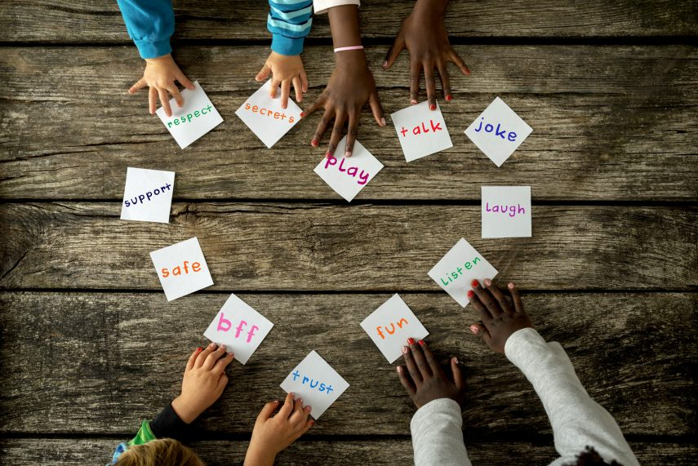
Collective worship
The value of Friendship
“A friend loves at all times” Proverbs 17:17
Worship 4

Slide 2



We think of God’s son, Jesus who loves us.
We think of God the Father who teaches us through his word.
We think of God, the Holy spirit, who guides us.

Slide 3

What did Jesus want?
Jesus wants us to learn about trust being an important part of friendship and how Christians trust God.
When we love and forgive we are following God’s wishes.

Slide 4
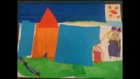
The helpful servant…

Slide 5
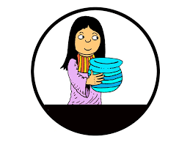
Reflection
Why must it have been hard for the servant girl to trust Naaman and his wife?

Slide 6
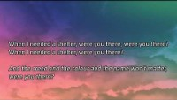
When I needed a neighbour

Slide 7

Prayer:
Dear God,
Thank you for our friends. Help us to look for friends in unexpected places and situations to make our school a place where we can trust each other and build lasting friendships.
Guide us in your light forever and always.
Amen.

Slide 8
Collective worship
The value of Friendship
“A friend loves at all times” Proverbs 17:17
Worship 4
class worship

Slide 9
We think of God’s son, Jesus who loves us.
We think of God the Father who teaches us through his word.
We think of God, the Holy spirit, who guides us.

Slide 10
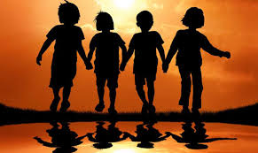
Reflection
How do you trust your friend?
Use a postit to record

Slide 11
This is a teaspoon prayer: it includes a Thank you , Sorry and Please (tsp)
Please bow your heads and put your hands together, or sit quietly to reflect
Prayer:
Dear God,
Thank you for being the light of the world, Sorry for the times we have not been as good a friend as we should have. Please help us to shine as lights and be supportive to our friends in good times and bad. Guide us in your light forever and always.
Amen.

Slide 12
Collective worship
The value of Friendship
“A friend loves at all times” Proverbs 17:17
Worship 4 Praise worship

Slide 13
When I needed a neighbour

Slide 14

Especially for key stage 1

Slide 15
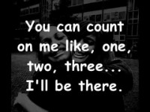
I’ll be there…

Slide 16

Children’s choice

Slide 17


Slide 18
Collective worship
The value of Friendship
“A friend loves at all times” Proverbs 17:17
Worship 4
Worship passports

Slide 19
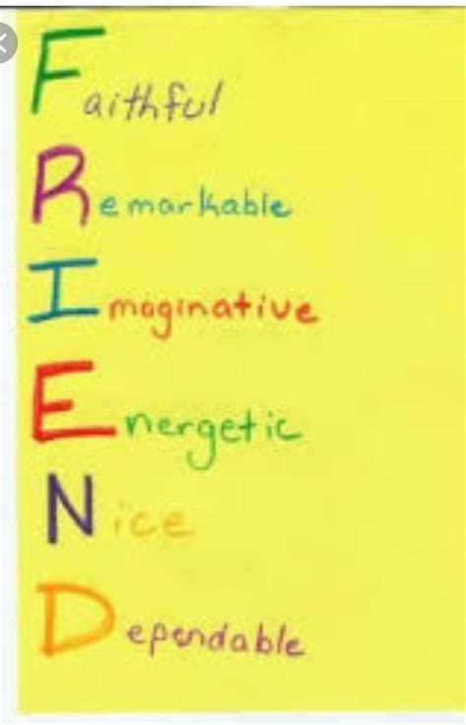
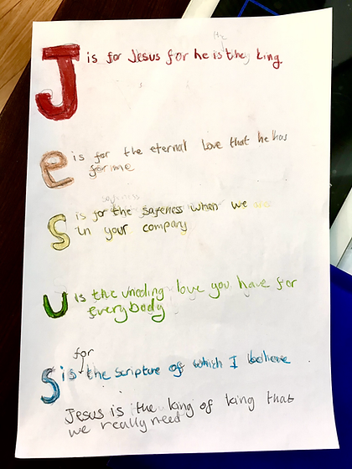
Reflection
Do you know that God is always your friend?
Value passport activity
To show wisdom
EYFS- to create a shared acrostic poem to display.
All classes to create either a friend acrostic poem or one to show how Jesus is your friend.

Slide 21
Celebration Collective worship
The value of Friendship
“A friend loves at all times” Proverbs 17:17
Worship 4
Celebration Worship

Slide 22

Birthdays….Happy Birthday to YOU.

Slide 23

Personal Development Awards

Slide 24

Head Teacher Awards
Achievement for all

Slide 25
I’ll be there…

Slide 26

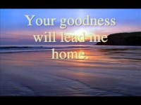
Prayer to share

Slide 27

Reminders:

Slide 28


Reverend Jan
Blessing to all

