Slide 1
Whilst You Are At Home
We are going to stay in touch
21st April 2020

Slide 2
Positive Message of the Week
Hello everyone, because we cannot visit you in your schools at the moment, we are now on our third weekly message. Each week we will be adding new activity ideas for you to do at home either by yourself, a family member or your personal friends online.
We are all aware of the changes still going on at the moment which might make you feel scared or worried. That’s OK. It’s totally normal to feel like this. We all need to remember this situation won’t last forever.
Remember we are staying in touch with you to help keep you safe.

Slide 3
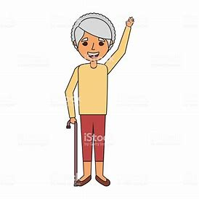
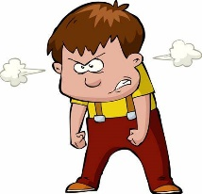
PCSO GEORGIE GRIFFITHS SAYS HI
Please don’t talk to strangers Online
When outside for your exercise Always use the Green Cross Code.
Always wear your seat belt in the car
Make sure you wear your helmet whilst on your bikes

Slide 4
Police Safety Messages
You are all smart children and we want you to remember the Online Safety messages your parents, your teachers and the PCSO’s talk to you about all the time! This week we want you to focus on Not sharing personal information or communicating with people you don’t really know.
This message came from PCSO Georgie Griffiths
Think about the following messages:
Don’t talk to strangers Online.
Always use the Green Cross Code.
Don’t run across the roads.
Always wear your seat belt.
Always wear your helmet when your on a bike.
Always tell someone you trust if something upsets you.
Cheshire Police
PCSO’s
working together to keep you safe at all times

Slide 5
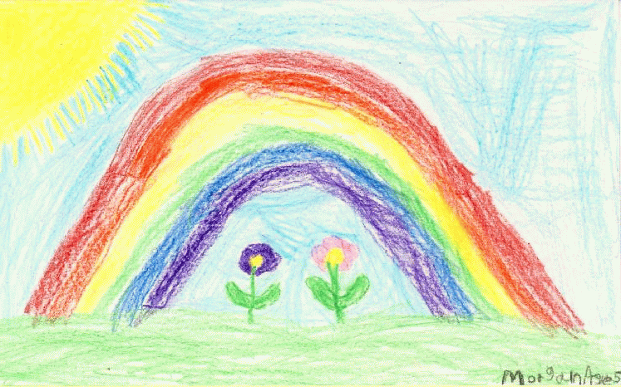
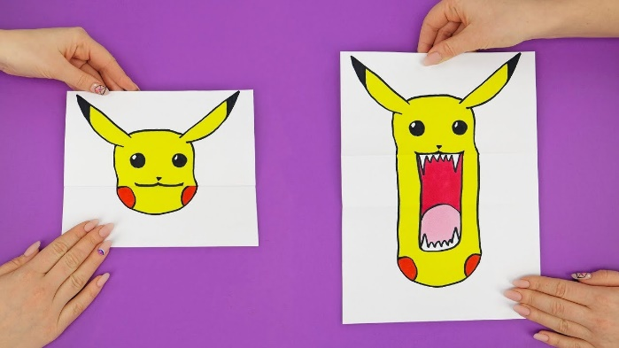
Activities
This weeks Drawing Project
What does a key worker look like?
Maybe write a story about key workers, thinking about how others help Us.
How about a poem, that can be shared with family, friends, your teachers or your local Police.
Riddle: What do you call a Fairy who hasn’t had a bath?
Answers on last slide, no peeking until you’ve had a go at this!
“Riddle: Why are Teddy Bears never hungry?”
Answers on last slide, no peeking until you’ve had a go at this!

Slide 6
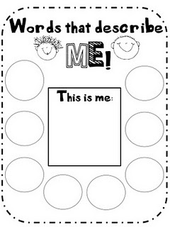

Slide 7
Until next Time
28th April 2020
Stay safe, by Washing your Hands and stay at home until it’s time for some exercise.
Stay healthy, by doing a bit of exercise every day.
Keep positive, by reminding yourself, You are an Amazing Child.
And remember we won’t be indoors forever
Childline | Childline
https://www.childline.org.uk
Get help and advice about a wide range of issues, call us on 0800 1111, talk to a counsellor online, send Childline an email or post on the message boards

Slide 8
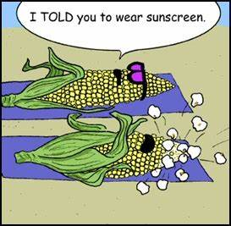
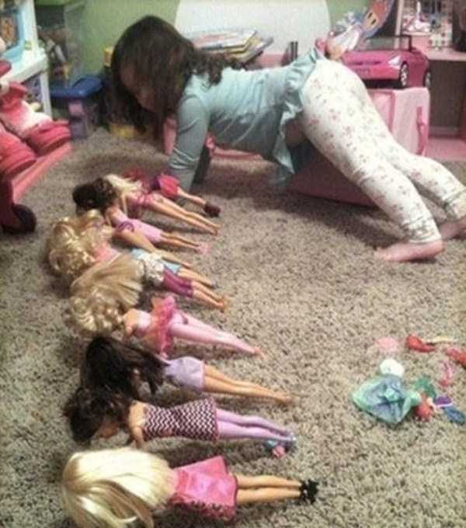
Answers to Riddles Riddle: Why are Teddy Bears never hungry: Answer: Because they are always stuffed. Riddle: What do you call a Fairy who hasn’t taken a bath. Answer: Stinkerbell
Why did the Banana go to the Doctor?
It wasn’t Peeling well!
What do you call a bear with no teeth?
A Gummy Bear!
How does the Ocean say Hello?
It waves Hello!

