Slide 1
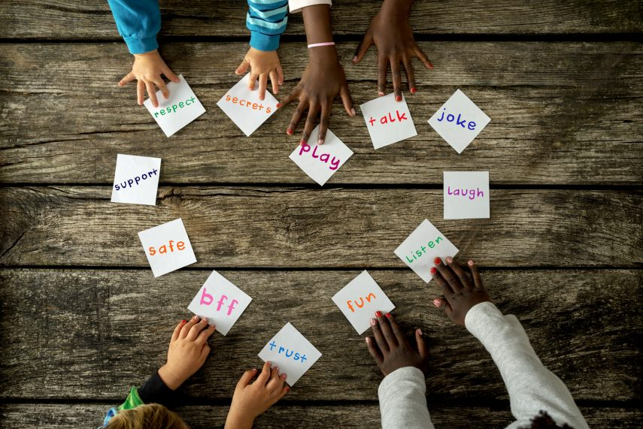
Collective worship
The value of Friendship
“A friend loves at all times” Proverbs 17:17
Worship 2

Slide 2



We think of God’s son, Jesus who loves us.
We think of God the Father who teaches us through his word.
We think of God, the Holy spirit, who guides us.

Slide 3

What did Jesus say?
God wants us to understand that when we say sorry there can be forgiveness, understanding and a stronger friendship.
When we love and forgive we are following God’s wishes.

Slide 4
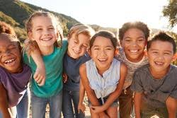
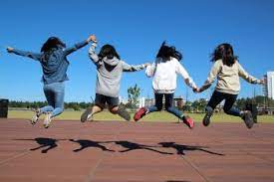
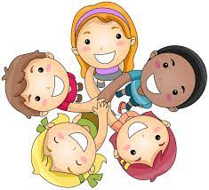
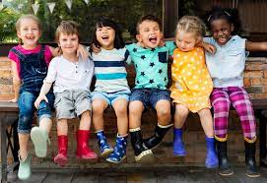
Have YOU ever had an argument with your friend or let them down?
In the story of Simon Peter, who was a disciple we see how he let his friend Jesus down.
This was a surprise to all the disciples because Jesus called Simon Peter his “rock”.

Slide 5
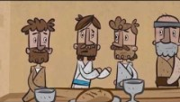

Slide 6

Reflection
If someone lets you down how can you show they are forgiven?

Slide 7

Prayer:
Dear God,
Thank you for our friends. Sometimes we know we will let people down but when that happens, help us to know how to make it right again. Guide us in your light forever and always.
Amen.

Slide 8
Collective worship
The value of Friendship
“A friend loves at all times” Proverbs 17:17
Worship 2
class worship

Slide 9
We think of God’s son, Jesus who loves us.
We think of God the Father who teaches us through his word.
We think of God, the Holy spirit, who guides us.

Slide 10
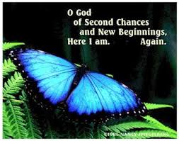
Reflection
Why would you give a friend a second chance?

Slide 11
This is a teaspoon prayer: it includes a Thank you , Sorry and Please (tsp)
Please bow your heads and put your hands together, or sit quietly to reflect
Prayer:
Dear God,
Thank you for being the light of the world, Sorry for the times we have not been as good a friend as we should have. Please help us to shine as lights and be supportive to our friends in good times and bad. Guide us in your light forever and always.
Amen.

Slide 12
Collective worship
The value of Friendship
“A friend loves at all times” Proverbs 17:17
Worship 2 Praise worship

Slide 13

The Lord is my shepherd

Slide 14
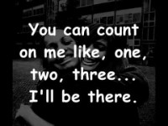
I’ll be there…

Slide 15

Especially for key stage 1

Slide 16

Children’s choice

Slide 17


Slide 18
Collective worship
The value of Friendship
“A friend loves at all times” Proverbs 17:17
Worship 2
Worship passports

Slide 19

Reflection
How can YOU feed the sheep?
How can you be a good friend?

Slide 21
Celebration Collective worship
The value of Friendship
“A friend loves at all times” Proverbs 17:17
Worship 2
Celebration Worship

Slide 22

Birthdays….Happy Birthday to YOU.

Slide 23

Personal Development Awards

Slide 24

Head Teacher Awards
Achievement for all

Slide 25
I’ll be there…

Slide 26

Reminders:

Slide 27

Ethos Group
Prayer to share on friendship and love.

Slide 28


Reverend Jan
Blessing to all

