Slide 1
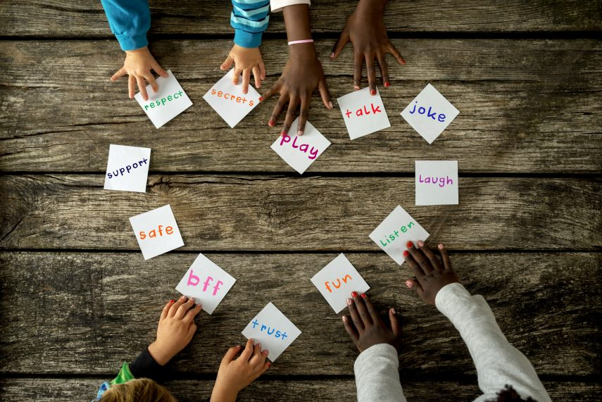
Collective worship
The value of Friendship
“A friend loves at all times” Proverbs 17:17
Worship 5

Slide 2



We think of God’s son, Jesus who loves us.
We think of God the Father who teaches us through his word.
We think of God, the Holy spirit, who guides us.

Slide 3

What did Jesus want?
Jesus wants us to know the greater value of friendship over the value of material possessions.
When we love and forgive we are following God’s wishes.

Slide 4

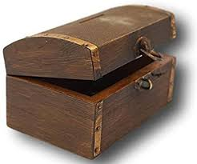
What is in the treasure chest?

Slide 5
YES the treasure was a mirror and in the reflection was YOU.
How can people be a
treasure?

Slide 6

A friend for little bear by Harry Horse

Slide 7

Reflection
What do you think Little Bear really needed?
Sometimes it feels like we should have the latest toy, phone or clothes to wear BUT friendship and companioship is ultimately more important to be happy.

Slide 8
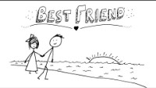
Listen and reflect…

Slide 9

Prayer:
Dear God,
Thank you for our friends and those that bring us happiness. Help us to show them how much we think and value them.
Guide us in your light forever and always.
Amen.

Slide 10
Collective worship
The value of Friendship
“A friend loves at all times” Proverbs 17:17
Worship 5
class worship

Slide 11
We think of God’s son, Jesus who loves us.
We think of God the Father who teaches us through his word.
We think of God, the Holy spirit, who guides us.

Slide 12

Reflection
Does this happiness really come from a drink?
Use a postit to record things that REALLY make you happy rather than material possessions.

Slide 13
This is a teaspoon prayer: it includes a Thank you , Sorry and Please (tsp)
Please bow your heads and put your hands together, or sit quietly to reflect
Prayer:
Dear God,
Thank you for being the light of the world, Sorry for the times we have not been as good a friend as we should have. Please help us to shine as lights and be supportive to our friends. Guide us in your light forever and always.
Amen.

Slide 14
Collective worship
The value of Friendship
“A friend loves at all times” Proverbs 17:17
Worship 5 Praise worship

Slide 15
My best friend…

Slide 16
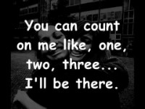
I’ll be there…

Slide 17

Especially for key stage 1

Slide 18

Children’s choice

Slide 19


Slide 20
Collective worship
The value of Friendship
“A friend loves at all times” Proverbs 17:17
Worship 5
Worship passports

Slide 21
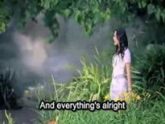
Reflection
Do you know that God is always your friend?
“A friend loves at all times” Proverbs 17:17
Listen and reflect…
How can a friend be like a gift?

Slide 23
Celebration Collective worship
The value of Friendship
“A friend loves at all times” Proverbs 17:17
Worship 4
Celebration Worship

Slide 24

Birthdays….Happy Birthday to YOU.

Slide 25

Personal Development Awards

Slide 26

Head Teacher Awards
Achievement for all

Slide 27
My best friend…

Slide 28


Prayer to share

Slide 29

Reminders:

Slide 30


Reverend Jan
Blessing to all

