Slide 1
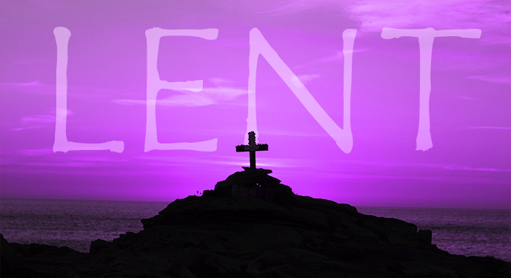
Collective worship
The value of Forgiveness
Forgive and you will be forgiven... Luke 6:37
Worship 5 Lent and Easter

Slide 2



We think of God’s son, Jesus who loves us.
We think of God the Father who teaches us through his word.
We think of God, the Holy spirit, who guides us.

Slide 3
What is Lent?
Lent is a season of forty days beginning with Ash Wednesday and ending on Holy Saturday.
The period of 40 days reflects the 40 days that Jesus spent fasting in the wilderness
The colour for Lent is purple

Slide 4

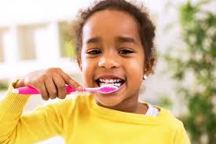
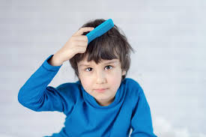
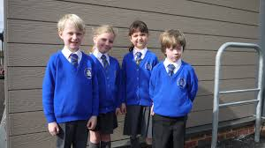
What did you do before coming to school this morning?
Today we are thinking about Lent. Lent is when Christians remember a time of preparation that Jesus went through.
A lot of preparation ready to get to school… You are PREPARING for school.

Slide 5
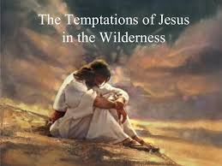
For 30 years Jesus had lived at home in Nazareth. At the age of 30, he knew that he was about to start his public work. He was about to start teaching people about God and doing many amazing miracles. He knew it would not be easy and that eventually it would lead to his death.
In preparation for this work, Jesus went off on his own into the desert for 40 days. For 40 days and nights he didn’t eat or drink anything and during this time he was tempted to do a number of things that he knew it was wrong to do.

Slide 6

Jesus didn’t give in to the temptations and didn’t do anything wrong. At the end of 40 days he left the desert and began the work he had come to earth to do. His time in the desert had prepared him for this work

Slide 7
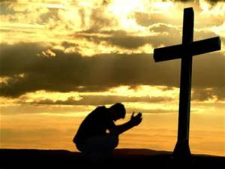
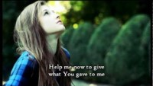
Song: Forgiveness
.

Slide 8
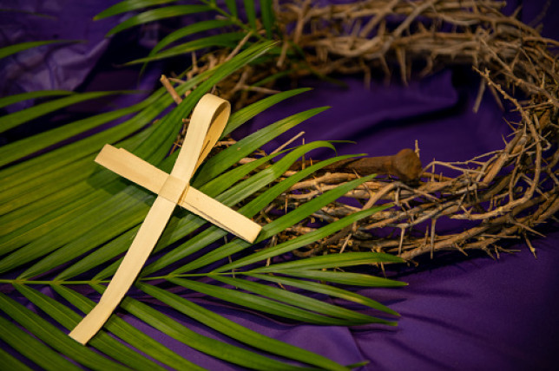
Lent is the period of time that leads up to Easter; it begins on Ash Wednesday (the day after Shrove Tuesday – Pancake day).
For Christians, Easter is the most important time of the year as it is then that they remember the death and resurrection of Jesus. Because Christians want to ‘be prepared’ for the celebration of Easter ,they use Lent as a time to think more about God, go to special church services and pray.

Slide 9
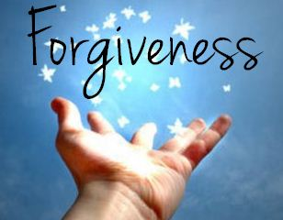
Prayer:
Dear Lord,
Help us to be ready to show forgiveness, as YOU are ready to forgive us.
Guide us in your light forever and always.
Amen.

Slide 10
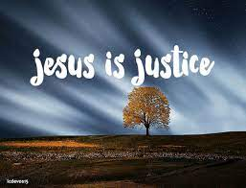
Collective worship
The value of Justice
“Hold fast to love and justice Hosea 12:6
Worship 5: Tuesday
Class worship

Slide 11
We think of God’s son, Jesus who loves us.
We think of God the Father who teaches us through his word.
We think of God, the Holy spirit, who guides us.

Slide 12
Time for reflection
In recent years there has been a move towards doing something good during Lent instead of giving something up. Examples would be tidying your room; saying something encouraging to someone every day; making your bed; doing homework without complaining!
Can you think of something special that you could do during Lent that would help someone else?
Experts tell us that if you do something for 40 days it will become a habit that you do automatically without thinking about it! Wouldn’t it be good if Lent helped you carry on doing something positive for the rest of the year!
.

Slide 13
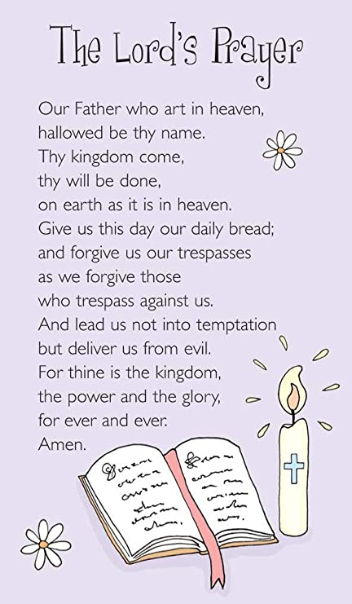
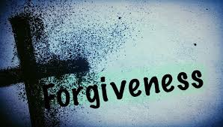

Slide 14
Collective worship
The value of Justice
“Hold fast to love and justice Hosea 12:6
Worship 4: Wednesday
Praise worship

Slide 15
We think of God’s son, Jesus who loves us.
We think of God the Father who teaches us through his word.
We think of God, the Holy spirit, who guides us.

Slide 16
.

Slide 17

Song : We have a king that rides a donkey

Slide 18
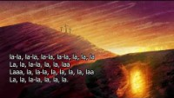

Slide 19

Children’s choice

Slide 20

Collective worship
The value of Forgiveness
Forgive and you will be forgiven... Luke 6:37
Worship 5- Thursday Class worship

Slide 21
We think of God’s son, Jesus who loves us.
We think of God the Father who teaches us through his word.
We think of God, the Holy spirit, who guides us.

Slide 22
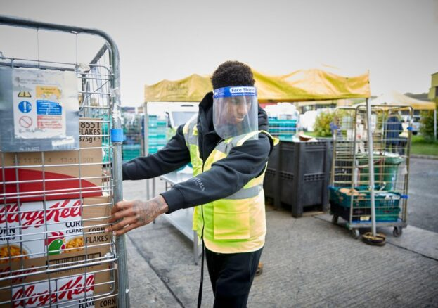
Marcus Rashford, footballer, campaigner, and bestselling author and just a kid from South Manchester
Not prepared to see kids go hungry and miss free school meals, using his celebrity clout, he single-handedly
called on ministers to offer a guaranteed “meal a day” to all school pupils in England in financially struggling families.
We are proud of you and how you are helping our society .
How is Marcus showing British values?

Slide 23



Slide 24
Collective worship
The value of Justice
“Hold fast to love and justice Hosea 12:6
Worship 5: Friday
Celebration worship

Slide 25
We think of God’s son, Jesus who loves us.
We think of God the Father who teaches us through his word.
We think of God, the Holy spirit, who guides us.

Slide 26

Birthdays….Happy Birthday to YOU.

Slide 27

Head Teacher Awards
Achievement for all

Slide 28

Personal Development Awards
Helping children prepare for life, growing with God.

Slide 29
.

Slide 30

Ethos Group group
Prayer to share

Slide 31

Reminders:

Slide 32


Reverend Jan
Blessing to all

