Slide 1
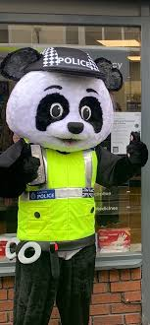


Whilst You Are At Home
We are going to stay in touch
Edition 12
30th June 2020
PC PANDA

Slide 2
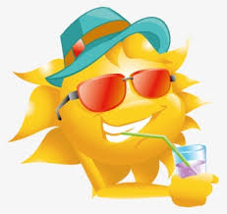
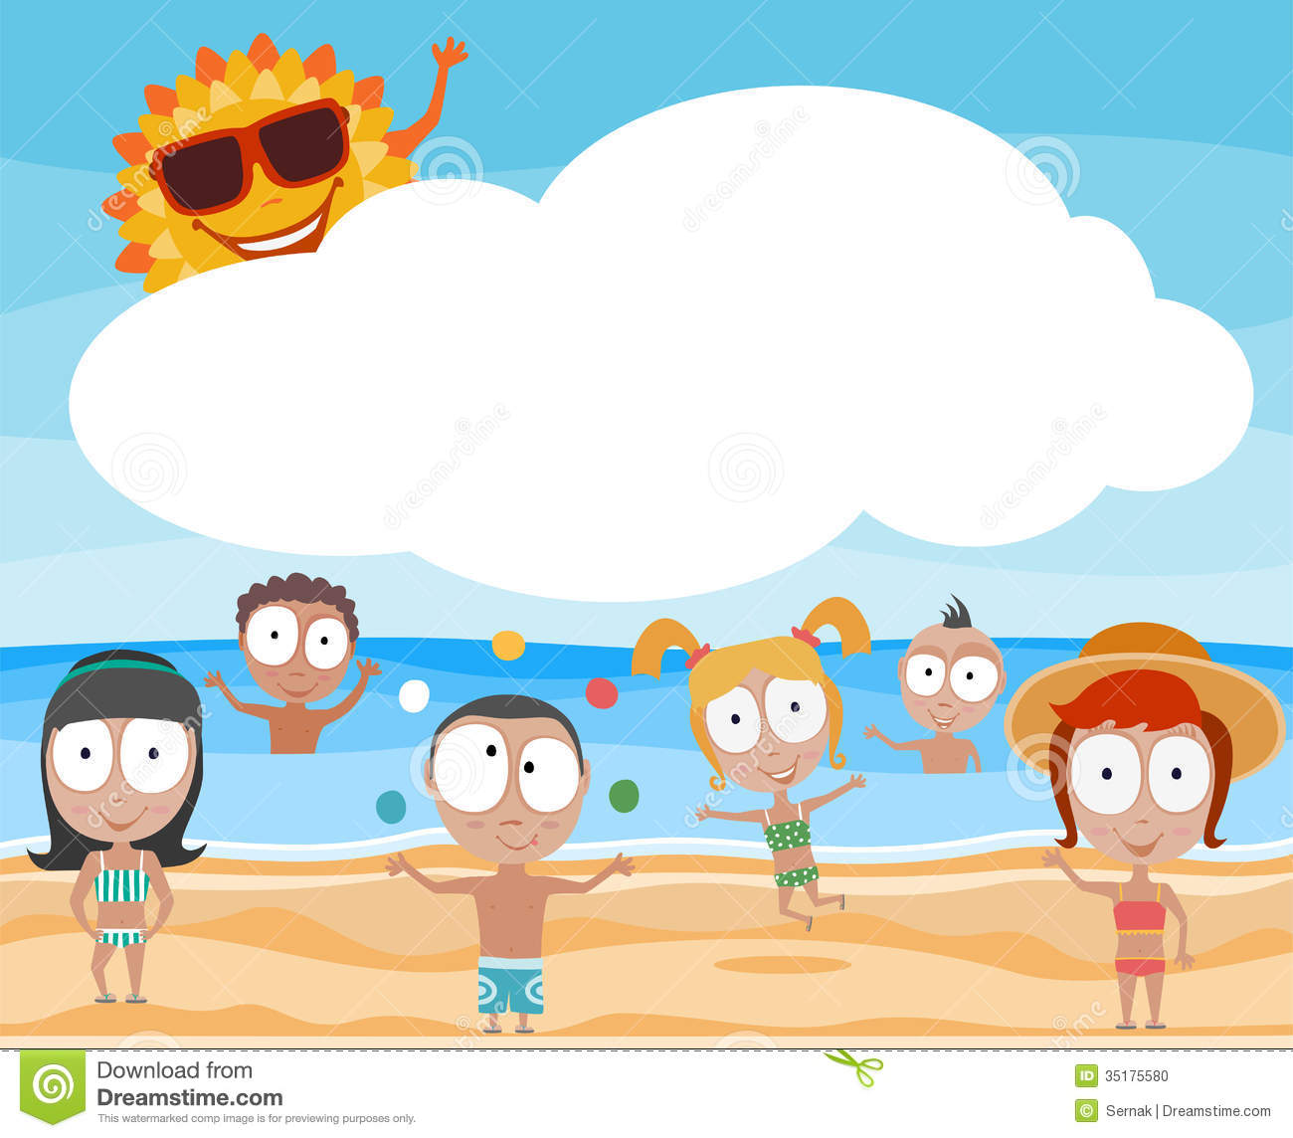
Positive messages of the week
Hello Everybody
The sunshine has returned, hopefully you will be able to get out to play & enjoy it,
The Prime Minister has now announced the Playgrounds will be opening as of the 4th of July.
And so with this we need you to think about being responsible while out and about.
Pc Panda wants you all to play your part in keeping safe!
We hope you have a great active and creative week.

Slide 3

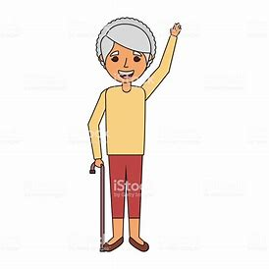
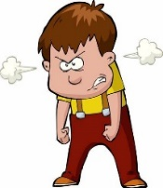
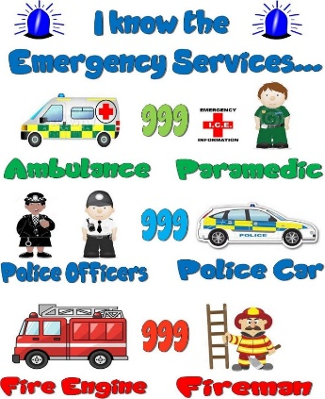
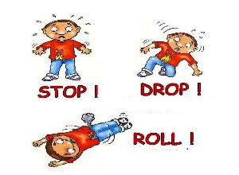


Personal Messages From Your Local PCSO
PCSO Di Wiggins said.
"Please don’t talk to strangers Online!”
PCSO Karen Nixon says know your emergency services!
PCSO Ange:
Says always know your fire safety
PCSO Watson said always use the
PCSO Jim Newns, Wants you to “Always wear a helmet
when on your bike”

Slide 4

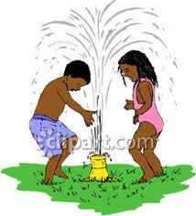
SAFETY AROUND WATER
And some things you need to think about when playing near water
Only swim when you are with an adult
On a very hot day, a body of water will be extremely cold & you could suffer “Cold Water Shock”
When you need ‘HELP’ shout as loud as you can
It only takes a small amount of water to drown
Places like canals can hide many dangerous items, like shopping trollies that you could get your legs trapped in.
Send for help to rescue a pet if it falls into water, never go in yourself

Slide 5
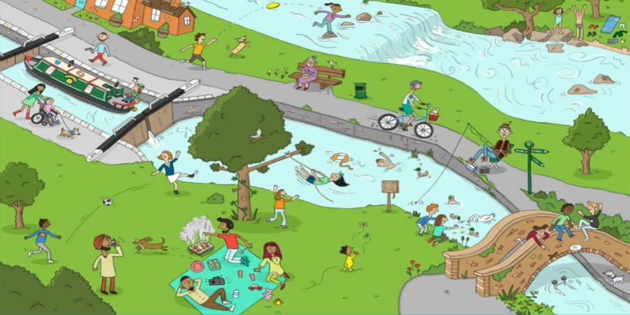
WATER SAFETY ACTIVITY
Have a look at the picture and see how many hazards you can find?
Have a look at the picture and see how many hazards you can find?

Slide 6
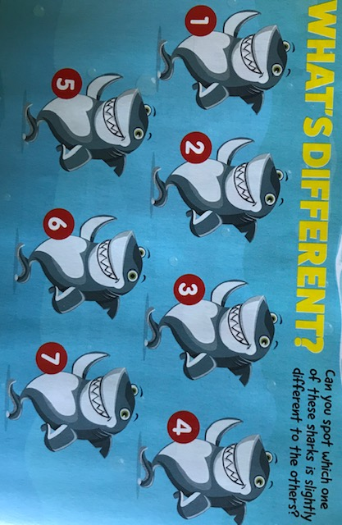
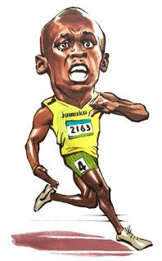
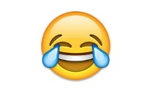
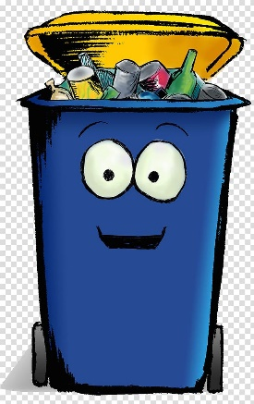



ACTIVITY & JOKES
What do Olympic sprinters eat before a race?
Nothing. They fast!
How do you learn to collect rubbish
The eye is in the detail
You pick it up as you go along!

Slide 7
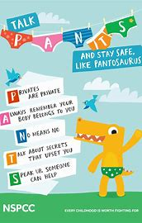
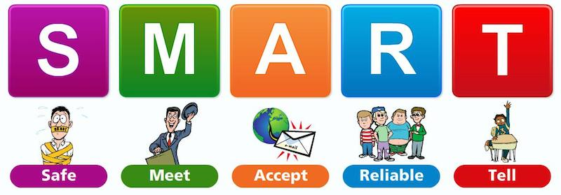
INTERNET SAFETY
PC Panda says ‘Staying safe online is very important’
PRIVATES ARE PRIVATE
ALWAYS REMEMBER YOUR BODY BELONGS TO YOU
No Means NO
TALK ABOUT SECRETS THAT UPSET YOU
SPEAK UP. SOMEONE CAN HELP
PANTOSAURUS HELPING US TO STAY SAFE, WHEN ONLINE & IN THE REAL WORLD

Slide 8

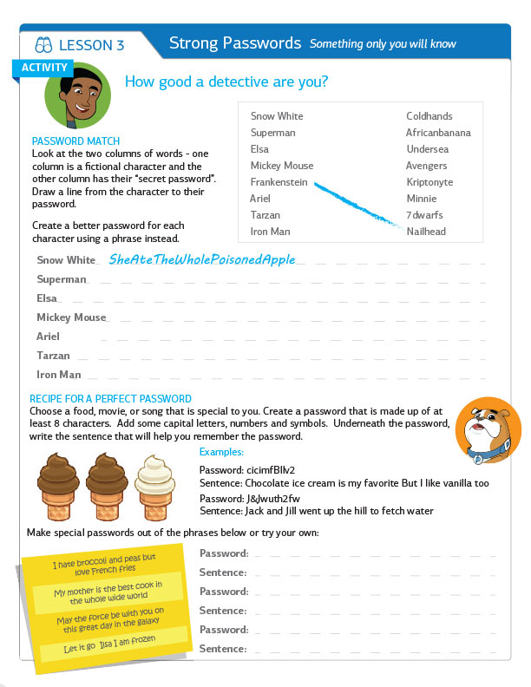
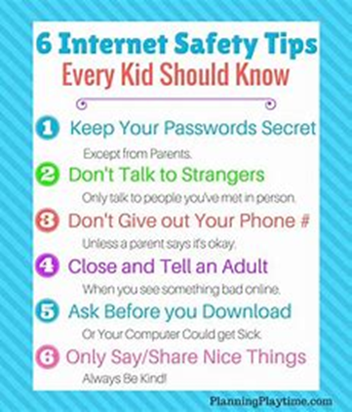
Choosing a Password
Choosing a strong password is very important in keeping yourself safe.
Here is a little help in creating a good strong password.
Remember:
Don’t share your passwords with your friends
Change your password regularly

Slide 9
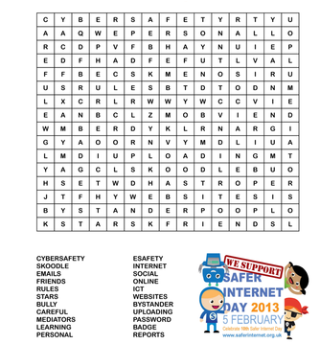


Internet Safety Activity
Find the words given in the puzzle. If you are not sure which each word means, ask your teacher of parent?

Slide 10
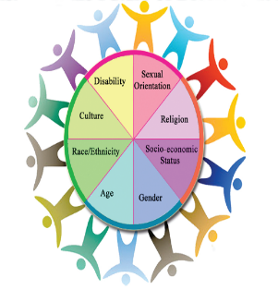



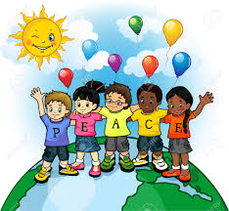
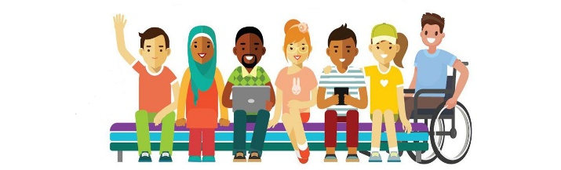

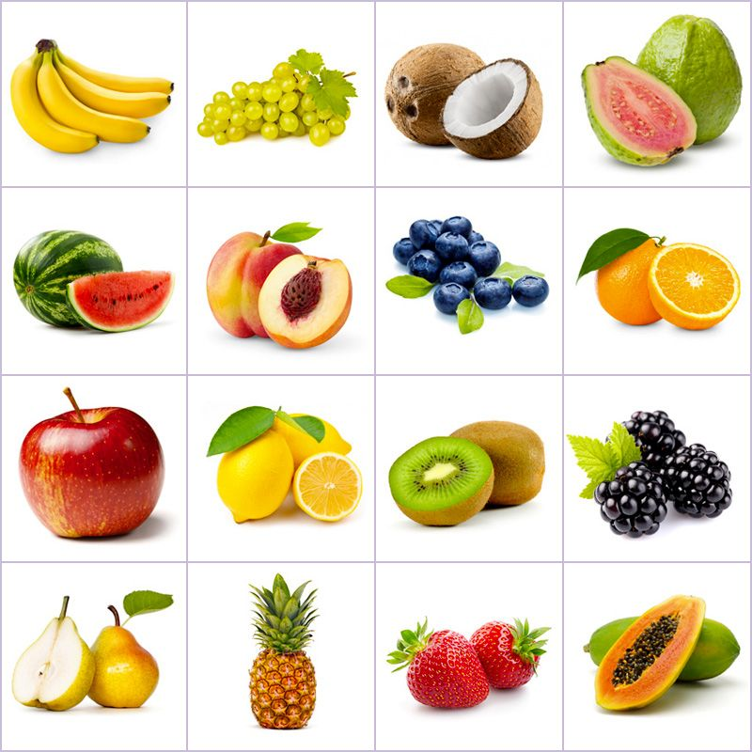
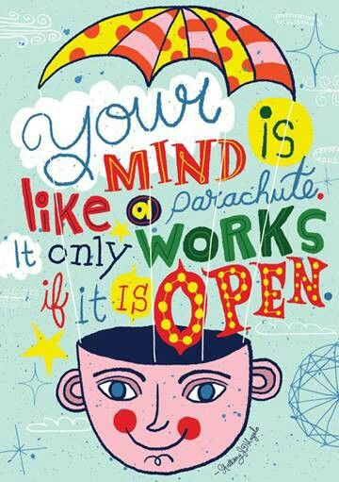

LOOKING AT DIVERSITY
The beauty of the world lays in the diversity of its people.
Could you create your own diversity poster for your home or school.
See if you can name the Fruit and the Country it may have grown in.
Every Child is a different flower. Altogether they make this world a beautiful garden!

Slide 11
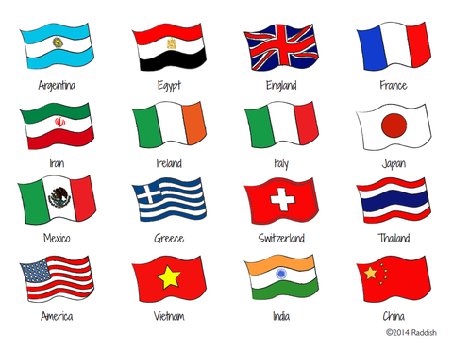


Great Britain is a Wonderfully Diverse Country
LOOKING AT DIVERSITY
Here are some religious symbols from around the world, see if you can find out which countries some of the religions are practiced.
China
Thailand
Japan
France
India
Vietnam
America
Switzerland
Italy
Ireland
Egypt
England
Iran
Mexico
Argentina
Greece
See if you can match the flags with the Country.

Slide 12







If it is your Birthday this week
Happy Birthday
Happy Birthday to you, Happy Birthday to you, Happy Birthday Special person Happy Birthday toooo yoooou

Slide 13

Until next Time 7th July 2020
Keep washing your hands and carry on with your exercise.
Stay healthy, by doing a bit of exercise every day.
Keep positive, by reminding yourself, You are an Amazing Child.
Do Your Bit for Great Britain and the NHS
Childline | Childline
https://www.childline.org.uk
Get help and advice about a wide range of issues, call us on 0800 1111, talk to a counsellor online, send Childline an email or post on the message boards
NSPCC Helpline
0808 800 5000

