Slide 1

Collective worship
The value of Peace
“A heart at peace gives life to the body” Proverbs 14:30
Worship 1

Slide 2



We think of God’s son, Jesus who loves us.
We think of God the Father who teaches us through his word.
We think of God, the Holy spirit, who guides us.

Slide 3
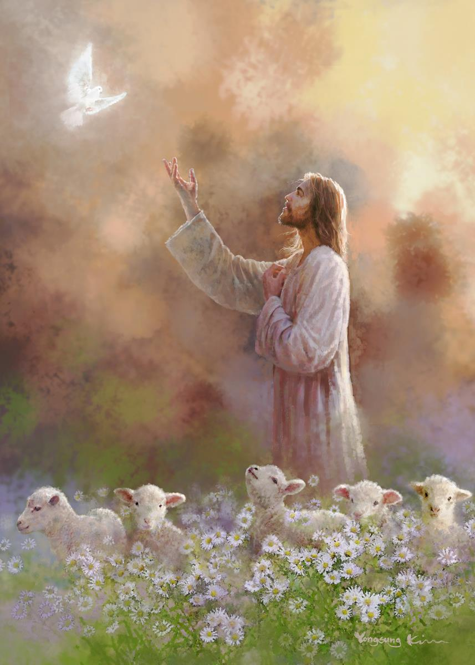
What do Christians believe?
Peace is creating space for stillness.
Peace making actions can range from helping to resolve conflict to creating stillness for peace.
God’s intention for peace is for the whole of creation is the promise for total well-being.

Slide 4
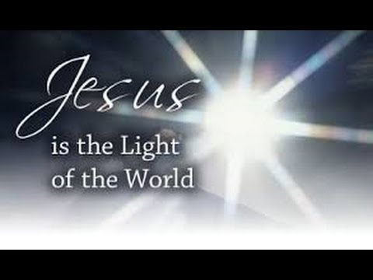
What did Jesus say?
Jesus said “Blessed are the peacemakers, for they shall be called the children of God” (Matthew :5:9)
Why do you think he said this?
When we help and are peace makers we are following God’s wishes.

Slide 5
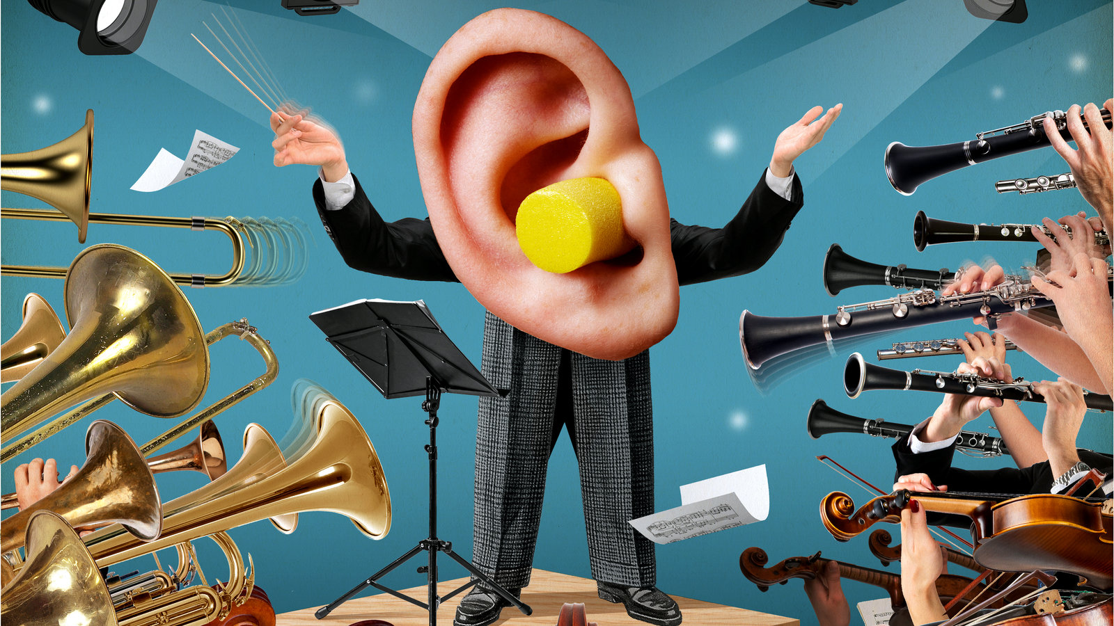
What can Peace mean to YOU?
Imagine if all the musical instruments played at the same time…..IT would be noisy!!!

Slide 6
When do we like to make a lot of noise?
Celebrations….parties…Sports day…football matches…cheering.
When do you like to be quiet?
Peace is quiet but it is also feeling calm, not being anxious, not fighting or disagreeing.

Slide 7
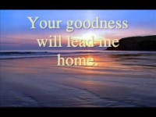
Reflection: Listen to the psalm of David –Psalm 23
It is important for all of us to have times of peace and quiet to help us all to think and reflect on things that are important to us.

Slide 8

This is a teaspoon prayer: it includes a Thank you , Sorry and Please (tsp)
Please bow your heads and put your hands together, or sit quietly to reflect
Prayer:
Dear God,
Thank you for being our strength and our guide, Sorry for the times we have not been a peace maker as you would like. Please help us to find our own place to be quiet and feel close to you.
Guide us in your light forever and always.
Amen.

Slide 9
Collective worship
The value of Peace
“A heart at peace gives life to the body” Proverbs 14:30
Class Worship 1

Slide 10
We think of God’s son, Jesus who loves us.
We think of God the Father who teaches us through his word.
We think of God, the Holy spirit, who guides us.

Slide 11

Reflection
Where can you find peace?
Use post its to record what YOU think.

Slide 12
Reflection: Listen to the psalm of David –Psalm 23
Psalms are also songs and prayers to listen to and reflect.

Slide 13
Collective worship
The value of Peace
“A heart at peace gives life to the body” Proverbs 14:30
Praise Worship 1

Slide 14
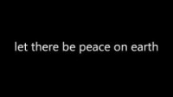

Slide 15

Song to reflect:

Slide 16
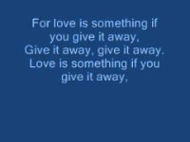
Especially for key stage 1

Slide 17


Slide 18

Children’s choice

Slide 19
Collective worship
The value of Peace
“A heart at peace gives life to the body” Proverbs 14:30
Class Worship 1
Thursday

Slide 20

Reflection
How can YOU be the voice of Peace?
Value Passport:
Class 1: Sing a song to make some one happy
Class 2: Find a song about peace and sing it together
Class 3: Learn how to sign “Peace be with you”
Class 4: Learn how to sign ”Peace be with you “ and share it in Celebration Worship.

Slide 22
Collective worship
The value of Peace
“A heart at peace gives life to the body” Proverbs 14:30
Celebration Worship 1

Slide 23
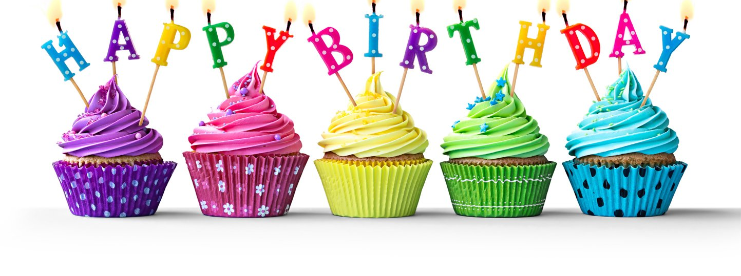
Birthdays….Happy Birthday to YOU.

Slide 24

Personal Development Awards
For the Lord gives wisdom: out of his mouth comes knowledge and understanding. Proverbs 2:6

Slide 25

Head Teacher Awards
Love never fails – 1 Corinthians 13.:8
Achievement for all

Slide 27

Class 4
Prayer to share

Slide 28

Reminders:

Slide 29


Reverend Jan
Blessing to all

