Slide 1
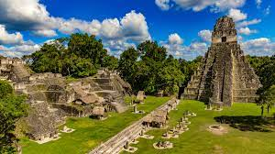
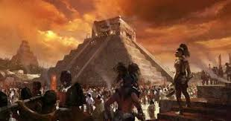
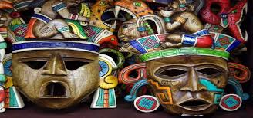
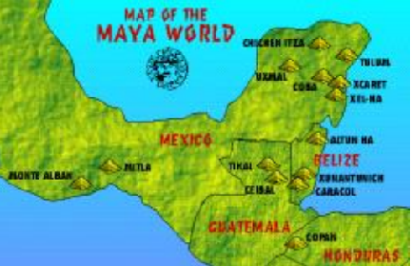
History Year 5/6 Big Idea
Main Learning: Civilisations – The Maya
Sticky knowledge
Know about the Maya and what they gave society
Know what was happening in Britain when the Maya were at their most powerful
Know how different the Mayan and the Egyptian pyramids were
Know how the Mayan belief in Gods created a culture of sacrifice
Understand how the pok-ta-pok Mayan game could be described as the earliest football match
Understand why the Mayan civilisation died out
Subject Specific Vocabulary
Chichen Itza | The most well-known Mayan pyramid
Itzamna | The main god of the Maya, Itzamna was the god of fire who created the Earth
codices | Books, made of soft bark and folded like a fan, created by the Maya
ahau or ahaw | The main king or lord of a Mayan city-state
batab | A lesser lord, usually ruling over a small town
Kukulcan | The serpent god of the Maya. One of the primary gods, especially to the Itza peoples of Chichen Itza
What did the Ancient Maya believe?
Religion was very important to the Ancient Maya, evidenced by their impressive temples. The Ancient Maya worshipped their kings like they were gods but they also worshipped their ancestors and a range of different gods and goddesses.
What was happening in 900 CE?
A wide range of civilizations were flourishing in 900 CE. The Maya in Central America, the Edo in West Africa and the Islamic Empire in Baghdad in Asia.
1

