Slide 1
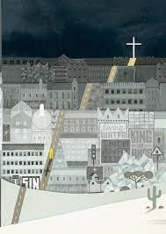
Collective worship
The value of Peace
“A heart at peace gives life to the body” Proverbs 14:30
Worship 6- the Big story - Panel 5

Slide 2



We think of God’s son, Jesus who loves us.
We think of God the Father who teaches us through his word.
We think of God, the Holy spirit, who guides us.

Slide 3
Incarnation
We have this frieze to tell us the “Big story” to help us remember the Bible and the word of God.
Can you see the nativity scene?

Slide 4
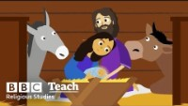
Watch from Luke 1-26 – the Christmas story…

Slide 5
Reflection:
What do you think the real gift that God gave the world was and why?

Slide 6
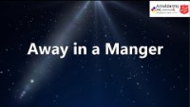

Slide 7

Dear God,
Thank you for the gift of your love in the birth of your son Jesus. Help us to love one another and show the light within us all. Guide us in your light forever and always.
Amen.

Slide 8

Collective worship
The value of Peace
“A heart at peace gives life to the body” Proverbs 14:30
Class Worship 6

Slide 9
We think of God’s son, Jesus who loves us.
We think of God the Father who teaches us through his word.
We think of God, the Holy spirit, who guides us.

Slide 10

Listen to the Christmas song silent night
As you listen… what does it make you think about God’s love for us all.
Record on a postit to share

Slide 11


Slide 12
Collective worship
The value of Peace
“A heart at peace gives life to the body” Proverbs 14:30
Praise Worship 6

Slide 14
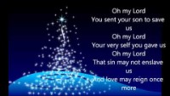

Slide 15
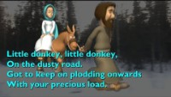
Especially for key stage 1

Slide 16

Children’s choice

Slide 18
Collective worship
The value of Peace
“A heart at peace gives life to the body” Proverbs 14:30
Class Worship 6
Thursday

Slide 19
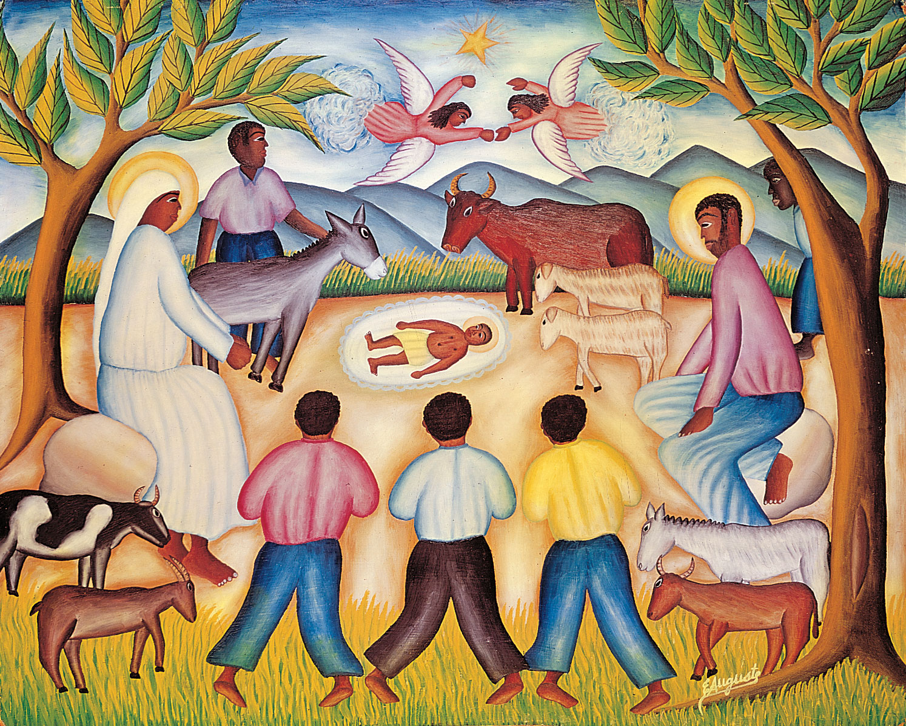
Reflection
How can YOU be the voice of Peace?
Value Passport:
Look at the image Can you create a nativity scene to reflect our times.
How would we greet the birth of Jesus today?

Slide 21
Collective worship
The value of Peace
“A heart at peace gives life to the body” Proverbs 14:30
Celebration Worship 6

Slide 22

Birthdays….Happy Birthday to YOU.

Slide 23

Personal Development Awards
For the Lord gives wisdom: out of his mouth comes knowledge and understanding. Proverbs 2:6

Slide 24

Head Teacher Awards
Love never fails – 1 Corinthians 13.:8
Achievement for all

Slide 25

Jesus the light of the world…
Laruen Daigle
Listen and reflect what do you feel when listening to this – record on postits

Slide 26

Ethos group
Prayer to share

Slide 27

Reminders:

Slide 28


Reverend Jan
Blessing to all

