Slide 1
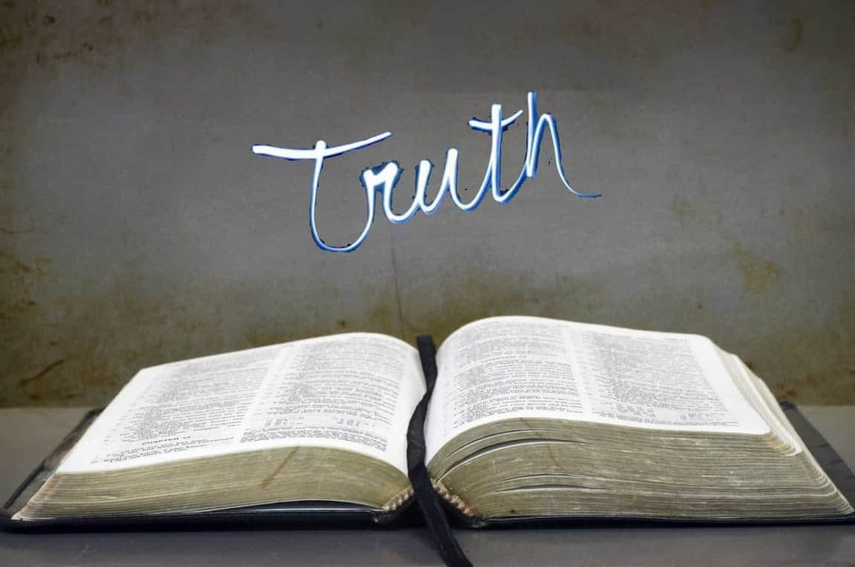
Collective worship
The value of Truthfulness
“The truth will set you free” John 8:32
Worship 5

Slide 2



We think of God’s son, Jesus who loves us.
We think of God the Father who teaches us through his word.
We think of God, the Holy spirit, who guides us.

Slide 3
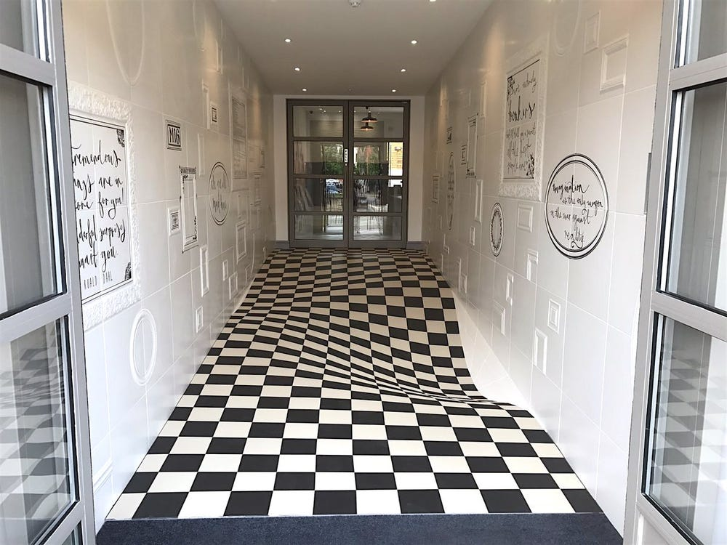
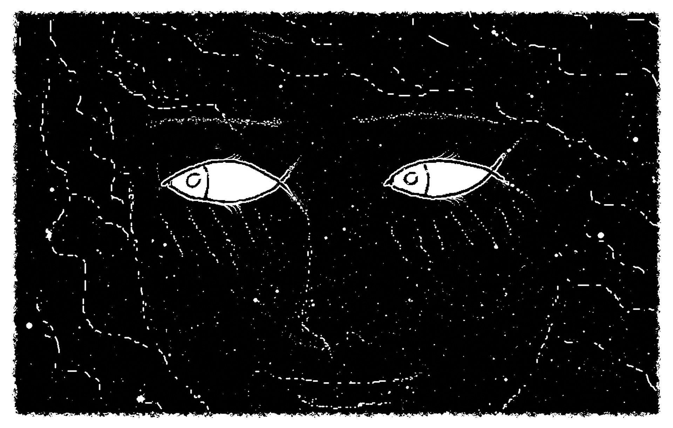

I can see it now…
Can you?

Slide 4
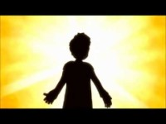
Seeing the truth
In this act of worship we will learn how Saul has a change of heart on the road to Damascus. His story will help us to know that we can admit to mistakes and live our lives in different ways.

Slide 5

Reflection:
Would YOU be able to admit when you have made a mistake?
Would you be able to see it now?

Slide 6
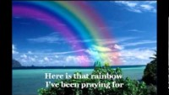
I can see clearly now the rain has gone.

Slide 7

Please bow your heads and put your hands together, or sit quietly to reflect.
Prayer:
Dear God,
Please help us to have courage to know when we don’t see the complete picture. Show us how we can see more clearly and admit our mistake. Help us see the truth.
Guide us in your light, now and forever.
Amen.

Slide 8
Collective worship
The value of Truthfulness
“The truth will set you free” John 8:32
Worship 5-Class worship

Slide 9
We think of God’s son, Jesus who loves us.
We think of God the Father who teaches us through his word.
We think of God, the Holy spirit, who guides us.

Slide 10
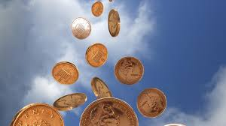
When the penny dropped for me…
Use a postit to recall a time when YOU have understood something for the first time.

Slide 11


Slide 12
Collective worship
The value of Truthfulness
“The truth will set you free” John 8:32
Worship 5-
Praise worship

Slide 13
I can see clearly now the rain has gone.

Slide 14
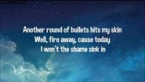
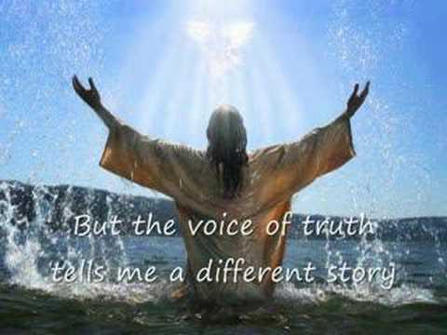
Song to reflect: This is me!

Slide 15
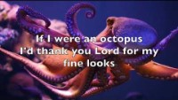
Especially for key stage 1
–The butterfly song

Slide 16

Children’s choice

Slide 18
Collective worship
The value of Truthfulness
“The truth will set you free” John 8:32
Worship 5-
Class worship Thursday

Slide 19
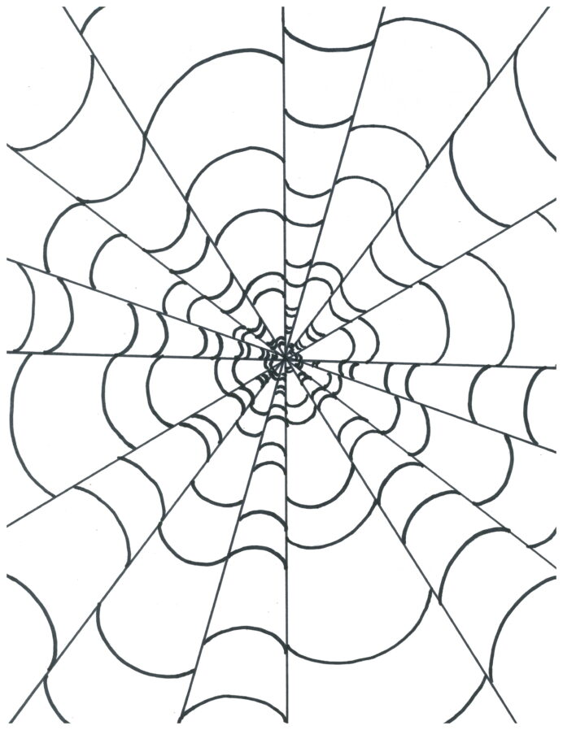
Reflection
Can you make something that makes you see something a different way?

Slide 21
Celebration Collective worship
The value of Truthfulness
“The truth will set you free” John 8:32
Worship -5
Celebration worship

Slide 22
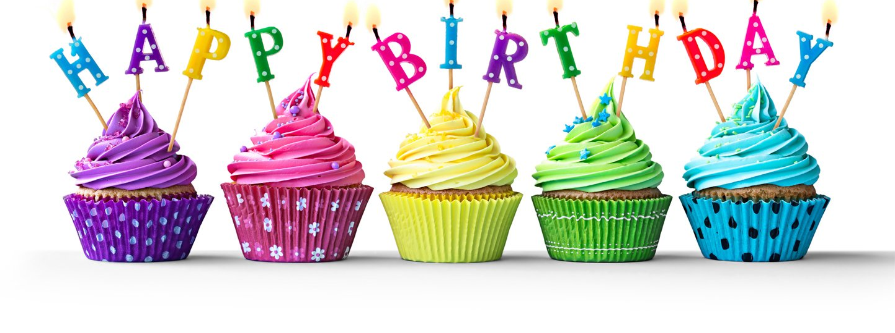
Birthdays….Happy Birthday to YOU.

Slide 23

Personal Development Awards

Slide 24
I can see clearly now the rain has gone.

Slide 25

Head Teacher Awards
Achievement for all

Slide 26

Reminders:

Slide 27


Reverend Jan
Blessing to all

