Slide 1
Whilst You Are At Home
We are going to stay in touch
5th May 2020

Slide 2
Positive Message of the Week
Hello everyone, So here we are again. Everyone at Cheshire Police hope you have all been able to stay positive even though we know it can be difficult for some, but we have come this far and we have confidence in ALL of YOU that we can hold it together.
We are all in this together around the World.
The Children of Cheshire are doing an AMAZING job at the moment by doing what our government is asking us to do by staying at home as much as possible, so that we keep ourselves and others safe and healthy, by washing ours hands, and by getting some exercise every day, a little or a lot. We are so very proud of YOU ALL.
We have said this before but it is important that you remember the changes going on at the moment, might make you feel scared or worried, it is ok to have these feelings. Please speak to the people in your home that care about you, let them know how you are feel.
We all need to remember this situation won’t last forever.
During this time of staying at home or isolation some children will be spending more time online than ever before. They may be tempted to join groups, share pictures or participate in live streaming, please Do Not, by Not joining some of these groups or live streaming we can keep you safe.

Slide 3
Police messages
Online safety
You are all smart children and we want you to remember the Online Safety messages you have talked about in School with your teachers and the Police. This week we would like you to tell your parents how you stay safe when you are using the internet.
We have put a reminder on the last page if you have forgotten any of them.
Parents
Set up rules for using the computer and the internet.
Never let your child give out personal information.
Check the Websites and services your children use.
Get to know your child’s online friends.
Keep the computer in a communal area of the house.
Check age ratings on games.
Twitter @CheshireSSYP

Slide 4
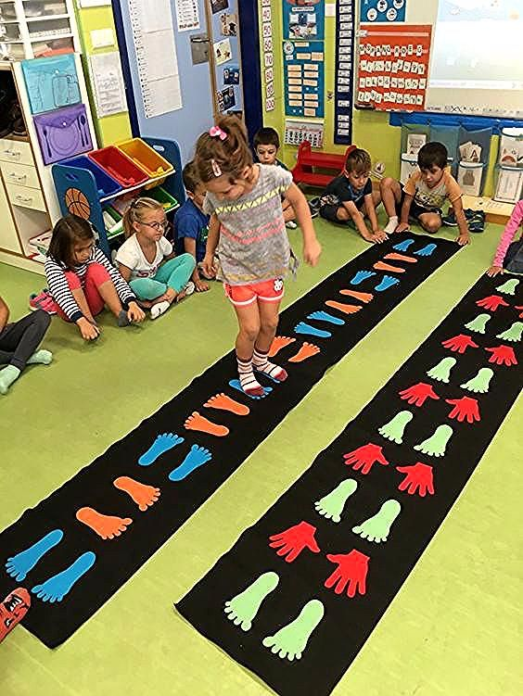
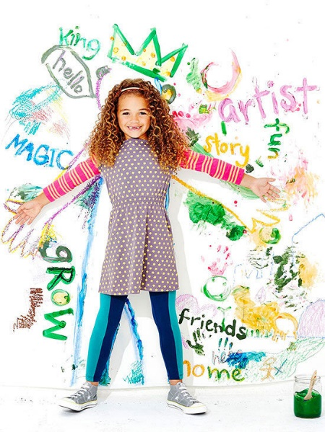
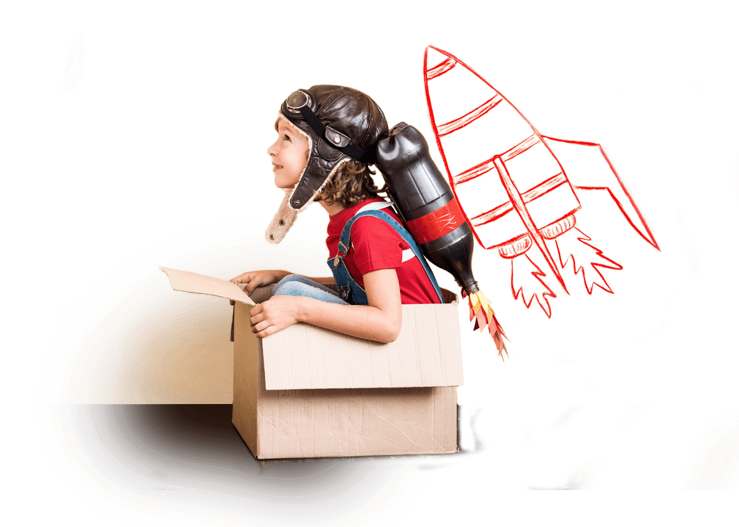
Riddle: What can’t be used until it’s broken?
Answer on slide 9, no peeking until you’ve had a go at this!
Joke
What do you call a pig that does Karate?
Slide 9 for punch line!
Activities
Who watched Britain’s Got Talent 2020, last week ?
We, really enjoyed listening to the Children’s choir singing an Anti-Bullying song. We know that our very own Cheshire Children could make up an equally Powerful song! Have a go….
Please share this song with your family and everyone you know, when we get back into School. We’d love to hear it.
Could you do this at home?
Riddle: What has two hands and a face?
Answer on slide 9, no peeking until you’ve had a go at this!

Slide 5
If it is your Birthday this week Happy Birthday
Happy Birthday to you, Happy Birthday to you, Happy Birthday Special person Happy Birthday toooo yoooou

Slide 6
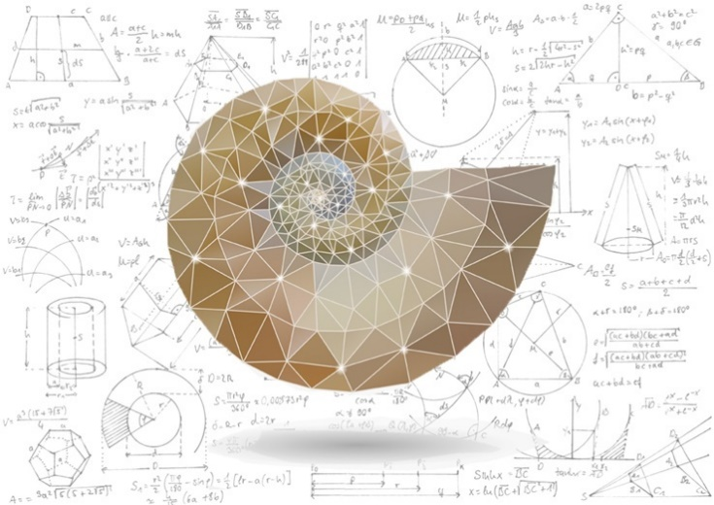
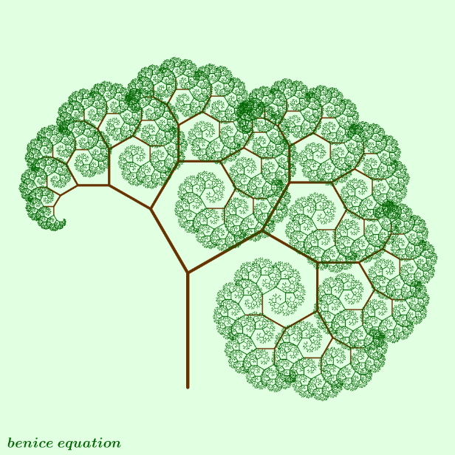
Answers to Riddles “Riddle: What can’t be used until it’s broken? Answer: An Egg. Riddle: What has two hands and a face? Answer: A clock.
Can anyone copy this!
What do you call a pig that does Karate?
Wa Wa Waaaaa
Have a go at this!

Slide 7
Until next Time
12th May 2020
Stay safe, by Washing your Hands and stay at home until it’s time for some exercise.
Stay healthy, by doing a bit of exercise every day.
Keep positive, by reminding yourself, You are an Amazing Child.
And remember we won’t be indoors forever
Childline | Childline
https://www.childline.org.uk
Get help and advice about a wide range of issues, call us on 0800 1111, talk to a counsellor online, send Childline an email or post on the message boards
https://www.o2.co.uk/help/nspcc/helpline

