Slide 1
Collective worship
The value of Peace
“A heart at peace gives life to the body” Proverbs 14:30
HEARTSMART
Class Worship 5

Slide 2
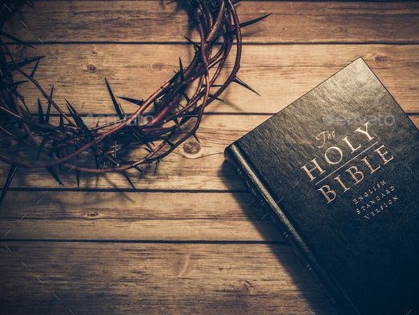
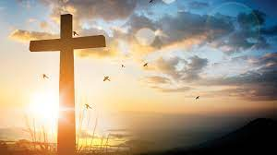
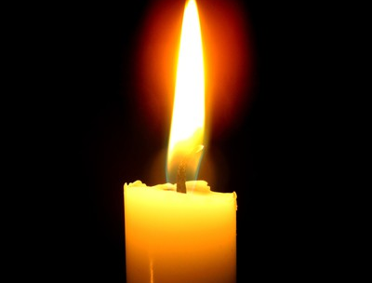
We think of God’s son, Jesus who loves us.
We think of God the Father who teaches us through his word.
We think of God, the Holy spirit, who guides us.

Slide 3
Jesus the light of the world…
Laruen Daigle
Listen and reflect what do you feel when listening to this – record on postits

Slide 4
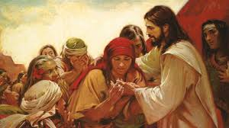

Slide 5
Collective worship
The value of Peace
“A heart at peace gives life to the body” Proverbs 14:30
Worship 5- the Big story - Panel 5

Slide 6
We think of God’s son, Jesus who loves us.
We think of God the Father who teaches us through his word.
We think of God, the Holy spirit, who guides us.

Slide 7
Incarnation
We have this frieze to tell us the “Big story” to help us remember the Bible and the word of God.
Can you see the nativity scene?

Slide 8
Watch from Luke 1 – the start of the christmas story…

Slide 9
Reflection:
Can you imagine how it must have felt to be given such a special job?
Can you see the sign saying:
King of Kings?

Slide 10
Jesus the light of the world…
Laruen Daigle
Listen and reflect

Slide 11
Dear God,
Thank you for the word of God that we have to guide us. Please help us to see our responsibilities and our path for peace. Guide us in your light forever and always.
Amen.

Slide 12
Collective worship
The value of Peace
“A heart at peace gives life to the body” Proverbs 14:30
Praise Worship 4

Slide 13
Jesus the light of the world…
Laruen Daigle
Listen and reflect what do you feel when listening to this – record on postits

Slide 15
Especially for key stage 1

Slide 16
Children’s choice

Slide 18
Collective worship
The value of Peace
“A heart at peace gives life to the body” Proverbs 14:30
Class Worship 5
Thursday

Slide 19
Reflection
How can YOU be the voice of Peace?
Value Passport:
Look at the image why do you think Mary may have been afraid?
Write on a postit to let us know your thoughts.

Slide 21
Collective worship
The value of Peace
“A heart at peace gives life to the body” Proverbs 14:30
Celebration Worship 5

Slide 22
Birthdays….Happy Birthday to YOU.

Slide 23
Personal Development Awards

Slide 24
Head Teacher Awards

Slide 25
Jesus the light of the world…
Laruen Daigle
Listen and reflect what do you feel when listening to this – record on postits

Slide 26
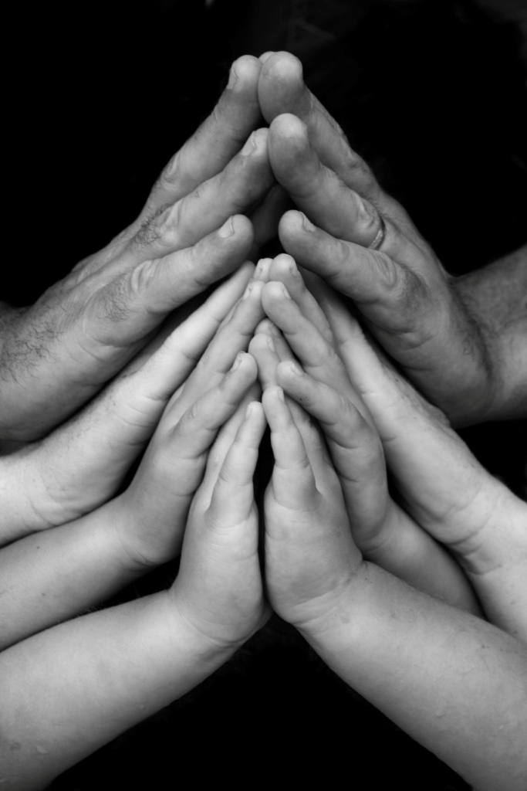
Ethos group
Prayer to share

Slide 27
Shining Stars

Slide 28
Reminders:

Slide 29
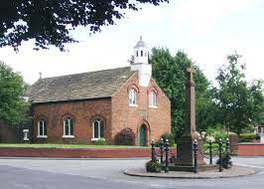
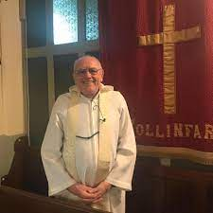
Blessing to all

