Slide 1
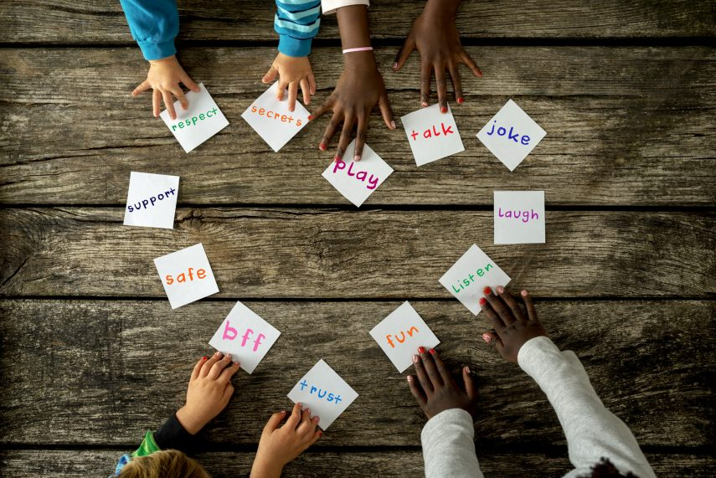
Collective worship
The value of Friendship
“A friend loves at all times” Proverbs 17:17
Worship 1

Slide 2



We think of God’s son, Jesus who loves us.
We think of God the Father who teaches us through his word.
We think of God, the Holy spirit, who guides us.

Slide 3
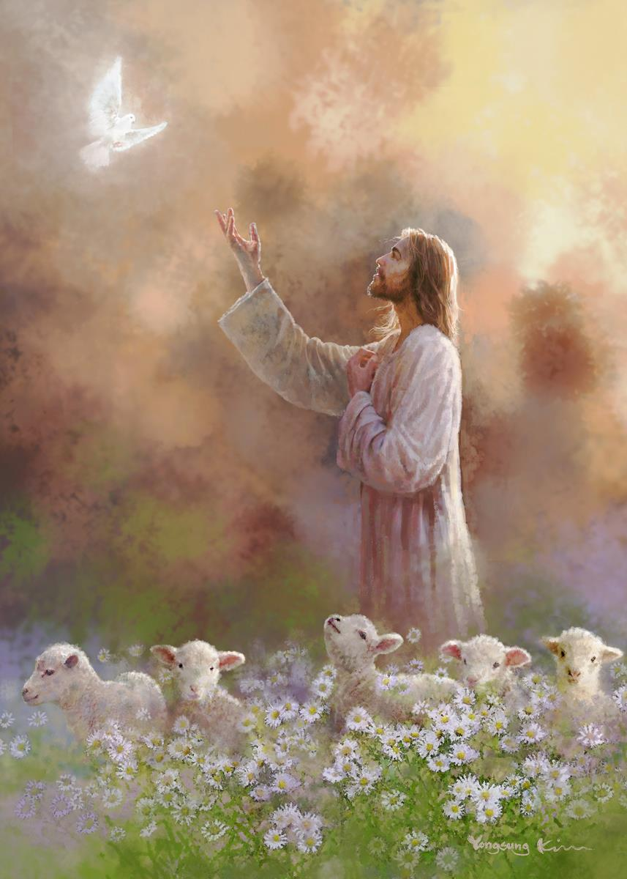
What do Christians believe?
Christians believe they can call God their friend because of the relationship mad possible through Jesus.
Friendship

Slide 4

What did Jesus say?
The most fundamental message of Jesus is that. “One who forgives an affront fosterswe must love and care for one another friendship, but one who dwells on disputes will alienate a friend.” The Message: Be kind and forgiving and you will have many devoted friends; hold grudges and you will lose them
When we love and forgive we are following God’s wishes.

Slide 5

The Lord is my shepherd

Slide 6
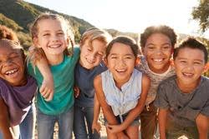
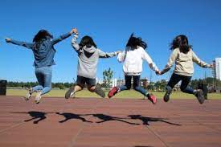
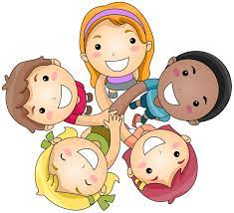
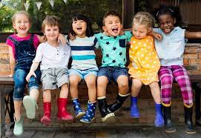
How do friends help and support us?
How can YOU support your friends in good and bad times?

Slide 7
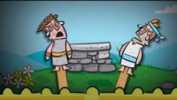
What sort of Friend do you think Jonathon was?

Slide 8

Reflection
How can YOU help each other when things go wrong?

Slide 9

Prayer:
Dear God,
Thank you for our friends . Help us to be good friends to others and to know how to help them when they need support.
Guide us in your light forever and always.
Amen.

Slide 10
Collective worship
The value of Friendship
“A friend loves at all times” Proverbs 17:17
Worship 1
class worship

Slide 11
We think of God’s son, Jesus who loves us.
We think of God the Father who teaches us through his word.
We think of God, the Holy spirit, who guides us.

Slide 12
Reflection
How can YOU be a good friend?
Use postits to make your own friendship heart

Slide 13
This is a teaspoon prayer: it includes a Thank you , Sorry and Please (tsp)
Please bow your heads and put your hands together, or sit quietly to reflect
Prayer:
Dear God,
Thank you for being the light of the world, Sorry for the times we have not been as good a friend as we should have. Please help us to shine as lights and be supportive to our friends in good times and bad. Guide us in your light forever and always.
Amen.

Slide 14
Collective worship
The value of Friendship
“A friend loves at all times” Proverbs 17:17
Worship 1 Praise worship

Slide 15
The Lord is my shepherd

Slide 16
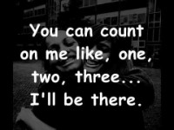
I’ll be there…

Slide 17

Especially for key stage 1

Slide 18

Children’s choice

Slide 19


Slide 20
Collective worship
The value of Friendship
“A friend loves at all times” Proverbs 17:17
Worship 1
Worship passports

Slide 21

Reflection
How can YOU show friendship?
Value Passport:
Class 1:
Draw a friend and put it on the wall.
Class 2:
Take a picture of a good friend
Class 3:
Write and share a prayer in class collective worship about love and friendship
Class 4:
Write a heart wordle of Friendship and put in value passport.

Slide 23
Celebration Collective worship
The value of Friendship
“A friend loves at all times” Proverbs 17:17
Worship 1
Celebration Worship

Slide 24

Birthdays….Happy Birthday to YOU.

Slide 25

Personal Development Awards

Slide 26

Head Teacher Awards
Achievement for all

Slide 27
I’ll be there…

Slide 28

Reminders:

Slide 29

Class 3
Prayer to share on friendship and love.

Slide 30


Reverend Jan
Blessing to all

