Slide 1

Collective worship
The value of Peace
“A heart at peace gives life to the body” Proverbs 14:30
Worship 2

Slide 2



We think of God’s son, Jesus who loves us.
We think of God the Father who teaches us through his word.
We think of God, the Holy spirit, who guides us.

Slide 3
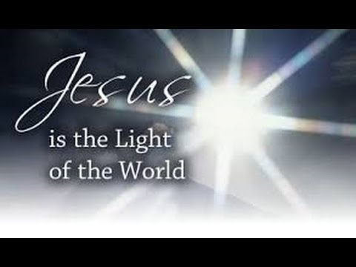
What did Jesus say?
Jesus said “Blessed are the peacemakers, for they shall be called the children of God” (Matthew :5:9)
Why do you think he said this?
When we help and are peace makers we are following God’s wishes.

Slide 4
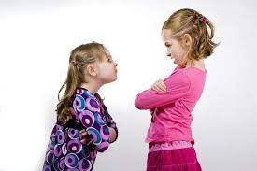
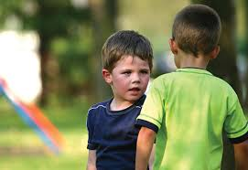
Can you think what may have happened between the children seen here?
What could have been the cause of the argument?
What might they be feeling inside?
How do you think the argument could be resolved?

Slide 5
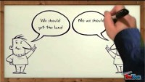
In the Bible it show us how we need to show Gods love to resolve conflict.
Reflection:
Can we learn from this story?

Slide 6

Dear God,
Help and guide us in our friendships. Help us to be peacemakers when we disagree.
Guide us in your light forever and always.
Amen.

Slide 7
Collective worship
The value of Peace
“A heart at peace gives life to the body” Proverbs 14:30
Class Worship 2

Slide 8
We think of God’s son, Jesus who loves us.
We think of God the Father who teaches us through his word.
We think of God, the Holy spirit, who guides us.

Slide 9

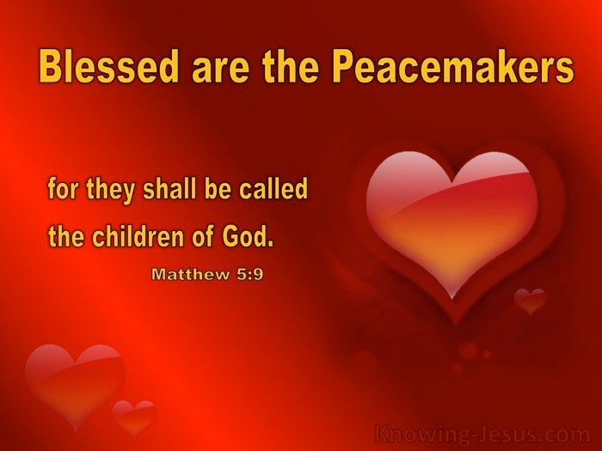
Reflection
What are the ways YOU can be a peacemaker?
Use postits to record what YOU think.

Slide 10
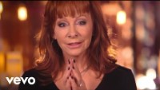
Reflection:
Can you pray for peace?
.

Slide 11
Collective worship
The value of Peace
“A heart at peace gives life to the body” Proverbs 14:30
Praise Worship 1

Slide 12
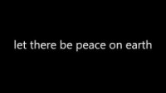

Slide 13

Song to reflect:

Slide 14

Especially for key stage 1

Slide 15


Slide 16

Children’s choice

Slide 17

Collective worship at all saints church
Laying of the wreath
Flanders field
A wish for peace

Slide 18
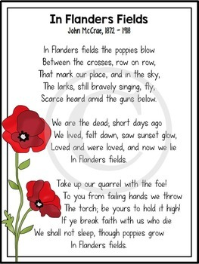
Collective worship at all saints church
Laying of the wreath
Flanders field
A wish for peace
Prayers
Blessing

Slide 19
Collective worship
The value of Peace
“A heart at peace gives life to the body” Proverbs 14:30
Celebration Worship 2

Slide 20

Birthdays….Happy Birthday to YOU.

Slide 21

Personal Development Awards
For the Lord gives wisdom: out of his mouth comes knowledge and understanding. Proverbs 2:6

Slide 22

Head Teacher Awards
Love never fails – 1 Corinthians 13.:8
Achievement for all

Slide 23
Song to reflect:

Slide 24

Class 4
Prayer to share

Slide 25

Reminders:

Slide 26


Reverend Jan
Blessing to all

