Slide 1
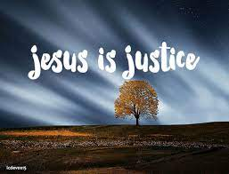
Collective worship
The value of Justice
“Hold fast to love and justice Hosea 12:6
Worship 2:

Slide 2



We think of God’s son, Jesus who loves us.
We think of God the Father who teaches us through his word.
We think of God, the Holy spirit, who guides us.

Slide 3
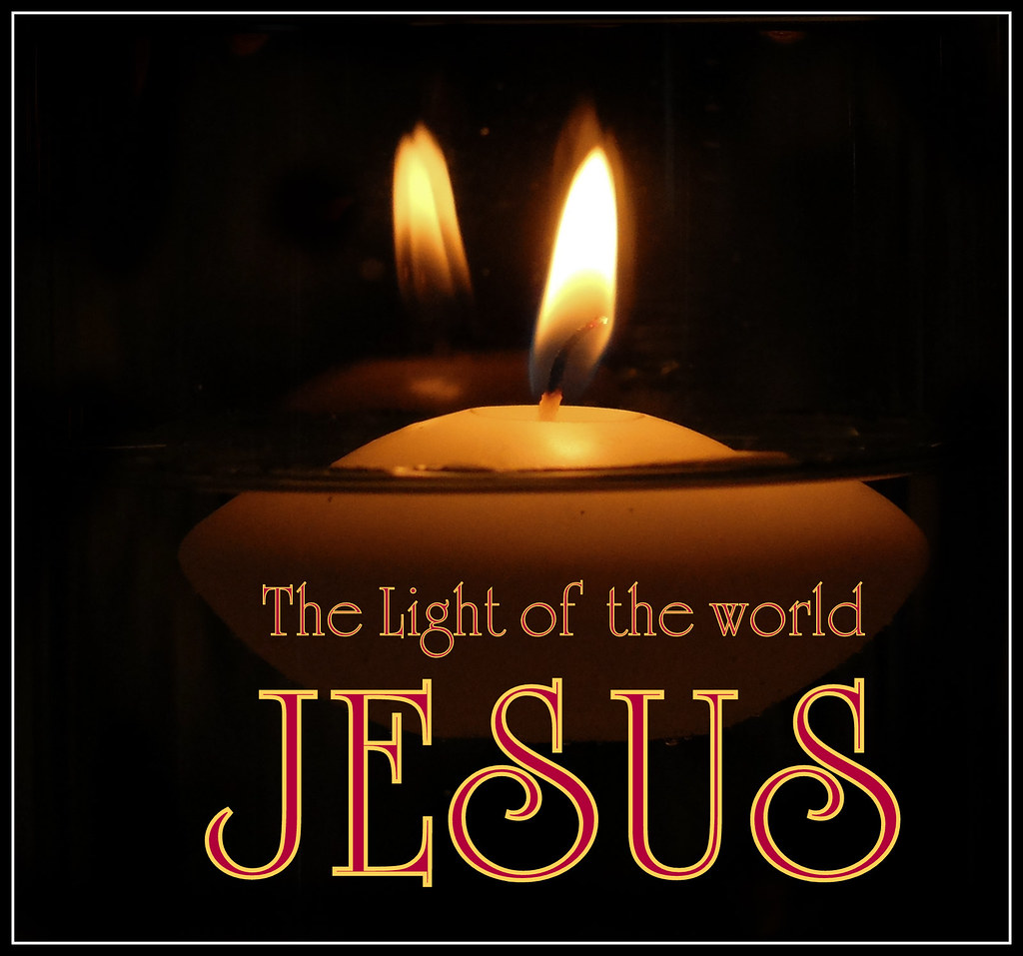
What did Jesus say?
Jesus gave the message that we should
“love others as we do ourselves”
and
“Learn to do good; seek justice, correct oppression; bring justice to the fatherless, and plead the widow's cause,” (Isaiah 1:17).
When we love and seek justice we are following God’s wishes.

Slide 4



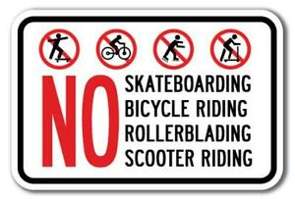

What purpose do you think the rules have?

Slide 5
No bike riding!
No using your car or bus!
Shop only between 3pm and 5pm
NO WALKING in the streets between 8am and 6pm
NO going to the cinema or theatre
No going to swimming pool, tennis courts or athletics fields.
NO SITTING in your garden after 8pm
What purpose do you think the rules have?
These rules were rules for the Jewish people from the NAZI Germany government during the second world war.
How would you feel if you had to follow these rules?

Slide 6
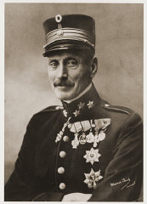
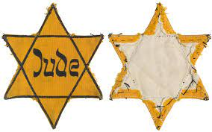
The Yellow star:
When the Nazi soldiers invaded Denmark, the people of that country began to suffer. The arrival of the Nazi army brought food shortages and curfews, they also put their flag over the Danish king’s palace. The Danish King sent a soldier to remove the flag . A Nazi officer went to the King and told him that the Nazi flag would be there again the next day. The Danish King said he would then remove it himself…the Nazi’s decided not to put the flag on the palace and this was seen as an powerful sign of bravery and resistance.
The Nazi’s decided that all the Danish people who were also Jewish, must sew a yellow star on their clothes. The Jewish people in Denmark were very afraid, as they had heard terrible stories of how Jews in other countries had been taken away and never heard of again when identified.
The Danish King was troubled and as he looked out at the night sky he saw stars and wondered …”If you wanted to hide a star –where would you place it?” The king had an idea and summoned his tailor and gave him a secret order.
The next day The king rode through the streets and on the front of his uniform
He wore a yellow star…the people understood what he had done and what
He wanted them to do and from that day all Danish people wore a
yellow star on their clothing. How did the King stand up for others?

Slide 7
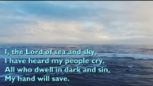
Here I am Lord

Slide 8

Prayer:
Dear God,
It is not always easy to know what to do when we see others treated unfairly. Help us to have the courage to share problems with others so we may help those being treated unfairly.
Guide us in your light forever and always.
Amen.

Slide 9
Collective worship
The value of Justice
“Hold fast to love and justice Hosea 12:6
Worship 2: Tuesday
Class worship

Slide 10
We think of God’s son, Jesus who loves us.
We think of God the Father who teaches us through his word.
We think of God, the Holy spirit, who guides us.

Slide 11

Listen and reflect…
Like Jesus how can we learn to do good?

Slide 12
Prayer:
Dear God,
It is not always easy to know what to do when we see others treated unfairly. Help us to have the courage to share problems with others so we may help those being treated unfairly.
Guide us in your light forever and always.
Amen.

Slide 13
Collective worship
The value of Justice
“Hold fast to love and justice Hosea 12:6
Worship 2: Wednesday
Praise worship

Slide 14
We think of God’s son, Jesus who loves us.
We think of God the Father who teaches us through his word.
We think of God, the Holy spirit, who guides us.

Slide 15
Here I am Lord

Slide 16

I’ll stand by You

Slide 17
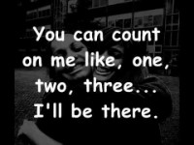
Count on me

Slide 18
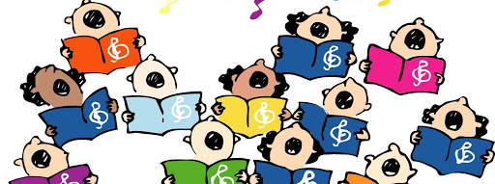
Children’s choice

Slide 19


Slide 20
Collective worship
The value of Justice
“Hold fast to love and justice Hosea 12:6
Worship 2: Thursday
Class worship

Slide 21
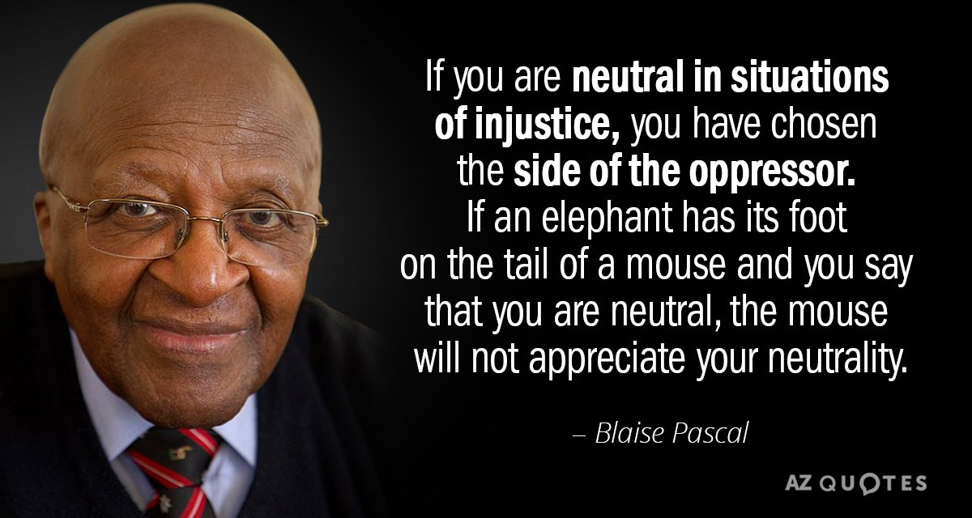
What is meant by this message?
Discuss with a partner and jot down what you think.

Slide 23
Collective worship
The value of Justice
“Hold fast to love and justice Hosea 12:6
Worship 2: Friday
Celebration worship

Slide 24

Head Teacher Awards
Achievement for all

Slide 25

Personal Development Awards
Helping children prepare for life, growing with God.

Slide 26
Here I am Lord

Slide 27
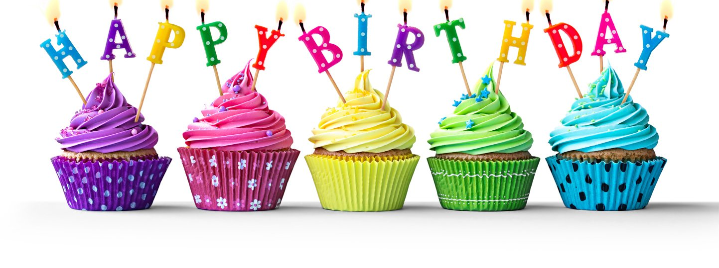
Birthdays….Happy Birthday to YOU.

Slide 28

Reminders:

Slide 29

Class 2
Prayer to share on Love and helping others.

Slide 30


Reverend Jan
Blessing to all

