Slide 1
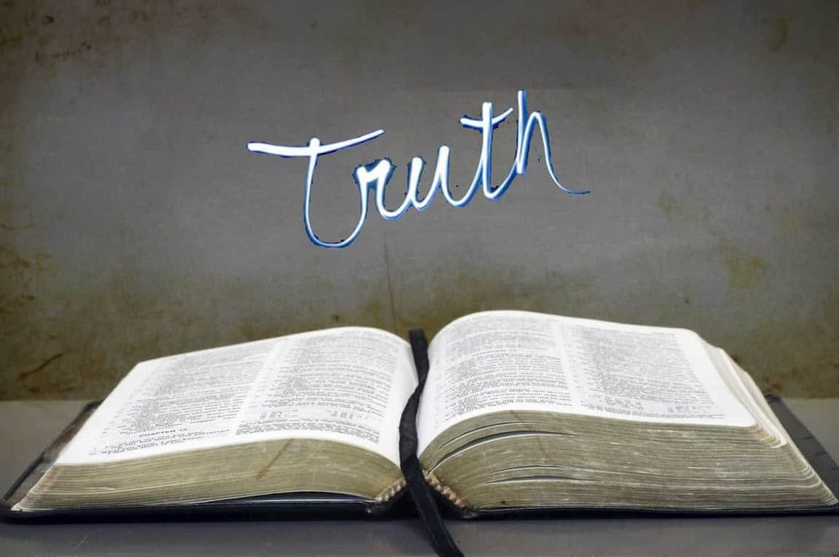
Collective worship
The value of Truthfulness
“The truth will set you free” John 8:32
Worship 5

Slide 2



We think of God’s son, Jesus who loves us.
We think of God the Father who teaches us through his word.
We think of God, the Holy spirit, who guides us.

Slide 3

Love never fails 1 Corinthians 13:8
For the Lord gives wisdom: from his mouth comes knowledge and understanding Proverbs 2:6
So why do we use the bible quotes in our school?
Love and wisdom are our core Christian values.

Slide 4

Just are we live by our Christian values the school has a mission statement to live by….so what is our mission statement?
It has 3 parts…
Our motto
Our vision
Our vision statement
What are they?

Slide 5
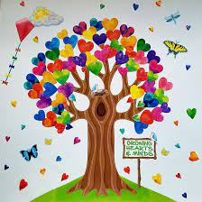
Our Motto:
“Growing together at the heart of God’s community”
Growing: Hearts and minds, in wisdom and knowledge
Heart: with a love of God and his family, love of learning and life
God’s community: as friends, family, school, church and global community
Our Vision:
“Love never fails” 1 Corinthians 13:8
“For the Lord gives wisdom: from his mouth comes knowledge and understanding” Proverbs 2:6
So what is our promise to children at this school?

Slide 6

The HEART of our school:
H – Helping children prepare for life, growing with God.
E – Embracing Christian Values.
A - Achievement for all.
R - Reading at the heart of our school
T – Teaching a knowledge rich curriculum.

Slide 7
Reflection – Why do you think we say HEART?
Which can you remember…test your teacher.
H
E
A
R
T

Slide 8

Please bow your heads and put your hands together, or sit quietly to reflect.
Prayer:
Dear God,
Please help us to know how we are loved and cared for, in school, our home and in your world.
Thank you for letting us know that love never fails.
Guide us in your light, now and forever.
Amen.

Slide 9
Collective worship
The value of Truthfulness
“The truth will set you free” John 8:32
Worship 5-Class worship

Slide 10
We think of God’s son, Jesus who loves us.
We think of God the Father who teaches us through his word.
We think of God, the Holy spirit, who guides us.

Slide 11
Which letter means a lot to you?
The HEART of our school:
H – Helping children prepare for life, growing with God.
E – Embracing Christian Values.
A - Achievement for all.
R - Reading at the heart of our school
T – Teaching a knowledge rich curriculum.
Use a postit to recall the phrase that YOU have understood the most.

Slide 12


Slide 13
Collective worship
The value of Truthfulness
“The truth will set you free” John 8:32
Worship 5-
Praise worship

Slide 14
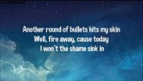
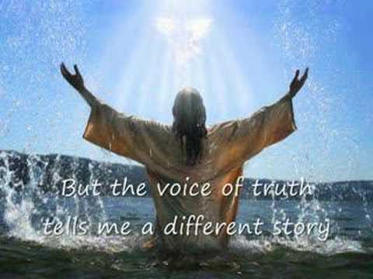
Song to reflect: This is me!

Slide 15

Song to reflect:

Slide 16
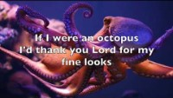
Especially for key stage 1
–The butterfly song

Slide 17

Children’s choice

Slide 19
Collective worship
The value of Truthfulness
“The truth will set you free” John 8:32
Worship 5-
Class worship Thursday

Slide 20
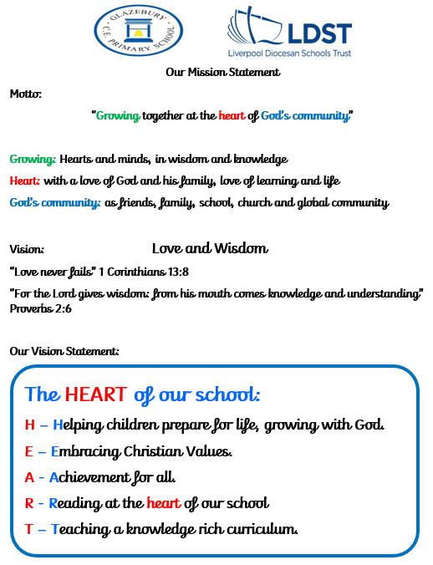
Reflection
Can you think of how love never fails or how the Lord gives wisdom?

Slide 21
Celebration Collective worship
The value of Truthfulness
“The truth will set you free” John 8:32
Worship -5
Celebration worship

Slide 22
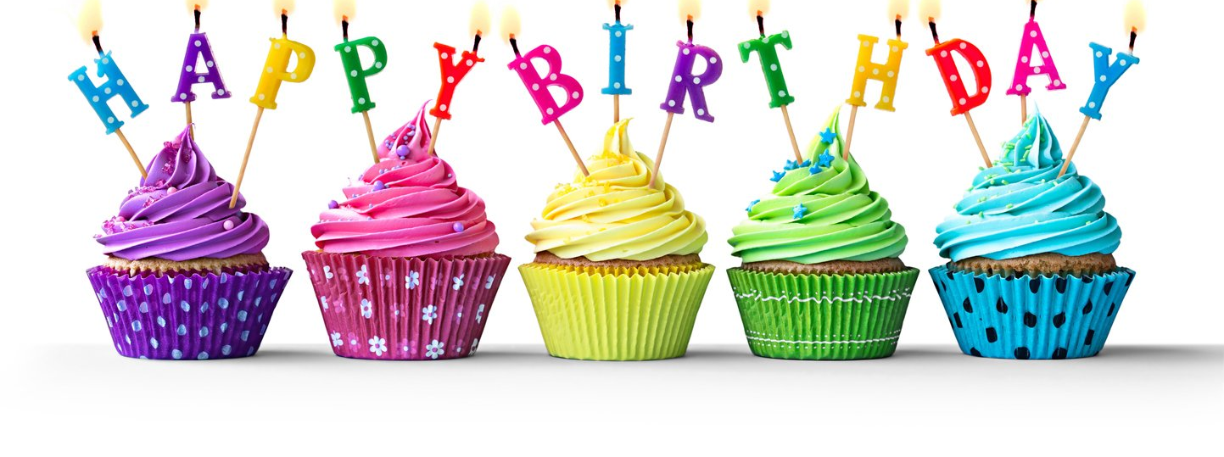
Birthdays….Happy Birthday to YOU.

Slide 23

Personal Development Awards

Slide 24
Song to reflect:

Slide 25

Head Teacher Awards
Achievement for all

Slide 26

Reminders:

Slide 27


Reverend Jan
Blessing to all

