Slide 1
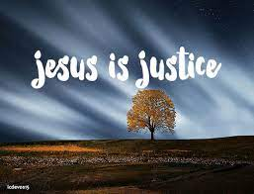
Collective worship
The value of Justice
“Hold fast to love and justice Hosea 12:6
Worship 3:

Slide 2



We think of God’s son, Jesus who loves us.
We think of God the Father who teaches us through his word.
We think of God, the Holy spirit, who guides us.

Slide 3
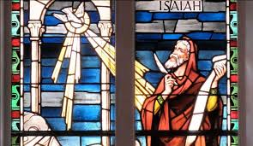
What did the Bible say?
In Isaiah 1 11-16 it tells us that people thought they were pleasing God by offering sacrifices, but because their everyday lives were full of wrong choices, God was unhappy he wanted the people to turn from their selfishness, and begin to show love and honesty in their everyday dealings The people must be willing to stop pleasing themselves and obey him instead.
When we love and seek justice we are following God’s wishes.

Slide 4


So how can we make a difference?
This half term we are celebrating RED Nose day Friday 18th March– cakes will be on sale (50p)
This will go to help others that that may need a helping hand.
On Thursday 24th March we have an own clothes day from school council –please bring a tin or packet of food for our Food bank. This will help those that need a helping hand to feed themselves.
How else can we help to make a difference?

Slide 5
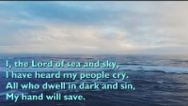
Here I am Lord

Slide 6

Prayer:
Dear God,
It is not always easy to know what to do when we see others treated unfairly. Help us to make a difference and help other that may need it. Guide us in your light forever and always.
Amen.

Slide 7
Collective worship
The value of Justice
“Hold fast to love and justice Hosea 12:6
Worship 3: Tuesday
Class worship

Slide 8
We think of God’s son, Jesus who loves us.
We think of God the Father who teaches us through his word.
We think of God, the Holy spirit, who guides us.

Slide 9
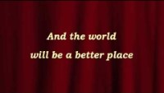
Listen and reflect…
Like Jesus how can we learn to do good and make the world a better place?

Slide 10
Prayer:
Dear God,
It is not always easy to know what to do when we see others treated unfairly. Help us to act and speak out. Help us to care for others.
Guide us in your light forever and always.
Amen.

Slide 11
Collective worship
The value of Justice
“Hold fast to love and justice Hosea 12:6
Worship 3: Wednesday
Praise worship

Slide 12
We think of God’s son, Jesus who loves us.
We think of God the Father who teaches us through his word.
We think of God, the Holy spirit, who guides us.

Slide 13
Here I am Lord

Slide 15

Heal the world – sign language

Slide 16

Children’s choice

Slide 17


Slide 18
Collective worship
The value of Justice
“Hold fast to love and justice Hosea 12:6
Worship 3: Thursday
Class worship

Slide 19

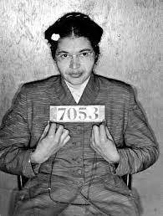
What would you like to be known as?
Discuss with a partner and jot down what you think.

Slide 21
Collective worship
The value of Justice
“Hold fast to love and justice Hosea 12:6
Worship 3: Friday
Celebration worship

Slide 22

Birthdays….Happy Birthday to YOU.

Slide 23

Head Teacher Awards
Achievement for all

Slide 24

Personal Development Awards
Helping children prepare for life, growing with God.

Slide 26

Class 3
Prayer to share on Love and making a difference.

Slide 27

Reminders:

Slide 28


Reverend Jan
Blessing to all

