Slide 1
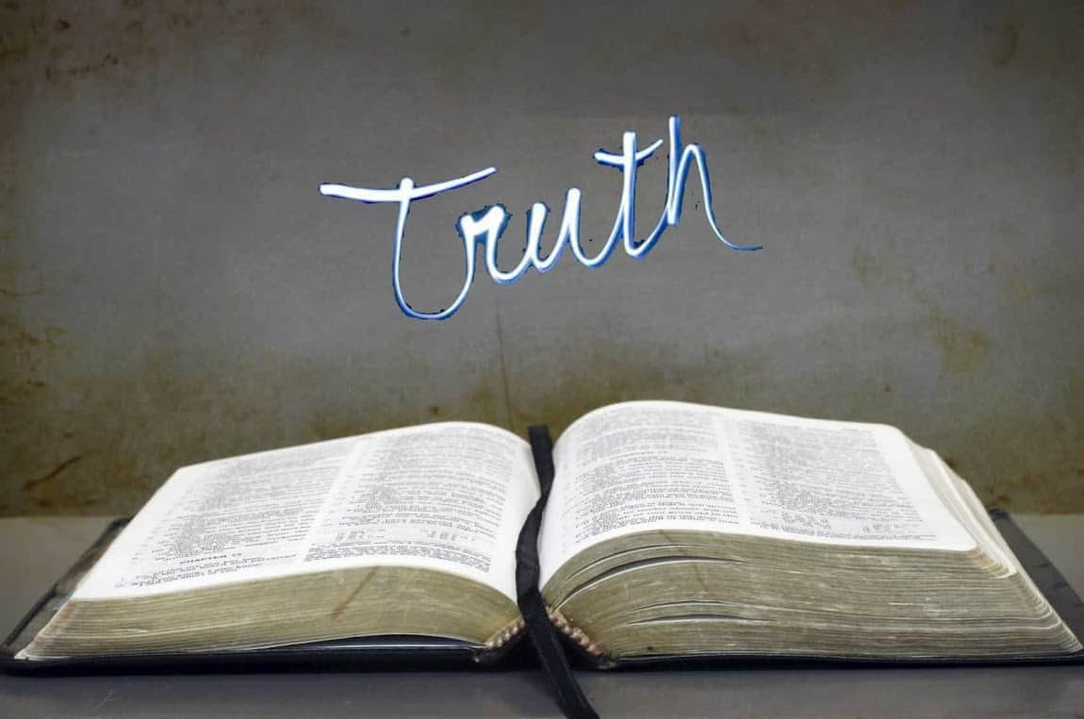
Collective worship
The value of Truthfulness
“The truth will set you free” John 8:32
Worship 2

Slide 2



We think of God’s son, Jesus who loves us.
We think of God the Father who teaches us through his word.
We think of God, the Holy spirit, who guides us.

Slide 3

Is it ever right to lie to get something you want?
At my previous school, we had a Christmas fair, and this retell is about 2 boys in my year 6 class who attended. On the second hand toy stall there was a FIFA 16 computer game with Jordan Henderson on the front. One boy saw the game and paid £10 for it. His friend saw this and said it was his and had been donated by mistake. When I investigated the disagreement the year 6 boy admitted that he had lied because he wanted the game and he apologised to his friend and to the teacher that was running the stall.

Slide 4
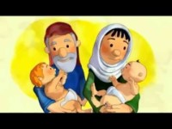
The Bible also tells us of two brothers and one who lied to get what he wanted.

Slide 5
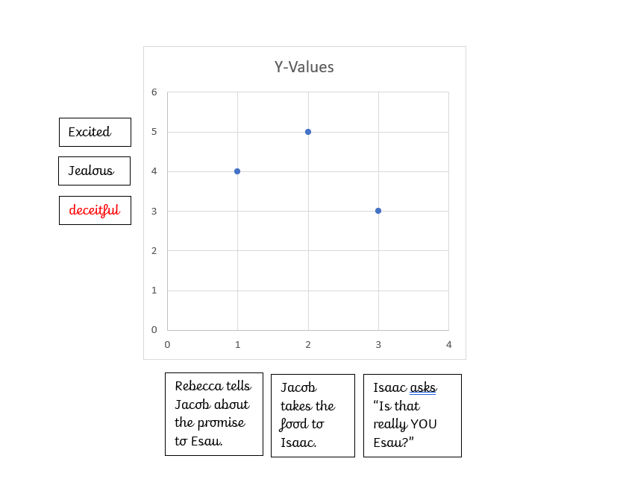
How did the brothers feel in the story?

Slide 6
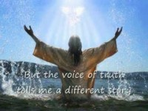
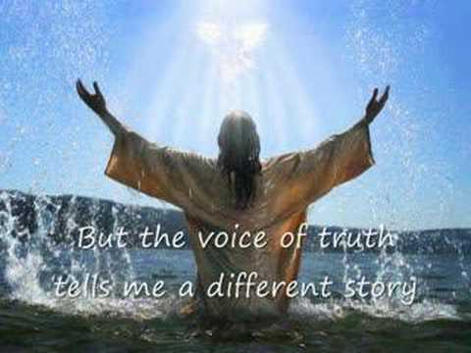
Song to reflect:
https://www.youtube.com/watch?v=tcuiuIwtpa4

Slide 7
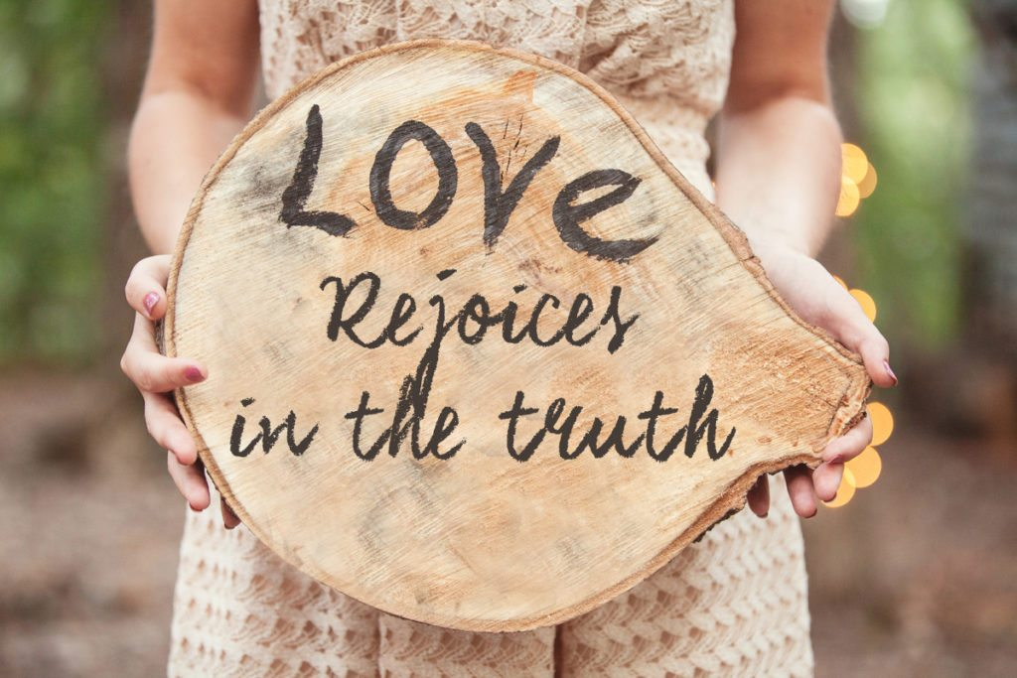
Reflection
How do you feel if you are lied to?

Slide 8

Please bow your heads and put your hands together, or sit quietly to reflect.
Prayer:
Dear God,
Please help us to shine as lights and be truthful and open in our friendships.
Guide us in your light forever and always.
Amen.

Slide 9
Collective worship
The value of Truthfulness
“The truth will set you free” John 8:32
Worship 2-Class worship

Slide 10
We think of God’s son, Jesus who loves us.
We think of God the Father who teaches us through his word.
We think of God, the Holy spirit, who guides us.

Slide 11
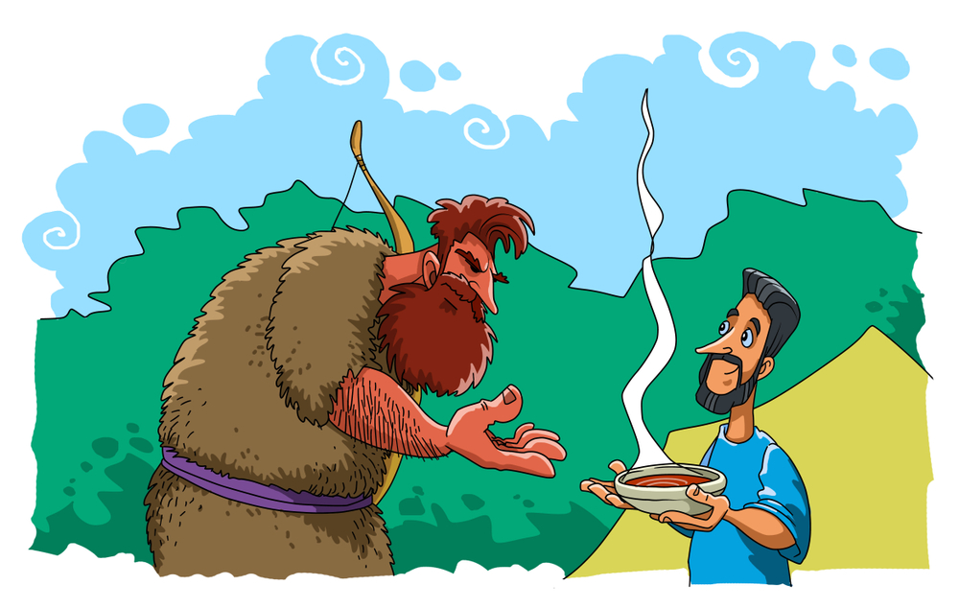
Reflection
What advise would you have given Jacob when he was asked to give Esau soup?
Use postits to record what YOU think.

Slide 12


Slide 13
Collective worship
The value of Truthfulness
“The truth will set you free” John 8:32
Worship 2-
Praise worship

Slide 14
Song to reflect:
https://www.youtube.com/watch?v=tcuiuIwtpa4

Slide 15
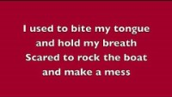
Roar by Katy Perry

Slide 16

Especially for key stage 1
–This little light of mine

Slide 17

Children’s choice

Slide 19
Collective worship
The value of Truthfulness
“The truth will set you free” John 8:32
Worship 2-
Class worship Thursday

Slide 20
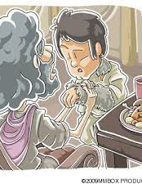
Reflection
What would you have Jacob say to his father Isaac ?
Class 1:
Tell friends why they should tell the truth.
Class 2:
Say sorry when you have made the wrong choice.
Class 3:
Say sorry when you have made the wrong choice and explain how you know that you have righted the wrong.
Class 4:
Create a poster to explain to someone younger why you should tell the truth.

Slide 22
Celebration Collective worship
The value of Truthfulness
“The truth will set you free” John 8:32
Worship 2-
Celebration worship

Slide 23

Birthdays….Happy Birthday to YOU.

Slide 24

Personal Development Awards

Slide 25
Song to reflect:
https://www.youtube.com/watch?v=tcuiuIwtpa4

Slide 26

Head Teacher Awards
Achievement for all

Slide 27

Reminders:

Slide 28


Reverend Jan
Blessing to all

Slide 29
This is a teaspoon prayer: it includes a Thank you , Sorry and Please (tsp)
Please bow your heads and put your hands together, or sit quietly to reflect
Prayer:
Dear God,
Thank you for being the light of the world, Sorry for the times we have not been as truthful as we should have. Please help us to shine as lights and be truthful and be the voice of truth in all that we do
Guide us in your light forever and always.
Amen.

