Slide 1
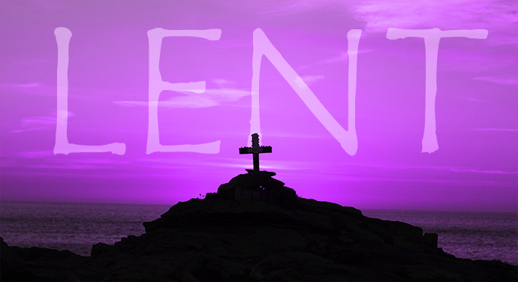
Collective worship
The value of Forgiveness
Forgive and you will be forgiven... Luke 6:37
Worship 6 Lent and Easter

Slide 2



We think of God’s son, Jesus who loves us.
We think of God the Father who teaches us through his word.
We think of God, the Holy spirit, who guides us.

Slide 3

What do you understand by this message?

Slide 4
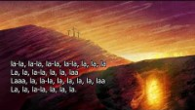
Listen and reflect .
How does it make YOU feel?

Slide 5



Slide 6
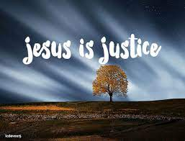
Collective worship
The value of Justice
“Hold fast to love and justice Hosea 12:6
Worship 6: Tuesday
Class worship

Slide 7
We think of God’s son, Jesus who loves us.
We think of God the Father who teaches us through his word.
We think of God, the Holy spirit, who guides us.

Slide 8

Song : When I think about the cross
How does it make you feel?

Slide 10
Collective worship
The value of Justice
“Hold fast to love and justice Hosea 12:6
Worship 6: Wednesday
Praise worship

Slide 11
We think of God’s son, Jesus who loves us.
We think of God the Father who teaches us through his word.
We think of God, the Holy spirit, who guides us.

Slide 12
Song : When I think about the cross

Slide 13

Song : We have a king that rides a donkey

Slide 15

Children’s choice

Slide 16
We think of God’s son, Jesus who loves us.
We think of God the Father who teaches us through his word.
We think of God, the Holy spirit, who guides us.

Slide 17

Collective worship
The value of Forgiveness
Forgive and you will be forgiven... Luke 6:37
Worship 6- Thursday Class worship

Slide 18
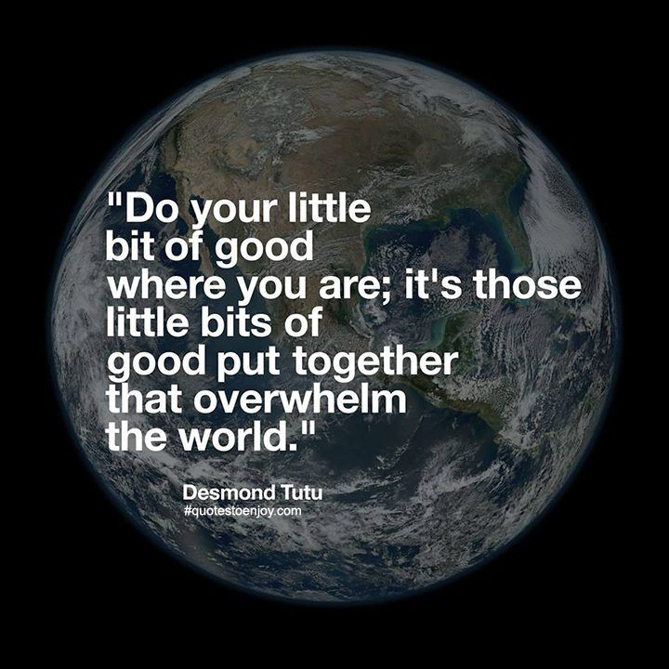
How is Demond Tutu representing British values?

Slide 20
Collective worship
The value of Justice
“Hold fast to love and justice Hosea 12:6
Worship 6: Friday
Celebration worship

Slide 21
We think of God’s son, Jesus who loves us.
We think of God the Father who teaches us through his word.
We think of God, the Holy spirit, who guides us.

Slide 22

Birthdays….Happy Birthday to YOU.

Slide 23

Head Teacher Awards
Achievement for all

Slide 24

Personal Development Awards
Helping children prepare for life, growing with God.

Slide 26

Ethos Group group
Prayer to share

Slide 27

Reminders:

Slide 28


Reverend Jan
Blessing to all

