Slide 1
National Day of Reflection 2021

Slide 2
“We need to take a moment to mark the huge amount of loss we’ve seen in the past 12 months and show support for everyone who has been bereaved – be that from Covid or any other cause.”
Please listen to the song “Supermarket flowers” donated by Ed Sheeran – this was wrote for his late grandma and the words could be for anyone who has been special in our lives and we have lost.
https://www.youtube.com/watch?v=XpF9Y7rcqBs

Slide 3
Today we are coming together at 12pm for a minute’s silence, to think of all those that are no longer with us and to remember that a life lived is a life loved.

Slide 4
Today we will tie a yellow ribbon around a branch in your reflection area that will show our prayers. Today we will all make a message of hope and love that we will put together and send to a local care home.

Slide 5
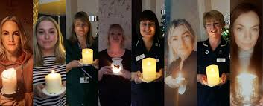
Today with our parents we will light a light, candle or lantern and put on our door step or in our window to show: We share the light.

Slide 6
Dear God, Be with us as we think about all that has changed this year, And help us to trust that you are always with us. Be close to us as we remember those who have died, and help us to trust they are at peace with you. Show us how to reach out to others with kindness and care , So that hope shines out in every heart and home, Amen

