Slide 1
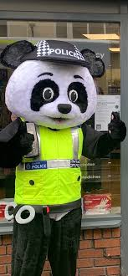
Whilst You Are At Home
We are staying
in touch
Edition 15
14th July 2020
PC PANDA

Slide 2
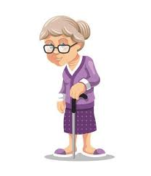
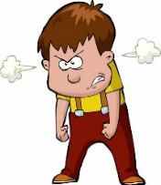
Positive messages of the week
Hello Everybody
So here we are again, and oh WOW! how the weeks are flying by. In just a couple of weeks it will be the start of the Summer Holiday, for some of you this will mean not going into School and for others, no more School work from Home. And so this week we are going to revisit some of the Safety Messages that we have all looked at in previous weeks to keep you all Summer Safety Sensible! Making sure your safety TOOLBOX is full of tips and hints to keep you safe ☺ So please take a look at Pc Panda’s safety messages.
Road Safety
Fire Safety
Internet Safety
Water Safety
TOOLBOX
Stranger Danger

Slide 3
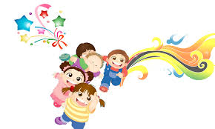
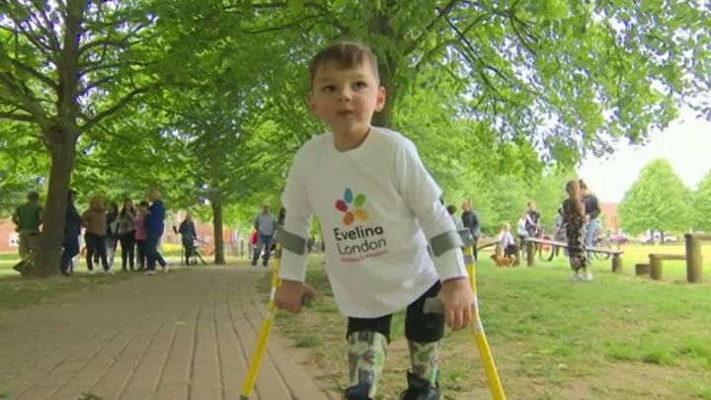
Personal Messages From Your Local PCSO
PCSO Sarah Brown
Said…
Be the person you want to be & not who someone else wants you to be
Follow Your Dreams.
PCSO Karen Nixon
Said…
The beauty of the world lies in the diversity of its people.
PCSO Phil Hambleton
It’s good to be different
&
No one is perfect!
But as long as you know you have done your best.
PCSO Mandy Simpson hAs quoted the dalai Lama,
who said:
When ever possible be Kind,
It is always possible!
And a huge shout out from everyone in Cheshire Police to
5 year old Tony Hudgell, who raised A MILLION Pounds
by walk 10km for the NHS
What an inspirational little boy.
Tony was inspired after watching Captain Tom Moore.
Who or What could inspired you to do something great.

Slide 4
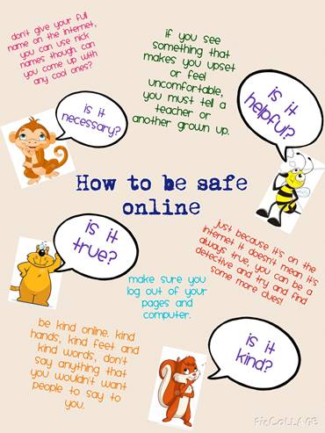
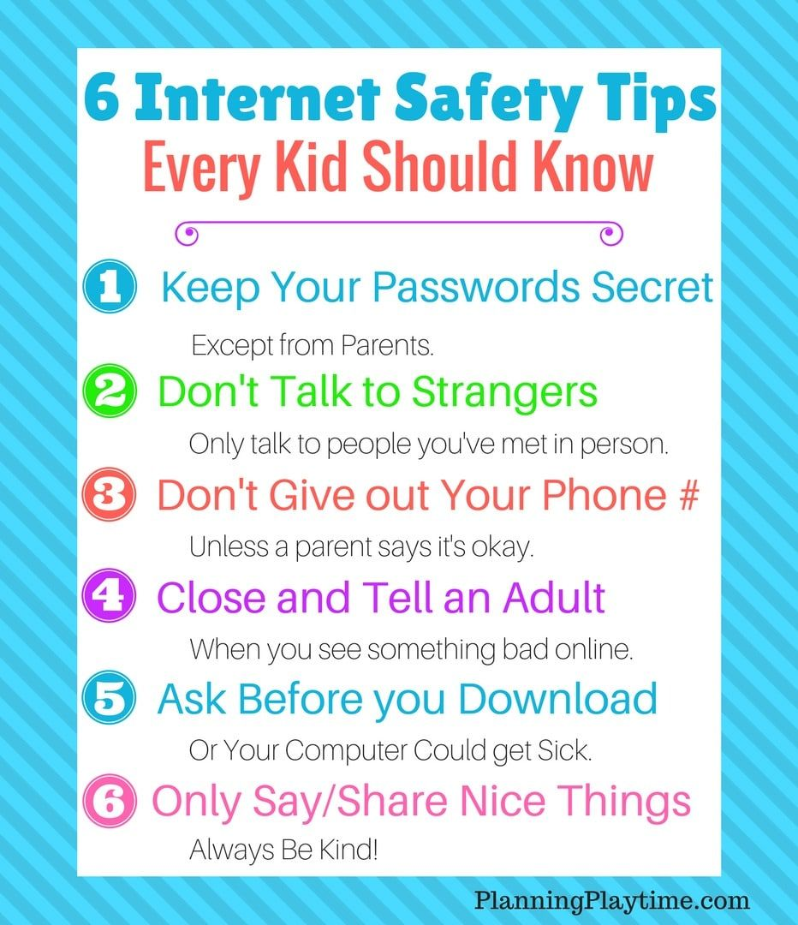
INTERNET SAFETY

Slide 5
SAFETY AROUND WATER
Slash
Slish
When you need ‘HELP’ shout as loud as you can
Places like canals can hide many dangerous items, like shopping trollies that you could get your legs trapped in.
Slosh
Only swim when you are with an adult

Slide 6
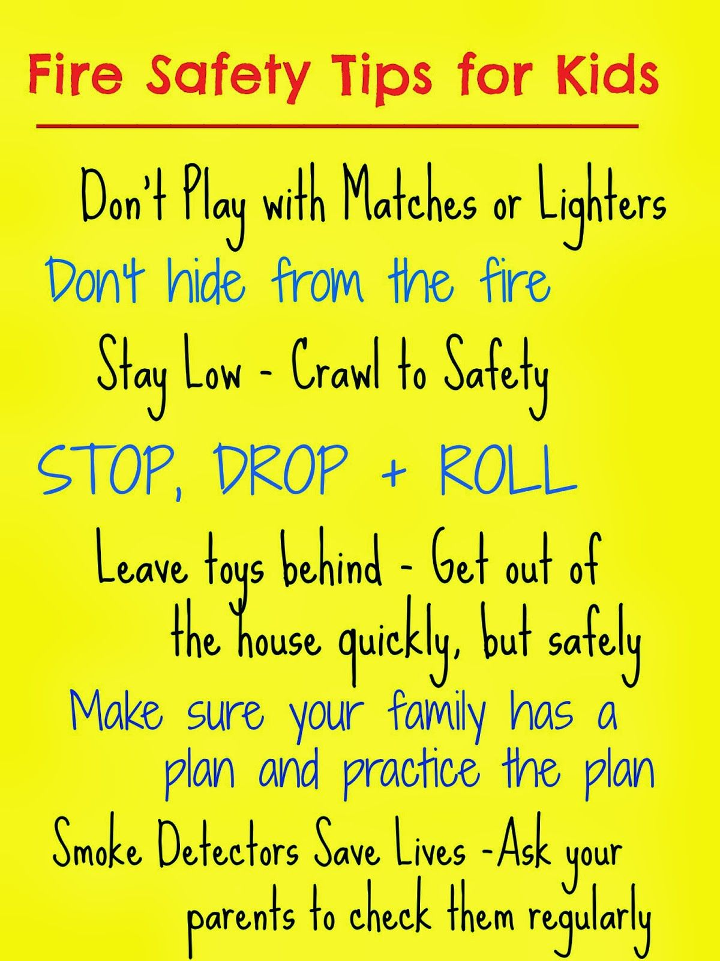
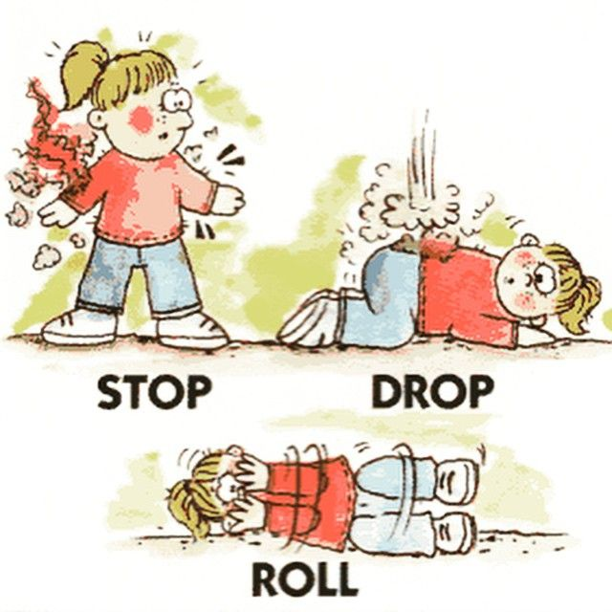
FIRE SAFETY
Well done young person, Stop Drop Roll, saved them from a painful burn!
Hoax = Pretend

Slide 7
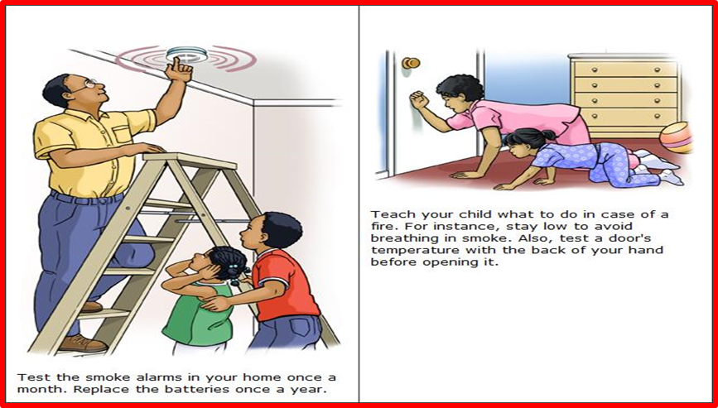
Test it Tuesday!
In case of a fire, stay low to avoid breathing in smoke. Also, test a doors temperature with the back of you hand before opening it.
Maybe you and an adult, could test your
Smoke detectors in your home on……
Test it Tuesday
Test your smoke alarm in your home once a week. Replace the batteries once a year.

Slide 8
What is a stranger?
Some strangers are ‘safer strangers’. Safer strangers are people who you can talk to and they will help you if you get lost. Safer strangers usually wear a uniform and a badge.
If you get lost, or feel unsafe and your grown-up is not near you, look for a safer stranger to talk to for help.
A stranger is someone that you or your family do not know.
Anyone can be a stranger until you get to know them.
Strangers do not always look scary.
Strangers can be nice and friendly.
KEEP SAFE AND TRUST YOUR GUT INSTINCT!

Slide 9
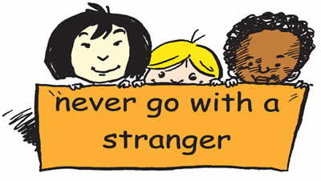
STRANGER DANGER

Slide 10
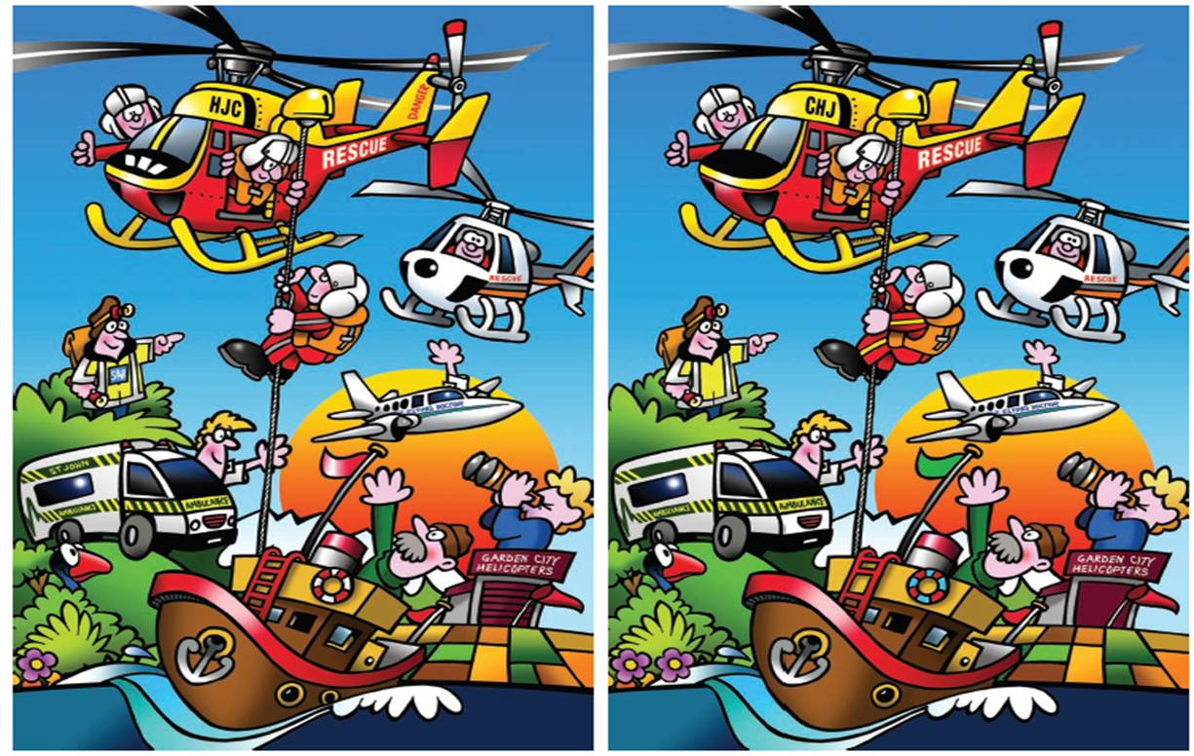
ACTIVITY PAGE
What has hands, but is not flesh, bone or blood?
Clock.
What goes up and down the stairs without moving?
Carpet.
George walked for thirty minutes in the pouring down rain without getting a single hair on his head wet, he had no hat, umbrella and his coat had no hood? How did he do it?
He is bald
What could you do on a Tuesday ?

Slide 11
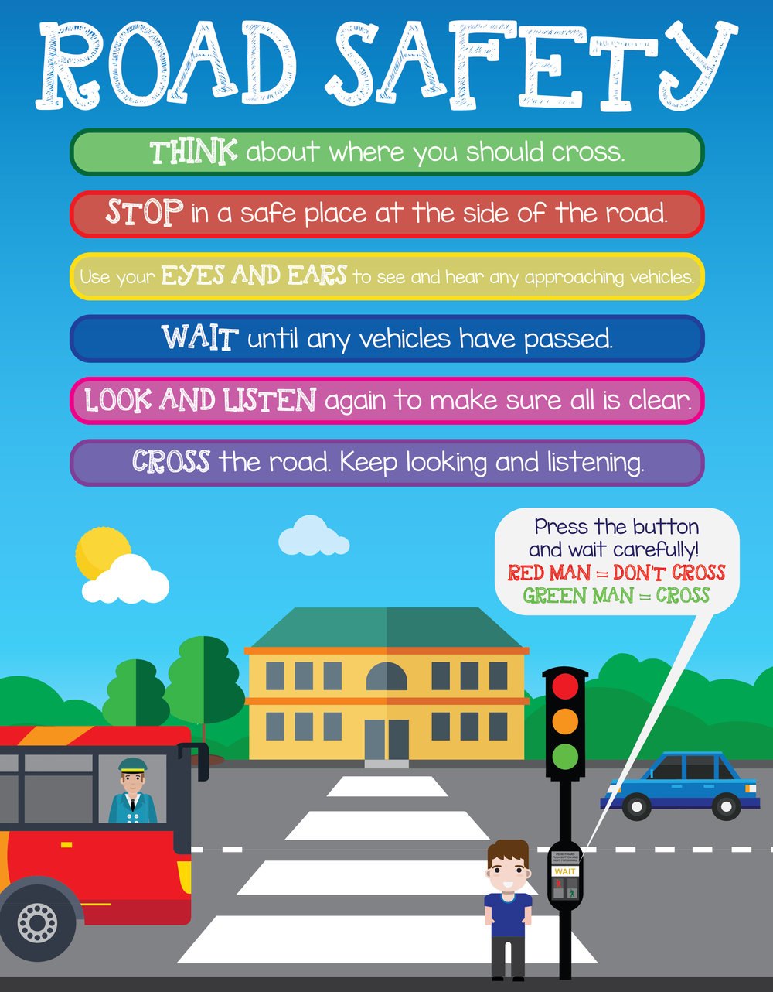
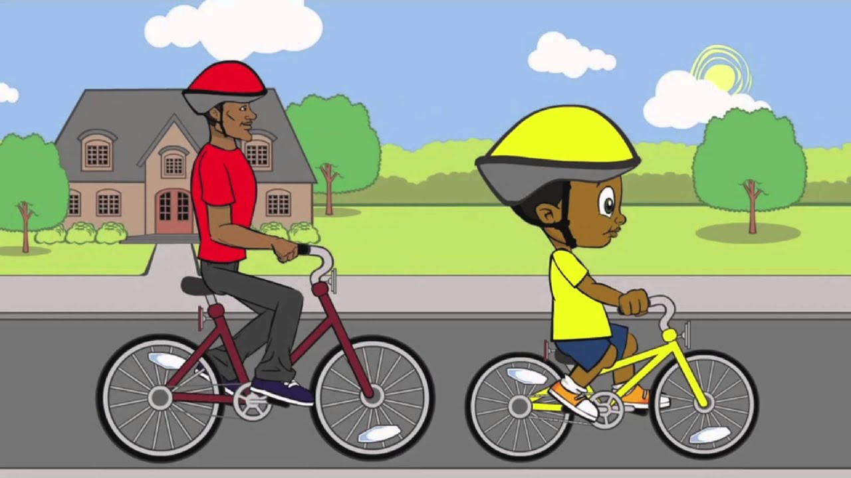
ROAD SAFETY
Top Hats, Gentlemen!

Slide 12
If it is your Birthday this week Happy Birthday

Slide 13
Until next Time 21St July 2020
Keep washing your hands and carry on with your exercise.
Stay healthy, by doing a bit of exercise every day.
Keep positive, by reminding yourself, You are an Amazing Child.
Carry On Doing Your Bit for Great Britain and the NHS
Childline | Childline
https://www.childline.org.uk
Get help and advice about a wide range of issues, call us on 0800 1111, talk to a counsellor online, send Childline an email or post on the message boards
NSPCC Helpline
0808 800 5000

