Slide 1
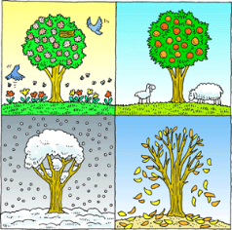
Science Big Ideas
Seasonal Change
Key knowledge
Know the main differences between the four seasons
Know the names of the four seasons
Know the type of weather normally associated with the four seasons
Know that we have longer periods of daylight in summer and shorter periods of daylight in winter
Know that different parts of the world have their summer and winter at different times to us
Know that temperature varies during the different seasons
Vocabulary
autumn | The time of year between September and November. Many leaves fall off the trees
winter | The coldest season in the UK. We often have snow in this season. It occurs between December and February
spring | The time of year between March and May. There are usually lots of signs of new growth in the spring
summer | The hottest season in the UK. It happens between June and August. The longest day is June 21st
temperature | The degree of heat or cold that can be measured using a thermometer
weather symbols | These are signs used to help us understand more about our daily weather
What question would I like to ask?
Skills we will use: Talk partners, research, grouping and classifying, observing, drawing, discussing, writing.
(c) Focus Education (UK) Ltd
1

