Slide 1

Collective worship
The value of Peace
“A heart at peace gives life to the body” Proverbs 14:30
Worship 1

Slide 2



We think of God’s son, Jesus who loves us.
We think of God the Father who teaches us through his word.
We think of God, the Holy spirit, who guides us.

Slide 3
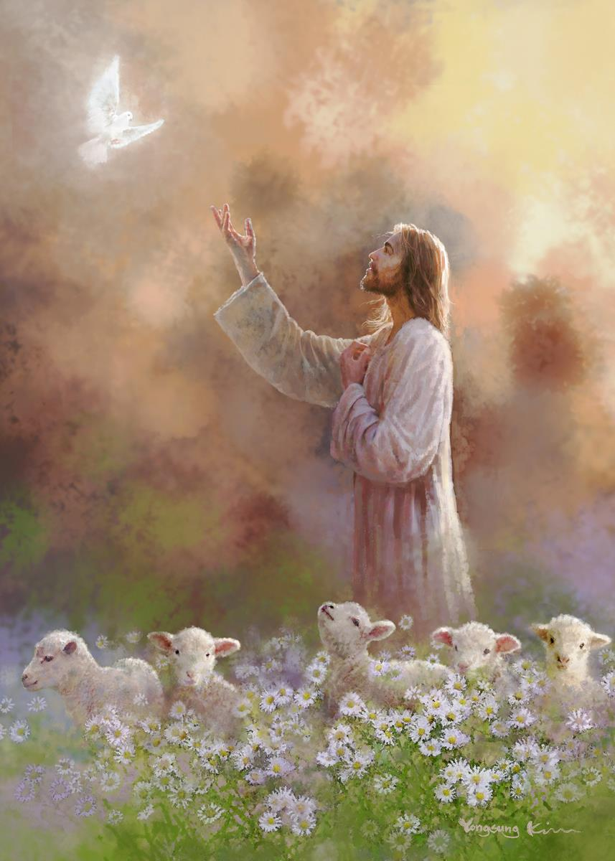
What do Christians believe?
Peace making actions can range from helping to resolve conflict to creating stillness for peace. God’s intention for peace for the whole of creation is the promise for total well-being.

Slide 4
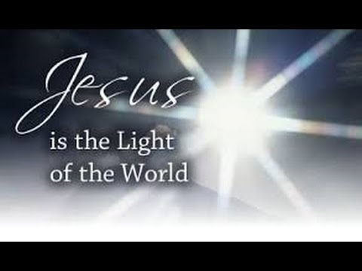
What did Jesus say?
Jesus said “Blessed are the peacemakers, for they shall be called the children of God” (Matthew :5:9)
Why do you think he said this?
When we help and are peace makers we are following God’s wishes.

Slide 5
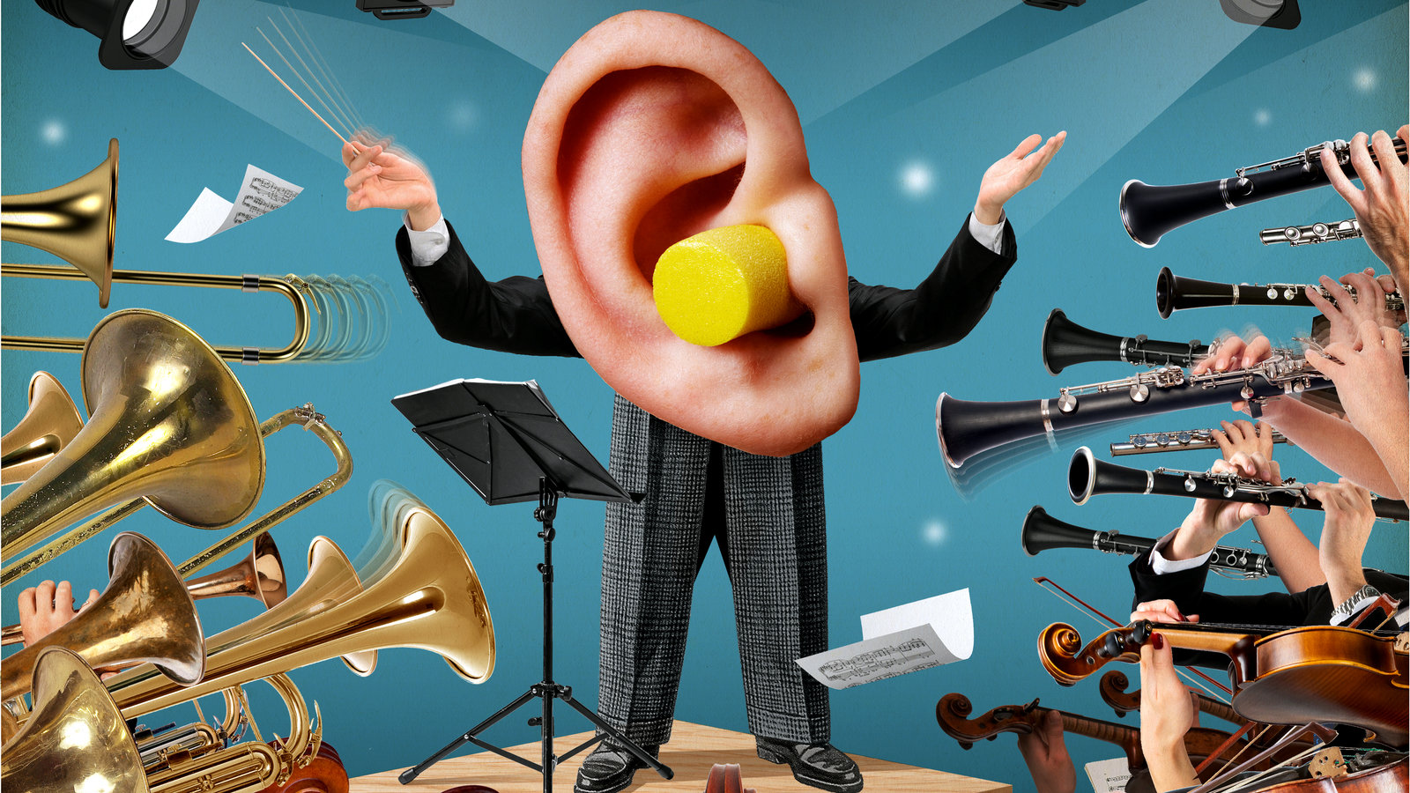
What can Peace mean to YOU?
Imagine if all the musical instruments played at the same time…..IT would be noisy!!!

Slide 6
When do we like to make a lot of noise?
Celebrations….parties…Sports day…football matches…cheering.
When do you like to be quiet?
Peace is quiet but it is also feeling calm, not being anxious, not fighting or disagreeing.

Slide 7
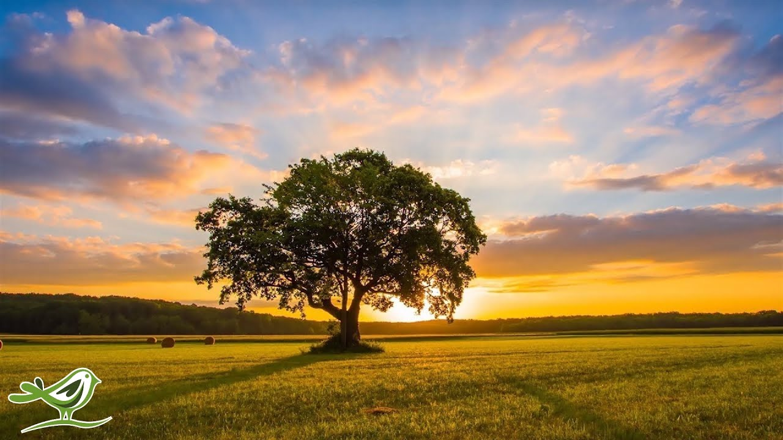
When do we like to make a lot of noise?
Celebrations….parties…Sports day…football matches…cheering.
When do you like to be quiet?
Peace is quiet but it is also feeling clam, not being anxious, not fighting or disagreeing.

Slide 8
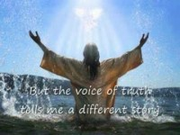
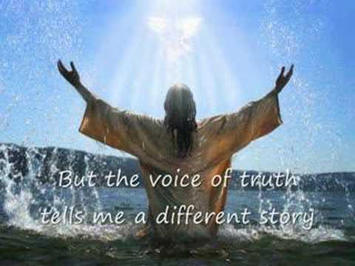
Song to reflect:
https://www.youtube.com/watch?v=tcuiuIwtpa4

Slide 9
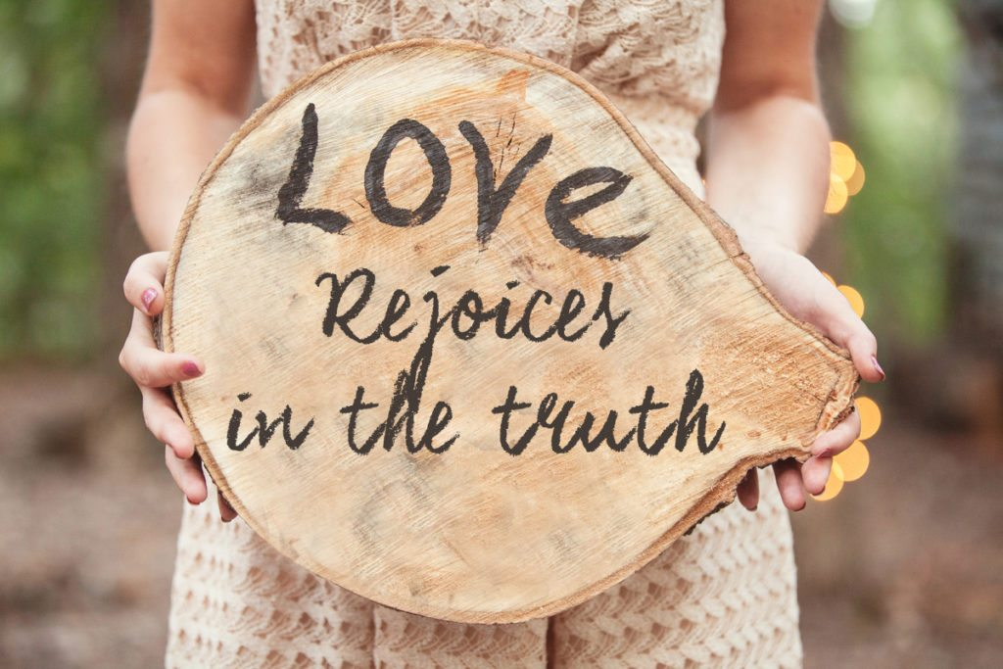
Reflection
How can YOU be the voice of truth?

Slide 10

This is a teaspoon prayer: it includes a Thank you , Sorry and Please (tsp)
Please bow your heads and put your hands together, or sit quietly to reflect
Prayer:
Dear God,
Thank you for being the light of the world, Sorry for the times we have not been as truthful as we should have. Please help us to shine as lights and be truthful and open in all that we do
Guide us in your light forever and always.
Amen.

Slide 11
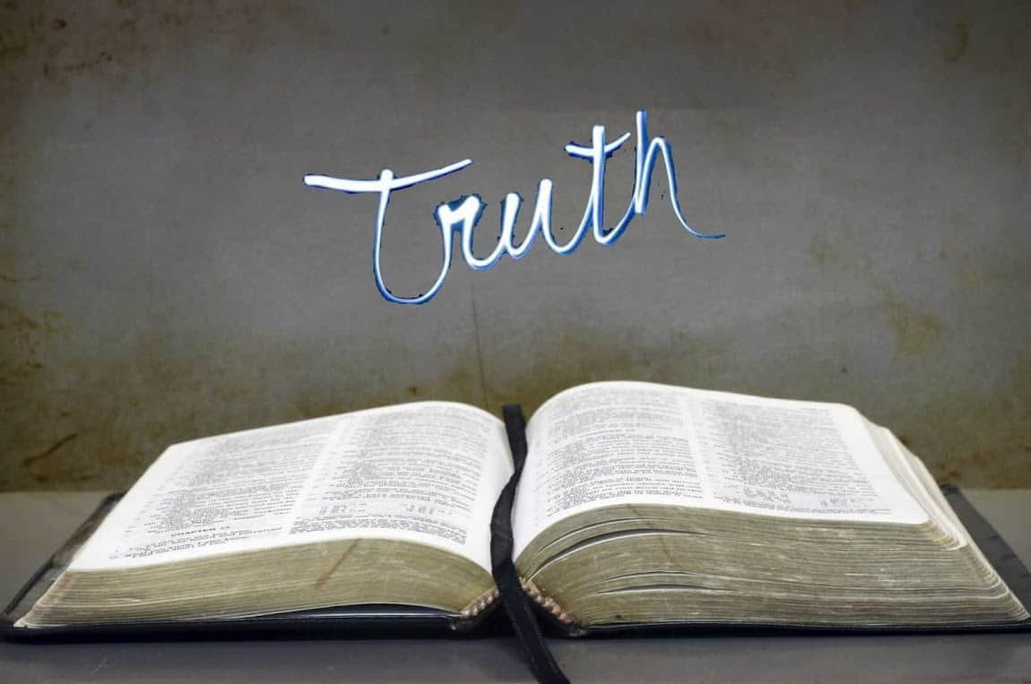
Collective worship
The value of Truthfulness
“The truth will set you free” John 8:32
Worship 1-Class worship

Slide 12
We think of God’s son, Jesus who loves us.
We think of God the Father who teaches us through his word.
We think of God, the Holy spirit, who guides us.

Slide 13
Reflection
How can YOU be the voice of truth?
Use postits to record what YOU think.

Slide 14
This is a teaspoon prayer: it includes a Thank you , Sorry and Please (tsp)
Please bow your heads and put your hands together, or sit quietly to reflect
Prayer:
Dear God,
Thank you for being the light of the world, Sorry for the times we have not been as truthful as we should have. Please help us to shine as lights and be truthful and be the voice of truth in all that we do
Guide us in your light forever and always.
Amen.

Slide 15
Collective worship
The value of Truthfulness
“The truth will set you free” John 8:32
Worship 1-
Praise worship

Slide 16
Song to reflect:
https://www.youtube.com/watch?v=tcuiuIwtpa4

Slide 17
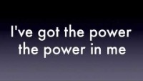
Power in me

Slide 18
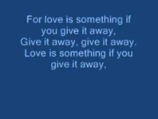
Especially for key stage 1

Slide 19


Slide 20

Children’s choice

Slide 21
Collective worship
The value of Truthfulness
“The truth will set you free” John 8:32
Worship 1-
Class worship Thursday

Slide 22

What can truth mean to YOU?
T..Trustworthy words and actions
R..Respect for doing the right thing
U…….. Uncovering the full picture
T……………………..Telling it as it is
H.……………… Having all the facts

Slide 23
Reflection
How can YOU be the voice of truth?
Value Passport:
Class 1:
say a prayer in school
Class 2:
Write a prayer
Class 3:
Write and share a prayer in class collective worship
Class 4:
Write and share a prayer in Celebration Worship

Slide 25
Celebration Collective worship
The value of Truthfulness
“The truth will set you free” John 8:32
Worship 1-
Celebration worship

Slide 26
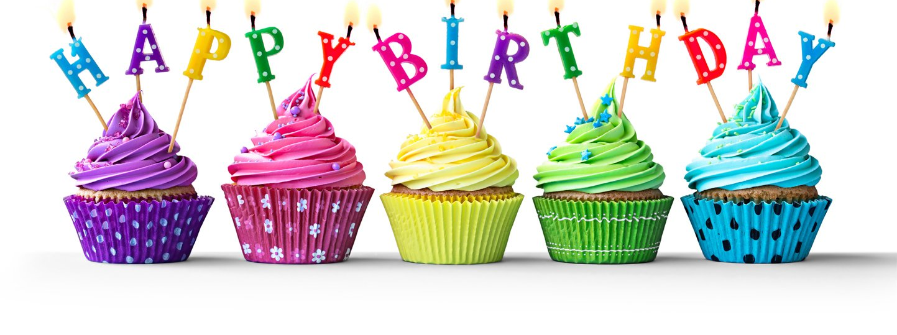
Birthdays….Happy Birthday to YOU.

Slide 27

Personal Development Awards

Slide 28
Song to reflect:
https://www.youtube.com/watch?v=tcuiuIwtpa4

Slide 29

Head Teacher Awards
Achievement for all

Slide 30

Reminders:

Slide 31

Class 4
Prayer to share

Slide 32


Reverend Jan
Blessing to all

