Slide 1
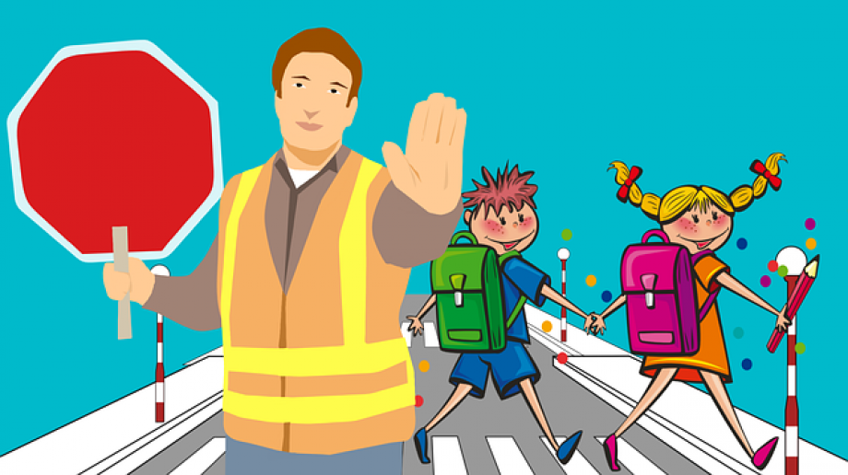
Whilst You’re At Home
We are going to stay in touch
23nd February 2021

Slide 3
Positive Message of the Week
Hi everyone, we hope you have all had a great week off for half term, and worked on staying positive, even though you may be missing your school friends.
This week we are going to be looking at Road Safety which is really important to keep you safe.
There will be a few activities to get involved with too.
If you are worried about anything please remember to talk
to someone you trust. Have a good week everyone.

Slide 4
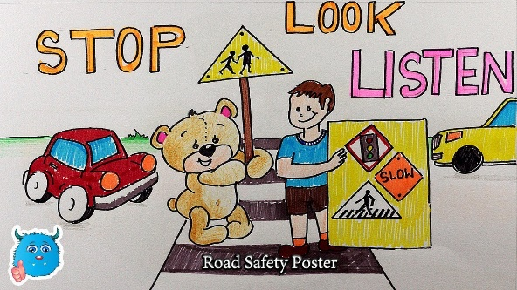
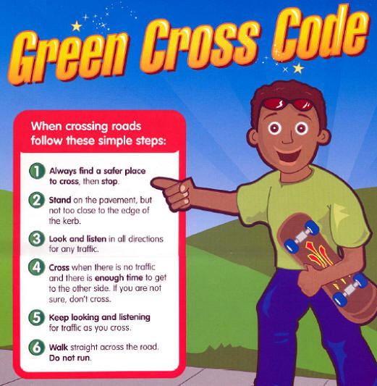
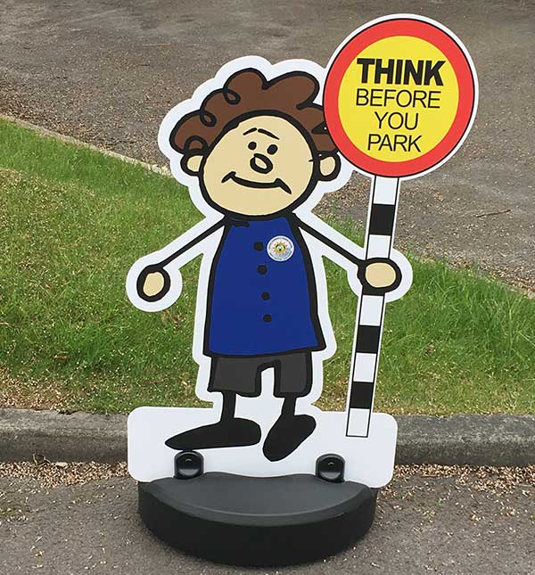
Introduction to Road Safety
Within the presentation we are going to be talking about a few different areas of Road Safety with a few activities such as:
Crossing the road
Seat belts
Parking
Quiz
Wordsearch
Colouring in sheet
You could create your own safer road crossing poster.

Slide 5
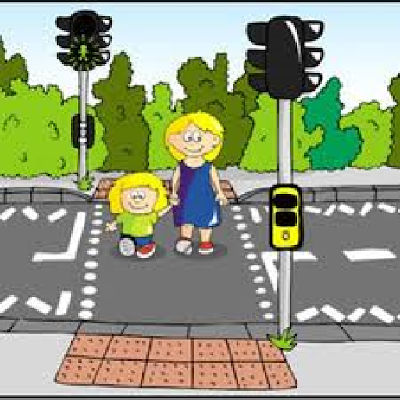
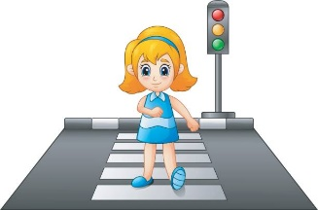
Different types of crossings
Zebra Crossing
School Crossing
Pelican Crossing
There are lots of different types of crossings.
Here are three that you will probably see all the time.
Always remember to hold an adults hand when you cross the road.

Slide 6
Seat belts and Car Safety
When parents are driving
PLEASE DO NOT
Have the music too loud
Distract the person who is driving
Mess about in the car which could distract the driver
Make sure you have the right car seat for you !!!!

Slide 7
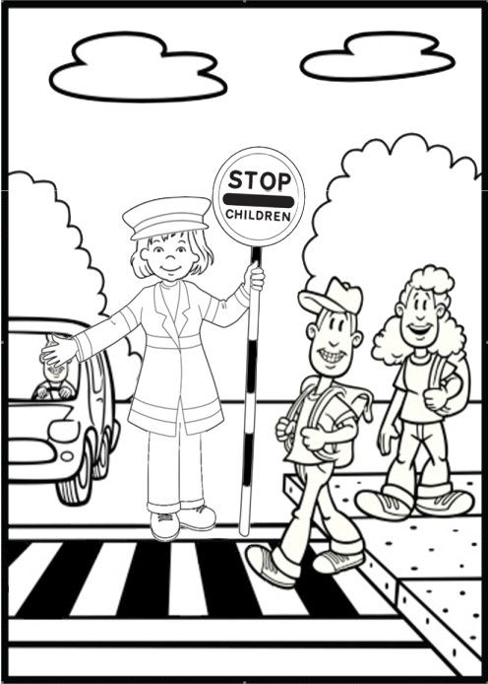
Activity
1
Please feel free to colour in this picture or Create your own picture

Slide 8
Activity 2 - Word search

Slide 9
Quiz
When out at night what should you wear to be seen by traffic?
Reflective clothing
Dark clothes
The latest trend
A warm coat
2. What must you do before you cross the road?
Run
Talk to friends
Keep looking and listening
Listen to music
3. When travelling in a car what must you always do?
Have a travel sickness tablet
Fasten your seat belt
Listen to the radio
Look out of the window
4. What should you wear when riding your bike?
Bobble Hat
Cap
Dark Clothes
Bike Helmet
5. When is it safe to cross at a zebra crossing?
When the traffic on both sides has slowed down
When the traffic on one side has stopped
When the traffic on one side has slowed down
When the traffic on both sides has stopped

Slide 10
If it is your Birthday this week Happy Birthday

Slide 11
Useful Links and Services
Useful Links and Services
Childline
https://www.childline.org.uk
Get help and advice about a wide range of issues, call us on 0800 1111, talk to a counsellor online, send Childline an email or post on the message boards
https://www.o2.co.uk/help/nspcc/helpline
NHS 111
Your local
Doctors surgery
Well-being
officer in School
NSPCC Helpline
0808 800 5000

Slide 12
Until next Time
2nd March 2021
Keep washing your hands, remember Hands, Face and Space.
Keep safe when out and about especially in cars
Keep positive by reminding yourself, You are an Amazing Child.
Cheshire Police on Facebook
@CheshireSSYP on Twitter
www.cheshire.police.uk

