Slide 1
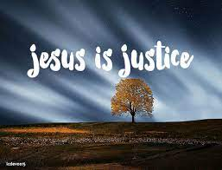
Collective worship
The value of Justice
“Hold fast to love and justice Hosea 12:6
Worship 4:

Slide 2



We think of God’s son, Jesus who loves us.
We think of God the Father who teaches us through his word.
We think of God, the Holy spirit, who guides us.

Slide 3
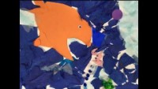
God’s Justice –Jonah the Groaner

Slide 4
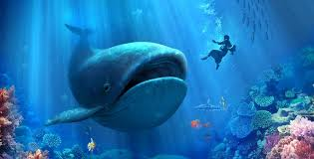
Jonah didn’t expect God to forgive the people in Nineveh… BUT when they followed God’s path. God forgave them.
Did this surprise you?

Slide 5

Listen and reflect –

Slide 6

Prayer:
Dear God,
Your justice is forgiveness and we know that you want us to all to follow the right path. Help us to make a difference and help others that may need it. Guide us in your light forever and always.
Amen.

Slide 7
Collective worship
The value of Justice
“Hold fast to love and justice Hosea 12:6
Worship 4: Tuesday
Class worship

Slide 8
We think of God’s son, Jesus who loves us.
We think of God the Father who teaches us through his word.
We think of God, the Holy spirit, who guides us.

Slide 9
Listen and reflect…
How can we be a generous giver?
Discuss with a partner.

Slide 10
Prayer:
Dear God,
Help us to care for others and show us how to be generous givers of time, support and kindness.
Guide us in your light forever and always.
Amen.

Slide 11
Collective worship
The value of Justice
“Hold fast to love and justice Hosea 12:6
Worship 4: Wednesday
Praise worship

Slide 12
We think of God’s son, Jesus who loves us.
We think of God the Father who teaches us through his word.
We think of God, the Holy spirit, who guides us.

Slide 13
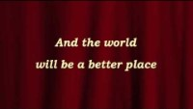

Slide 14
Listen and reflect –

Slide 15

Heal the world – sign language

Slide 16

Children’s choice

Slide 17


Slide 18
Collective worship
The value of Justice
“Hold fast to love and justice Hosea 12:6
Worship 4: Thursday
Class worship

Slide 19

Reflection
How can YOU show how you can help others?
Value Passport:
Class 1:
Draw a whale and Jonah to display in class.
Class 2:
Draw a whale to remind us of God’s promise.
Class 3:
Learn to sign : “make the world a better place for you and for me”
Class 4:
Create a class collage to show Gods Promise with Jonah and the whale.

Slide 21
Collective worship
The value of Justice
“Hold fast to love and justice Hosea 12:6
Worship 3: Friday
Celebration worship

Slide 22

Birthdays….Happy Birthday to YOU.

Slide 23

Head Teacher Awards
Achievement for all

Slide 24

Personal Development Awards
Helping children prepare for life, growing with God.

Slide 25
Listen and reflect –

Slide 26

Ethos Leaders
Prayer to share on Love and God’s Promise.

Slide 27

Reminders:

Slide 28


Reverend Jan
Blessing to all

